Slide 1
World War I Ends
The Treaty of Versailles

Slide 2
1917
April – U.S. joins the war
October – Russian Royal family are overthrown and executed
Russia leaves the war
Germany focuses all forces on France

Slide 3
The War Ends
Fall 1918 - German Army and Navy began to mutiny
Civilians riot due to food shortages
October - German leadership asked President Wilson for an armistice
November - German leader, Kaiser Wilhelm steps down
Europe - everything is left in ruins (industry & agriculture)

Slide 4
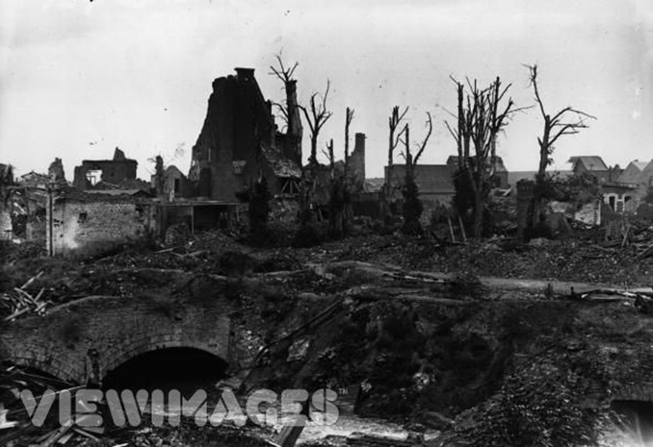
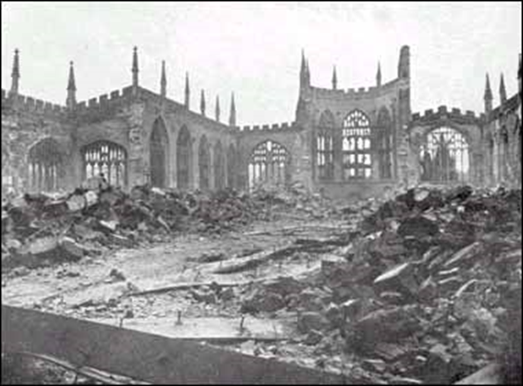
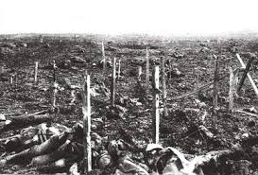

Slide 5
Armistice
November 11, 1918
Central Powers surrender
Cease fire declared on all fronts.
Fighting stops

Slide 6
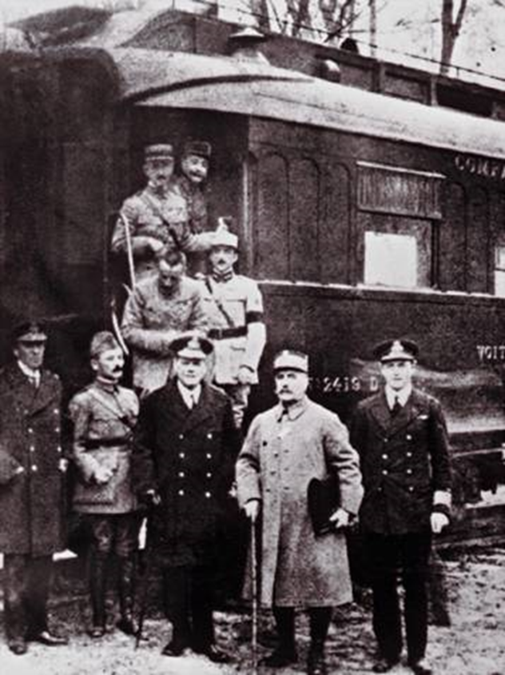

Slide 7
Treaty of Versailles
Paris, France
June 28, 1919
The “Big 4” meet
Signed peace treaty that formally and officially ended WWI.

Slide 8
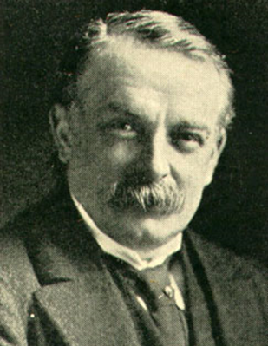
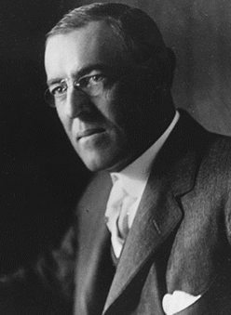
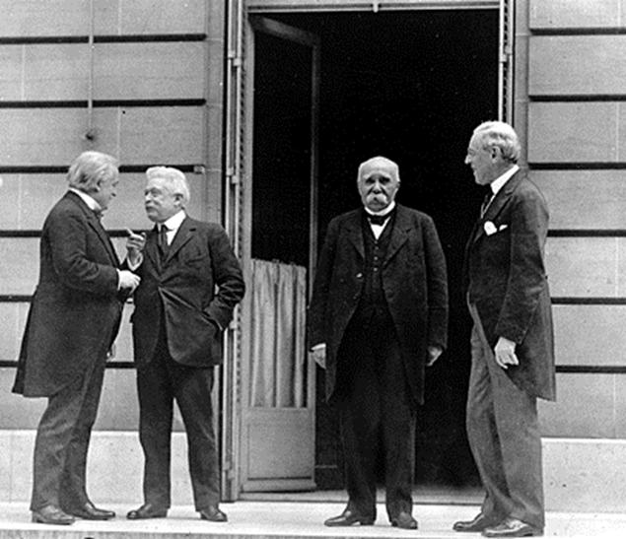
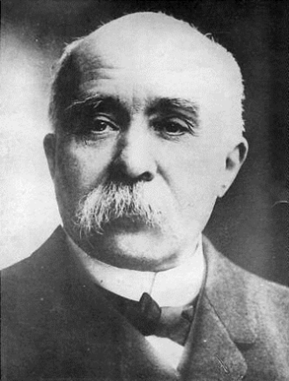
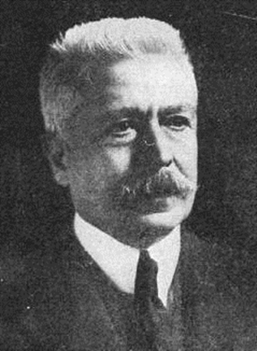
Woodrow Wilson
U.S. President
David Lloyd George British PM
Vittorio Orlando Italian PM
George Clemenceau
French Premier

Slide 9
14 Points
President Wilson’s proposal for peace in Europe after the Great War
Included…
No more secret agreements
Free movement on international waters
Removal of all barriers to trade
Reduce size of militaries and weapon production
No more new colonies
France should be restored
A polish country should be established
Create a League of Nations

Slide 10
Germany’s Punishment
Made to accept full responsibility for causing the war.
Made to disarm, give up land, and pay for war damages to certain Allied countries.
Germany lost colonies
Lost control of the Saar valley (all areas of Coal and Iron for 15 years)

Slide 11
The Outcome
Wilson’s14 Points
Americans loved it
European “Allies” hated it
Was not harsh enough
Germany wanted the U.S. involved, but the U.S. were considered “outsiders”
The 14 points benefited Germany
Would create a democratic government and get the country established again
U.S. believed the treaty was too harsh and refused to ratify (approve) the treaty

Slide 12
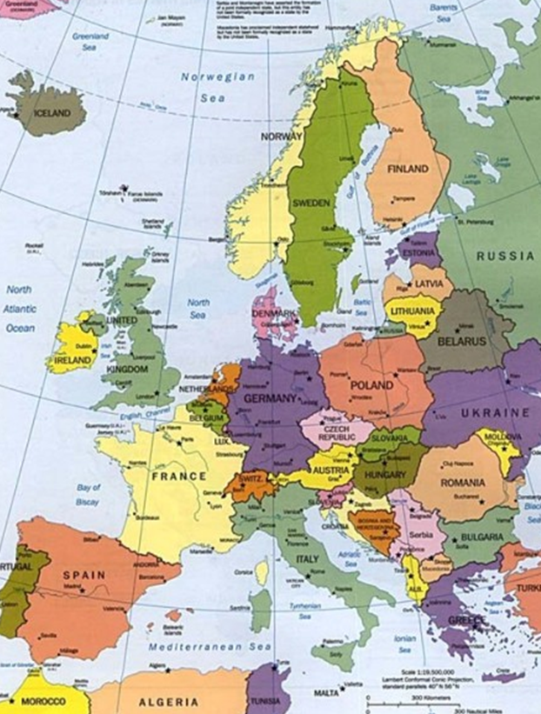
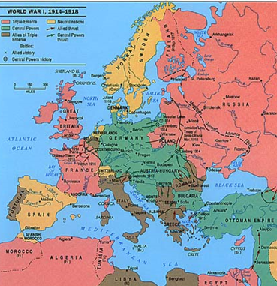

Slide 13
League of Nations (1919)
An international organization founded after WWI
Objectives/Goals
Disarmament
Preventing war through collective security
Settling disputes between countries through negotiation and diplomacy
Improving global welfare
The U.S. did not join

Slide 14
Europe - 1920s
Massive “recovery” was required
Businesses could not produce enough products to keep up with demand
prices soared
mass inflation
Germany was hit the hardest
Extreme food shortages and inflation

Slide 15
