Slide 1
World War I Begins
The Great War

Slide 2
Response to the Archduke’s Death
Gavrilo Princip was arrested after assassinating the Archduke and his wife
Tried to poison himself
Tried to shoot himself
Was to young to be executed
Was given a 20 year prison sentence
Very harsh conditions
Austria-Hungary declares war on Serbia thus starting the Great War (World War I)
*Princip would later die 3 years later in prison from tuberculosis

Slide 3
A World Affair
Domino Effect
Austria-Hungary declares war on Serbia
Russia declares war on Austria-Hungary
Alliance = Russia & Serbia
Germany declares war on Russia and France
Alliance = Germany & Austria-Hungary
Great Britain declares war on Germany
Alliance = Great Britain & France
Hundreds of countries will enter into the war because they are colonies or territories of European empires already at war.
Battles would be fought on three different continents

Slide 4
AFRICA
Algeria Angola Anglo-Egyptian Sudan Basutoland Bechuanaland Belgian Congo British East Africa (Kenya) British Gold Coast British Somaliland Cameroon Cabinda Egypt Eritrea French Equatorial Africa Gabun Middle Congo Ubangi-Schari French Somaliland French West Africa Dahomey Guinea Ivory CoastMauretania Senegal Upper Senegal and Niger Gambia German East Africa
AMERICA Brazil Canada Costa Rica Cuba Falkland Islands Guatemala Haiti Honduras Guadeloupe Newfoundland Nicaragua Panama Philippines U.S.A West Indies Bahamas Barbados British Guiana British Honduras French Guiana Grenada Jamaica Leeward Islands St. Lucia St. Vincent Trinidad and Tobago
ASIA Aden Arabia Burma
Bahrein El Qatar French Indo-China
Kuwait Trucial Oman Ceylon China India Japan Oman
Persia Siam Singapore Transcaucasia
Italian Somaliland Liberia Madagascar Morocco Portuguese East Africa (Mozambique) Nigeria Northern Rhodesia Nyasaland Sierra Leone South Africa South West Africa (Namibia) Southern Rhodesia Togoland Tripoli Tunisia Uganda and Zanzibar

Slide 5
AUSTRIALASIA & PACIFIC ISLANDS Antipodes Auckland Austral Islands Australia Bismarck Archipelgeo Borneo
Bounty Campbell Carolina Islands Chatham Islands Christmas Cook Islands Ducie Elice Islands Fanning Flint Fiji Islands Gilbert Islands Kermadec Islands Macquarie Malden Mariana Islands Marquesas Islands Marshal Islands New Guinea New Caledonia New Hebrides New Zealand Norfolk Palau Islands Palmyra Paumoto Islands Pitcairn
EUROPE Albania Austria-Hungary Belgium Bulgaria Cyprus
Czechoslovakia Estonia Finland France Great Britain Germany Greece Italy Latvia Lithuania Luxembourg Malta Montenegro Poland Portugal Romania Russia San Marino Serbia Turkey (Ottoman Empire)
ATLANTIC ISLANDS Ascension Sandwich Islands South Georgia St. helena Tristan da Cunha
INDIAN OCEAN ISLANDS Andaman Islands Cocos Islands Mauritius Nicobar Islands Reunion Seychelles
Phoenix Islands Samoa Islands Solomon Islands Tokelau Islands Tonga

Slide 6
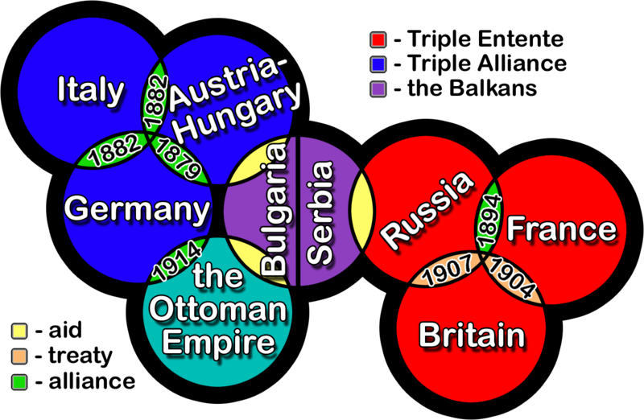

Slide 7
Germany’s Schlieffen Plan
Germany was the most mobilized country in all of Europe and was ready for war t0 breakout
Was created if and when Russia began to mobilize troops near the German border
THE ATTACK PLAN
Invade France through Belgium
Defeat France quickly and then focus on Russia
Britain would not uphold their 1839 Alliance with Belgium
Would only take 6 weeks to accomplish
THE ISSUE
Belgium resisted Germany
Slowed down the attack
France and Russia were able to mobilize to counter the German attack
Britain honored their alliance and entered the war

Slide 8
Over by Christmas
War was openly welcomed and celebrated in Europe
It was a romantic idea that war was a great adventure that made men out of boys.
“War was colorful flags, spiked helmets and flashing sabers. Those called to arms would be heroes, defending their homelands and way of life.”
Many thought World War I would be over in days or at least by Christmas
Christmas was a time of peace and goodwill towards others
Each side thought that their cause was just.
Each side thought God supported them.
After 5 months of harsh fighting many thought that the countries would be tired of fighting and would surrender.

Slide 9
The War to End All Wars
Name given to the Great War by many world leaders, primarily U.S. President Woodrow Wilson
No other war in the history of mankind was as destructive as the Great War until World War II
Many thought that due to the grand (great) scale of the war…
High death toll
Destruction of land
Global power changes
That there would never be another war in the history of
mankind.

Slide 10
Causes of World War I
M - ilitarism
A - lliances
I - mperialism
N - ationalism

Slide 11
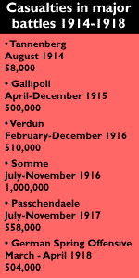
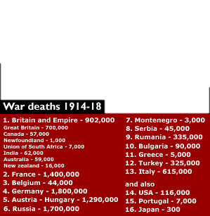
WWI Statistics
Overall cost = $186.3 Billion

Slide 12
Life In the Trenches
A War of Attrition

Slide 13
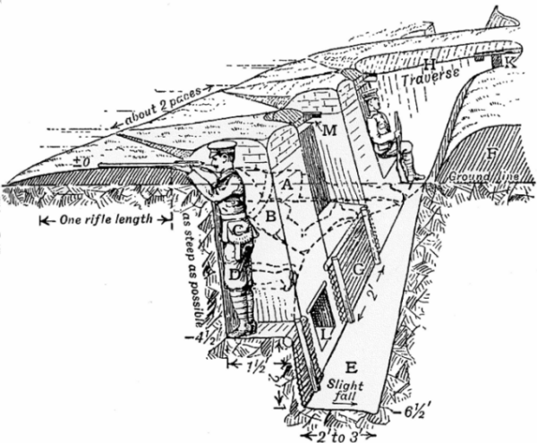
Trench Warfare
Trench – a long and narrow ditch system meant to provide shelter from enemy fire.

Slide 14
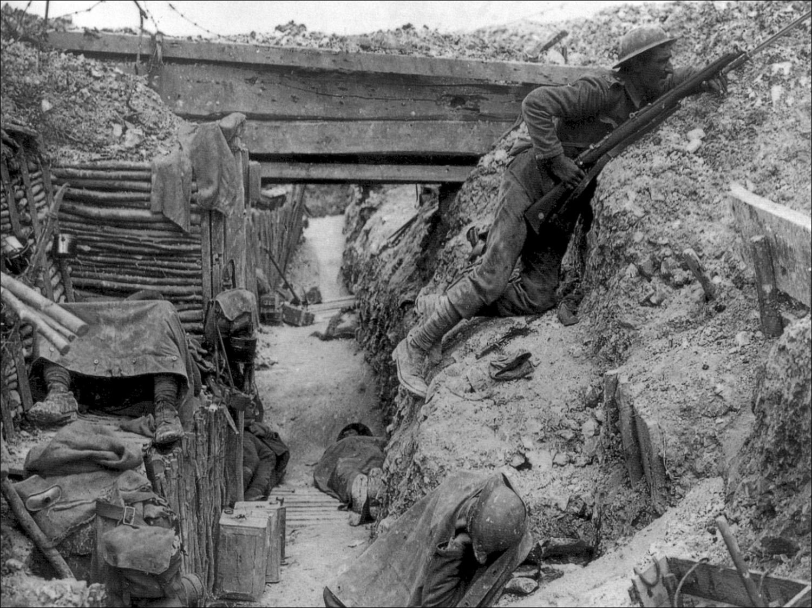

Slide 15
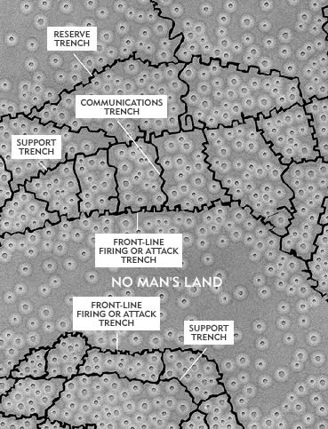
Trench Networks
Front Line
Firing or attack trench
Communication Trench
Connects the Front Line to the support trench behind it
Support Trench
Provides backup to the Front Line
Reserve Trench
Last line of defense

Slide 16
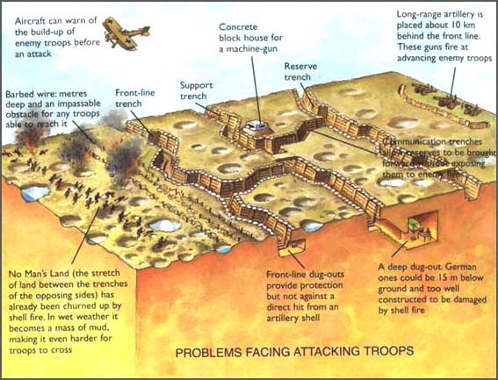

Slide 17
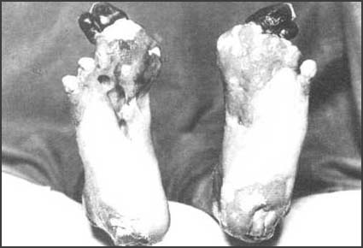
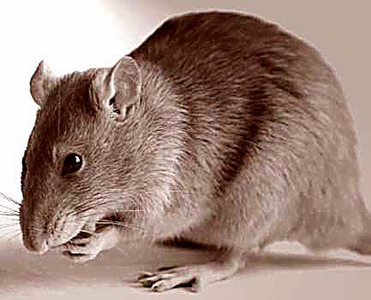
Life in the Trenches
Death was daily
Snipers
Disease
Rat Infestations
a single rat couple could produce up to 900 offspring in a year
Frogs, slugs, and horned beetles
Lice
Constant itching
Caused Trench Fever (took up to 12 weeks recover)
Trench Foot
fungal infection of the feet caused by cold, wet and unsanitary trench conditions
Could turn gangrene and lead to amputations

Slide 18
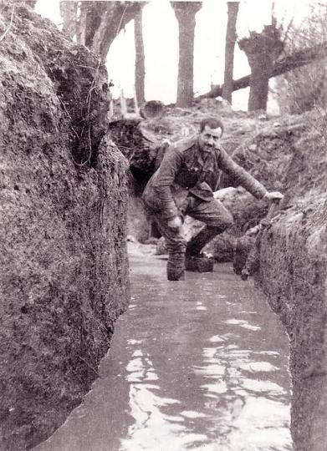
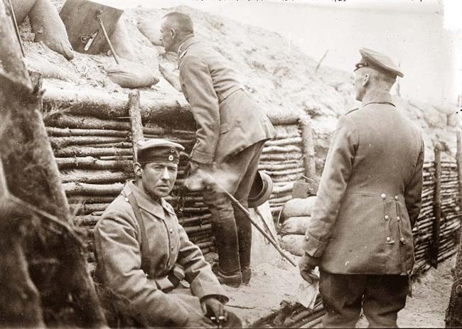
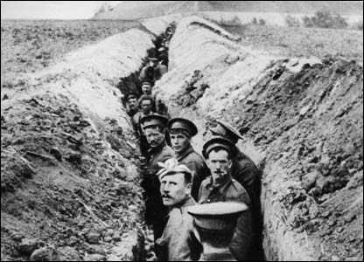
Trench Cycle (Time Spent)
Front Line
Support Line
Reserve Line
Rear/Rest

Slide 19
A Day In the Life of a Trench Soldier
Stand To (Dawn) - guard against a raid by the enemy
Morning Hate - machine gun fire, shelling and small arms fire, directed toward enemy trenches
Clean rifles
Breakfast Truce - no attacks/raids take place
Inspections and Chores
Stand To (Dusk)
Patrolling No Man’s Land
Relieving men on the Front Line

Slide 20
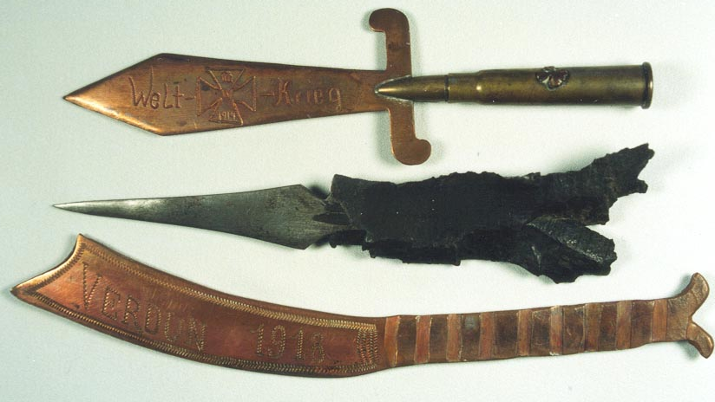
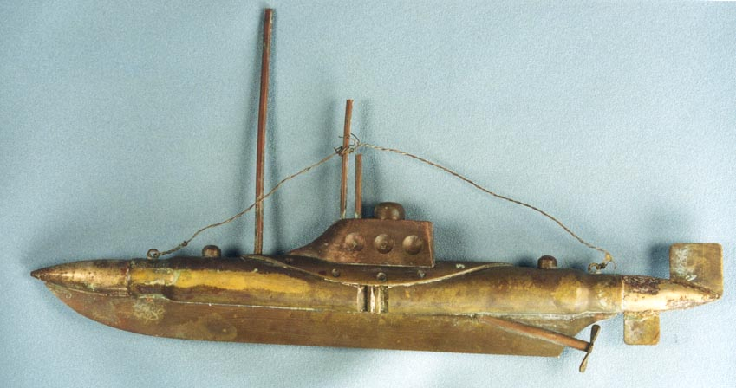
Fighting Boredom
Movement was restricted to nightfall
Read and write letters
Sleep
Making small trinkets from discarded shells or whittle

Slide 21
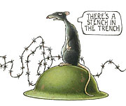
The Smell
Rotting carcasses
Many unburied or laid in shallow graves
Overflowing latrines
Men who had not been able to bath in weeks/months
Feet were considered to smell the worst
Creosol or chloride of lime
Used to fight off the threat of disease and infection
Cordite, the lingering odor of poison gas, rotting sandbags, stagnant mud, cigarette smoke and cooking food

Slide 22
Weapons of Modern Warfare
Killing People Efficiently

Slide 23
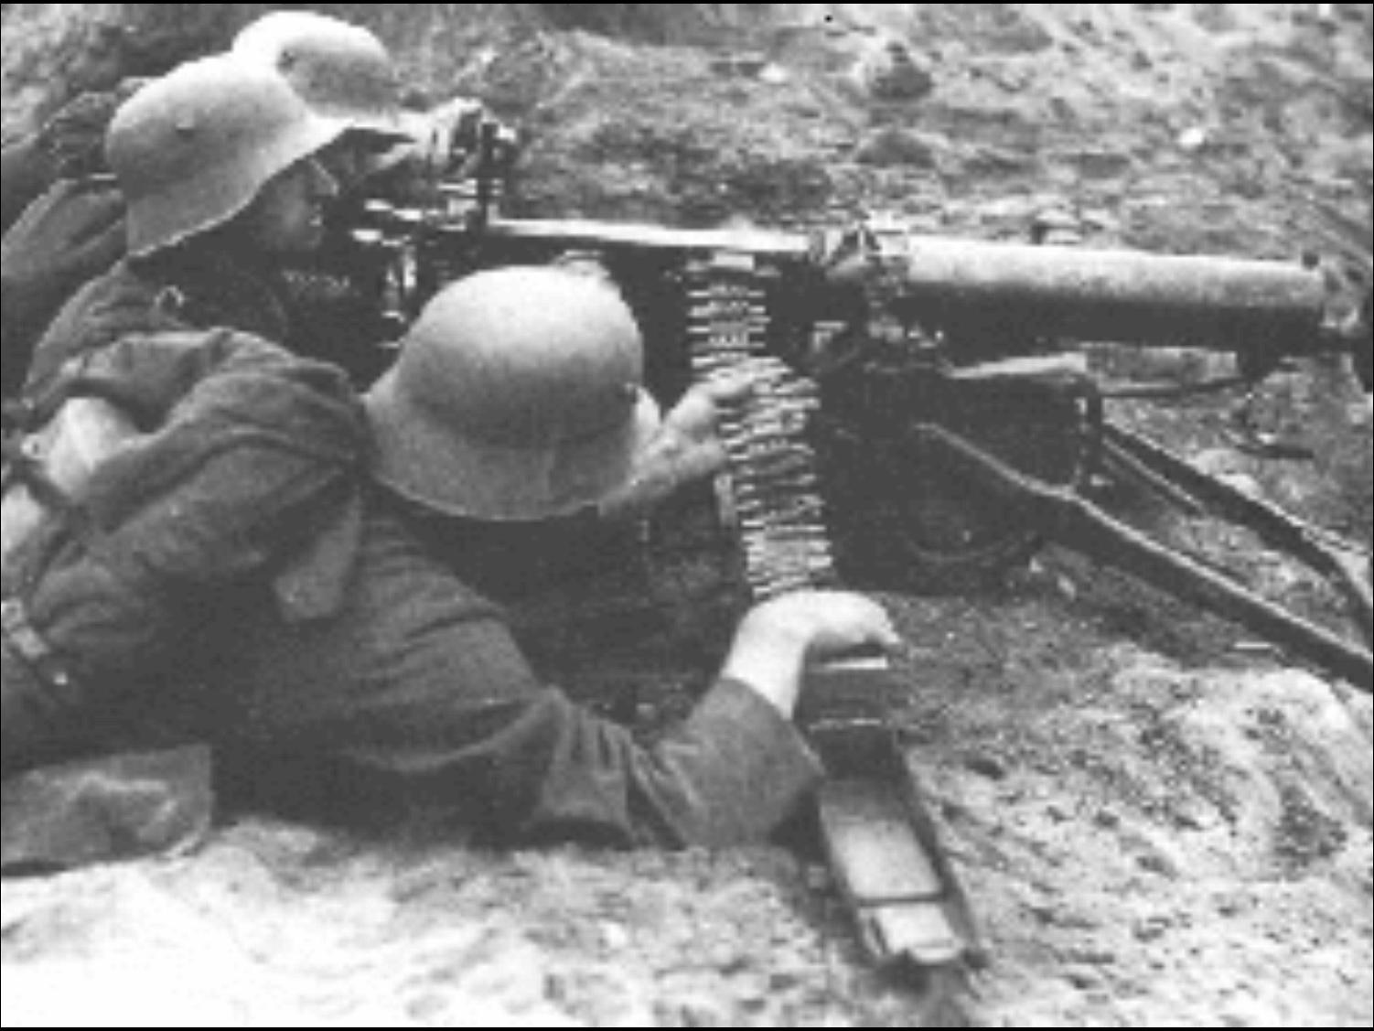
Machine Guns
Pros.
Kills or maims people quickly and in large numbers
Cons.
Overheat quickly
Jams easily
Heavy

Slide 24
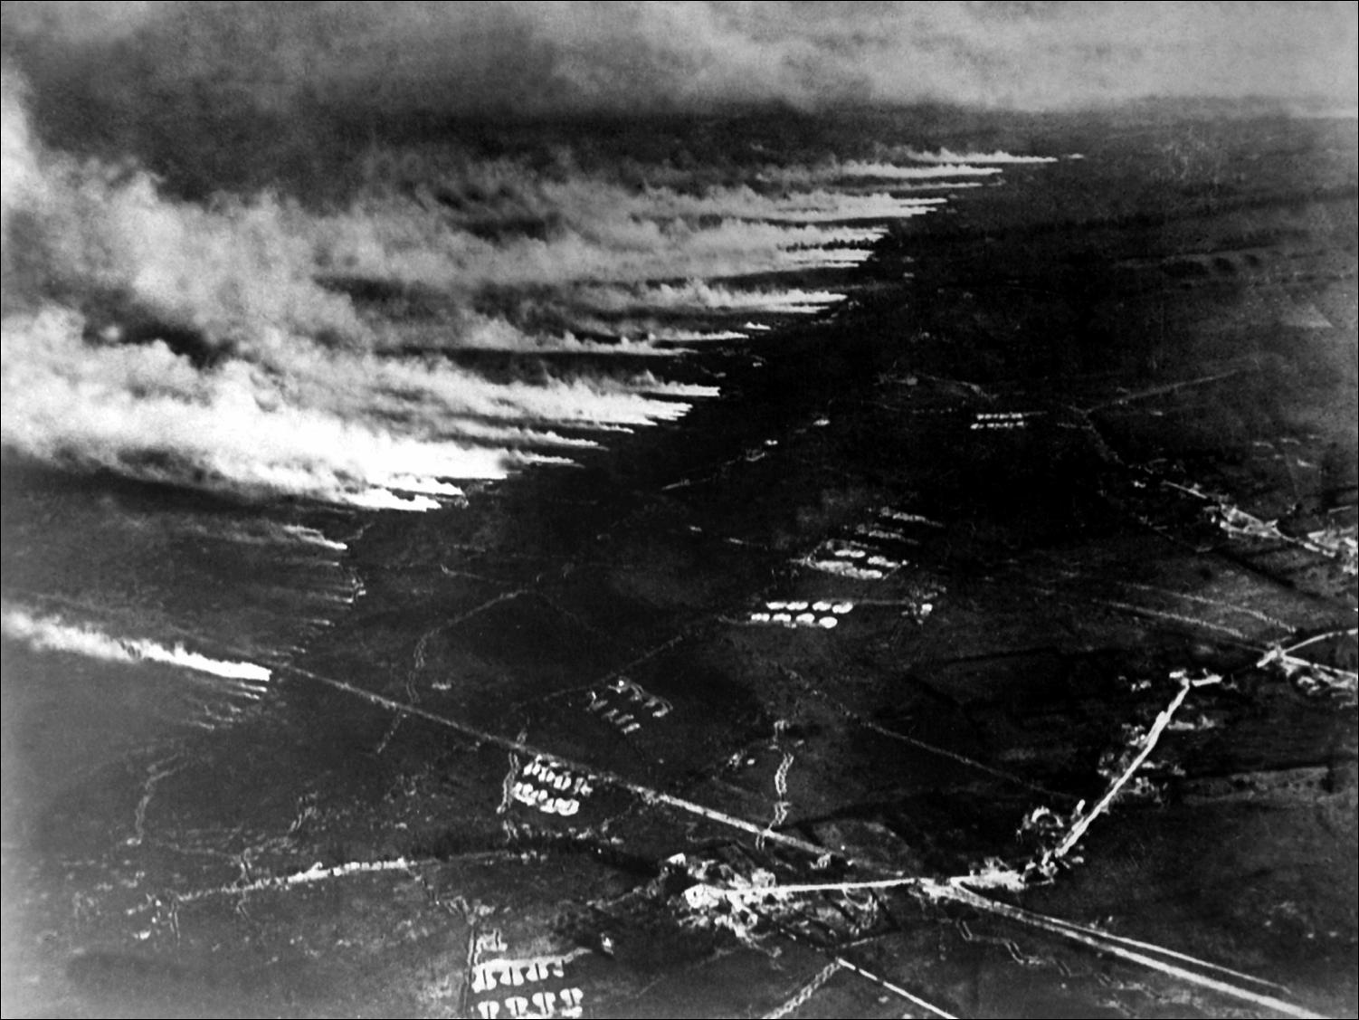
Poisonous Gas
Chemical Warfare
Pros.
Kills or maims large numbers
Long range weapon
Lasts for long period
Cons.
Wind direction
Other
Colorless
Odorless
Hard to avoid contact

Slide 25
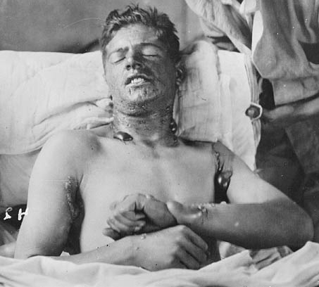
Death Would Sometimes be Better

Slide 26
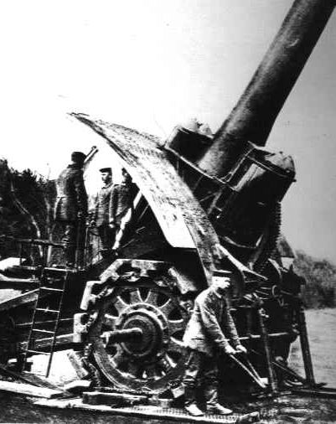
Heavy Artillery
Pros.
Destroy structures and trenches from a far distance
Cons.
Very large and heavy
Not accurate
Other
Psychological warfare

Slide 27
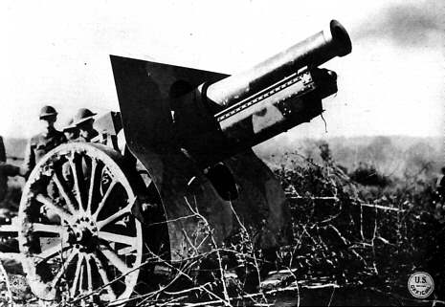
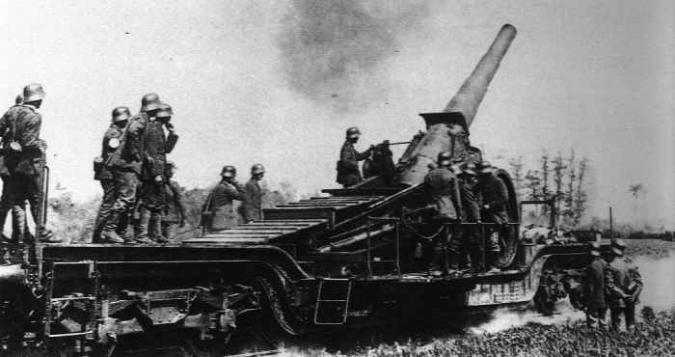
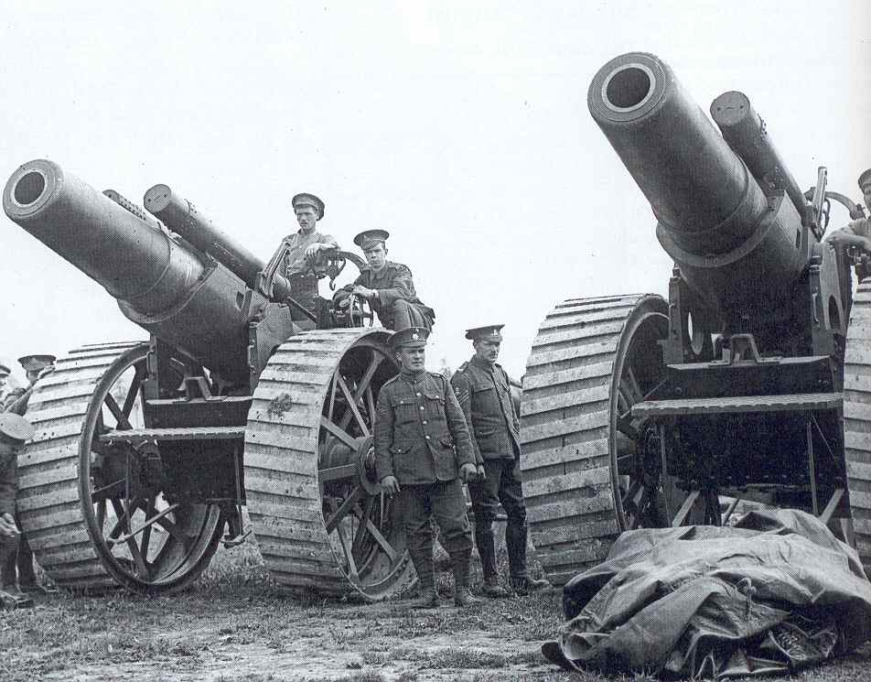
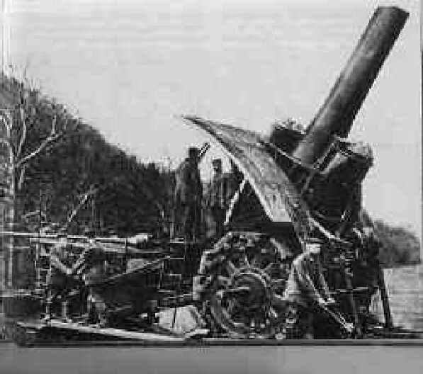

Slide 28
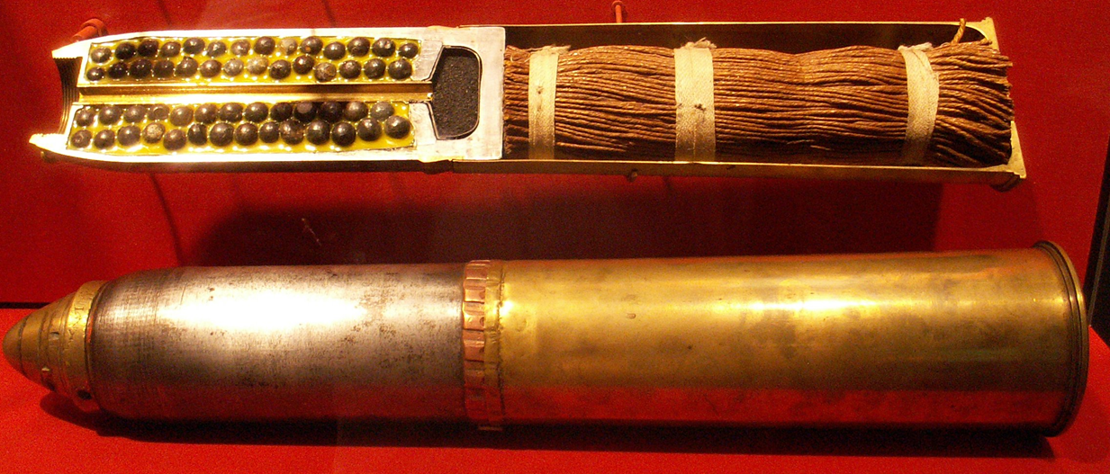
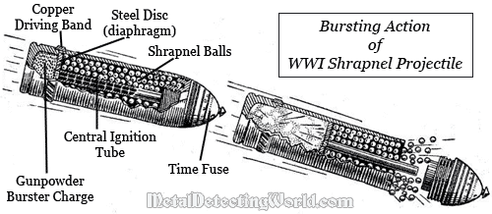

Slide 29
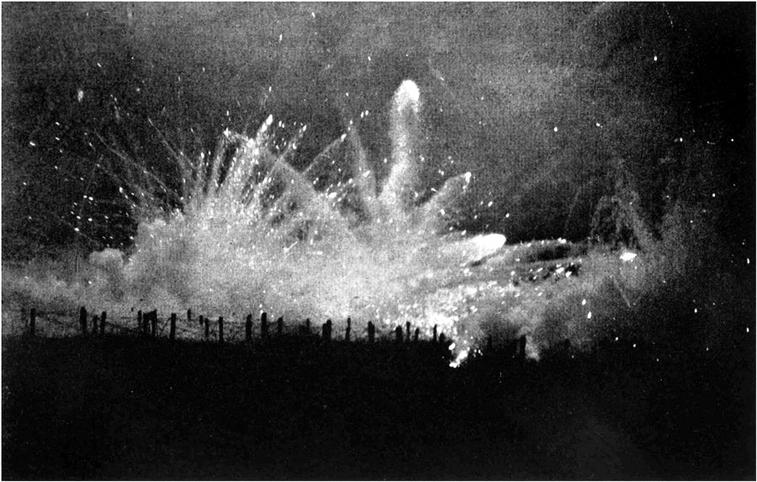

Slide 30
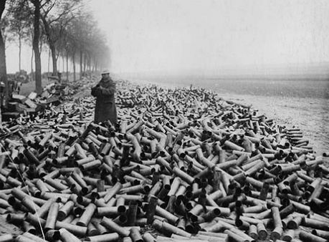
Battle of Verdun - On the first day of that battle alone, German forces used 1,200 artillery guns, 2.5 million shells, and 1,300 ammunition trains to attack their Allied foes. Overall, 14 million shells were fired in the Battle of Verdun alone

Slide 31
Tanks
Brand New
Pros.
Could go where others could not
Cons.
Slow
Got stuck easily
Broke down a lot
Easy target

Slide 32
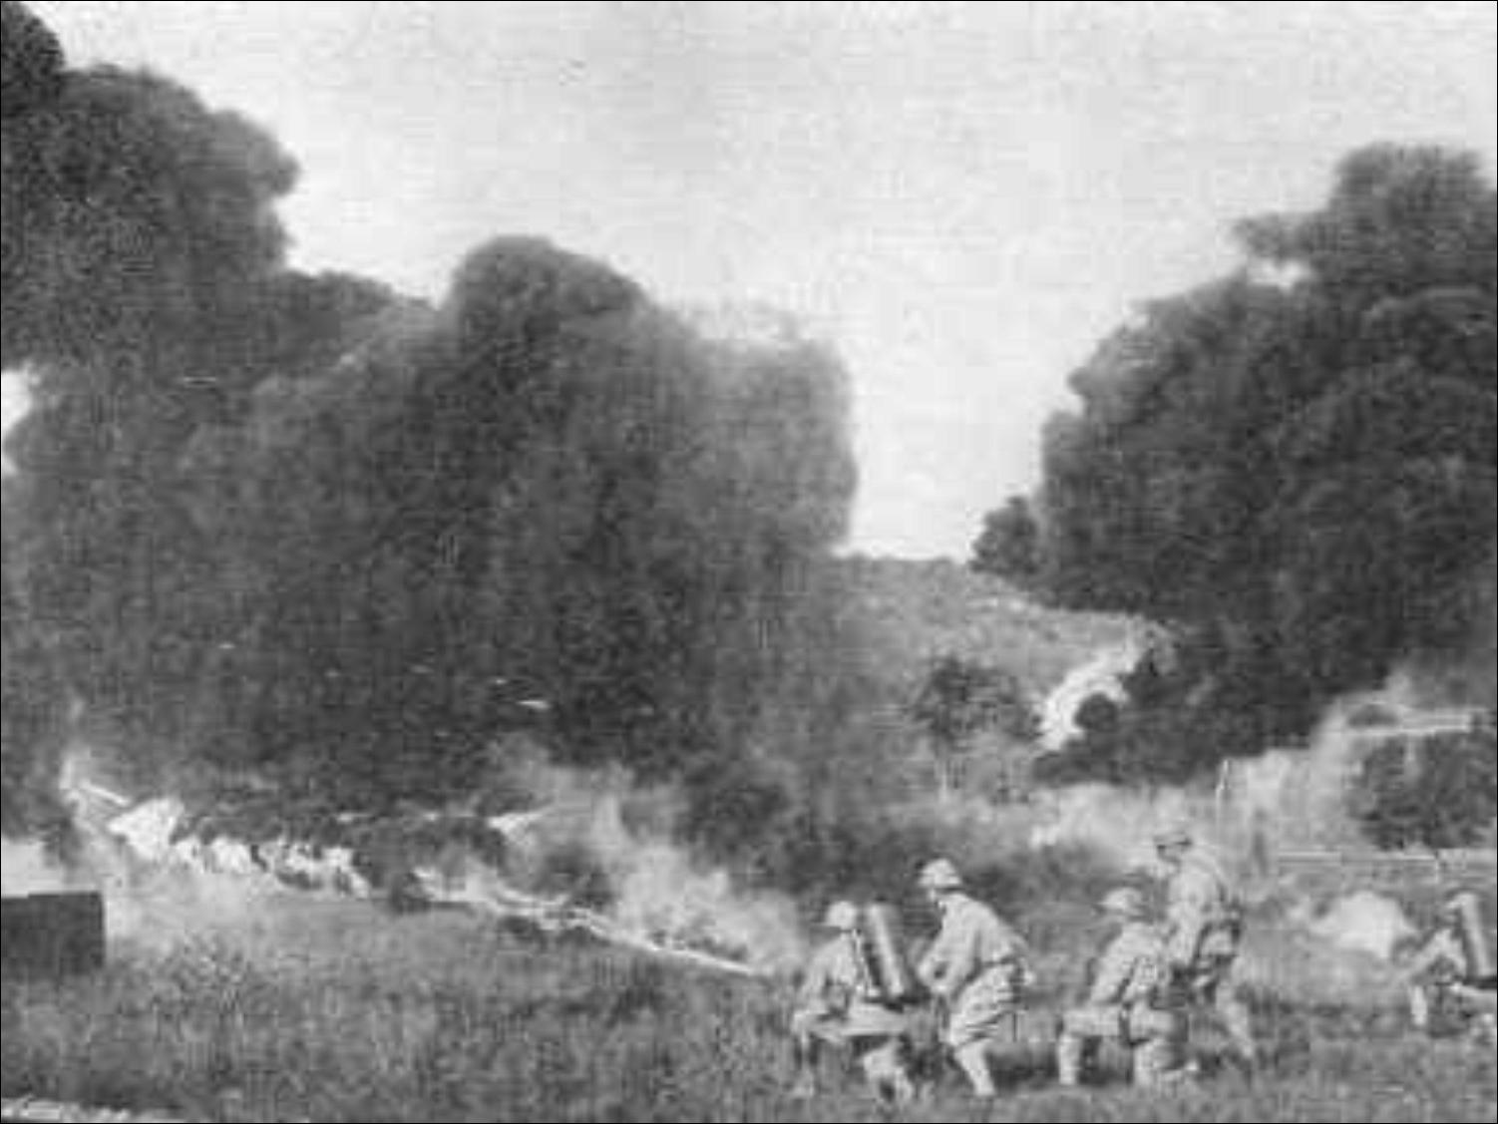
Flamethrowers
Pros.
Portable
59’ spray
Cons.
Fuel tank can explode if punctured

Slide 33
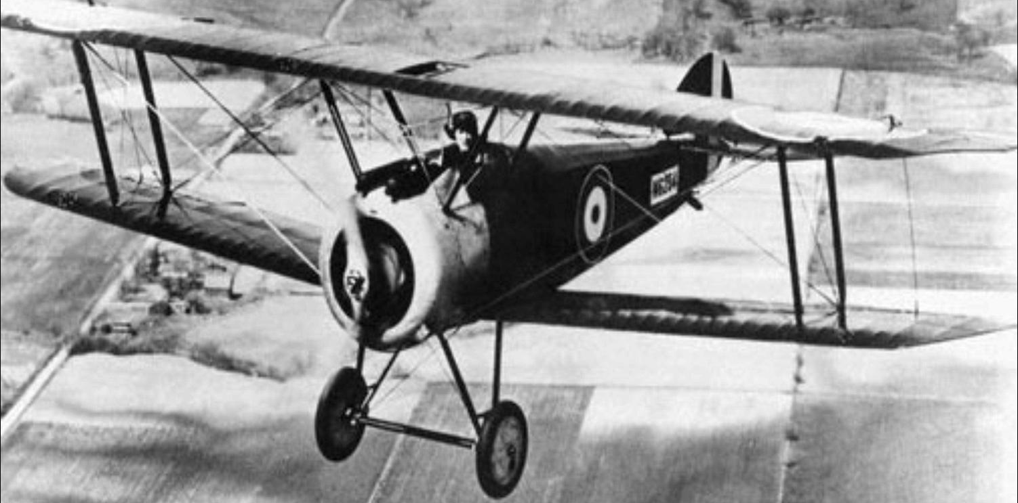
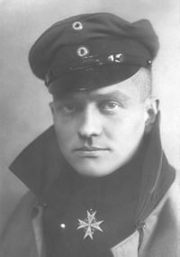
Airplanes
Brand New
Pros.
Could drop bombs
Used for reconnaissance
Cons.
Shot down easily
Other
Pilot was called an Ace after 5 Kills

Slide 34
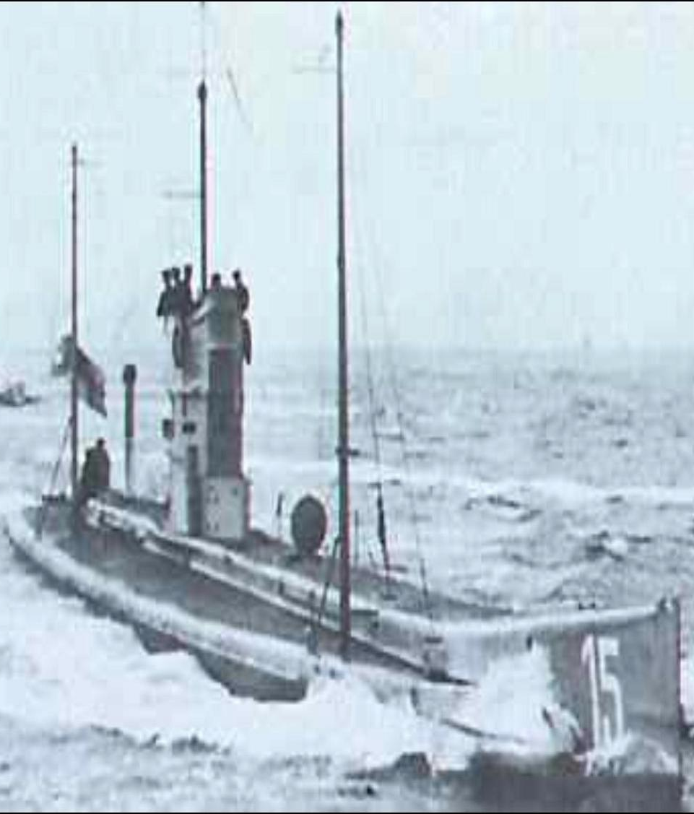
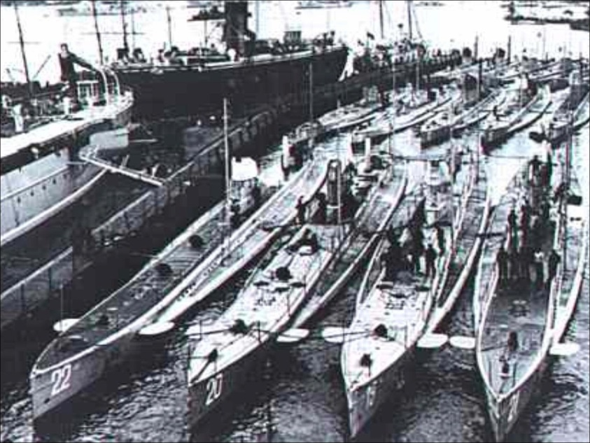
Submarines
Ships that ran underwater
Pros.
Attack without warning
Attack while underwater
Not easily detected
Other
Psychological warfare
Germany used them a lot

