Slide 1
Part II - Unit 2 Section 3 The U.S. Political System
Public Opinion
Interest Groups

Slide 2
Public Opinion

Slide 3
Role
Public Opinion
The collective opinion of large numbers of people
Considered to be the voice of the majority
People can influence the government policies that affect them

Slide 4
Forms
Voting
Speaking out /writing a letter
Newspaper, magazine, Representatives, etc.
Demonstrations/Protesting
Petitions
Joining an interest group
Donation of money or time

Slide 5
Influences
Ideology
Usually basic political beliefs/opinions
Ex. Freedom, opportunity, equality etc.
Political Socialization
Personal influences/experiences over a lifetime
Ex. Family, friends, jobs, age, gender, race, income,
education, geographic region etc.

Slide 6
Influence of Media
Criticisms
Bias
Objectivity
Negative Focus
Visual Imagery
“Horse-Race Coverage”
Focuses on the “winning” side
Limitations
Tend to reinforce beliefs people already hold
People do not always pay attention
Role
Informing the public
Provides facts to the people
Serving as a watchdog
Keep the power in check
Acting as a gatekeeper
Select stories based on importance

Slide 7
Polling - Surveying a population on an issue
The most reliable way of determining what the public thinks.
Types
In-person interviews
Telephone interviews
Mail questionnaires
Exit poll
Surveys a fraction of voters in randomly selected voting precincts after they have cast their ballots

Slide 8
Conducting a Poll
Accurate results depend on…
How people are chosen
Sampling
The type of poll being used
Proper wording and order of questions
Question wording
Question order
How familiar the public is with the issue

Slide 9
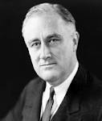
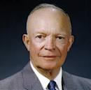
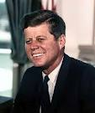
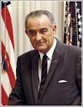
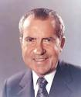
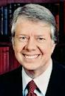
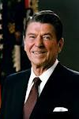
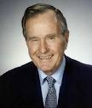
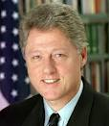
Presidential Public Approval
http://elearningexamples.com/presidential-approval-tracker/

Slide 10
Congressional Public Approval

Slide 11
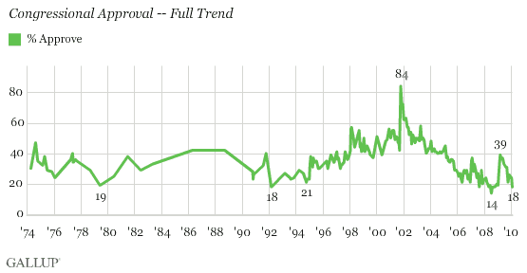

Slide 12
Public Opinion: Obama vs. Congress

Slide 13
Interest Groups

Slide 14
Role
Organizing people
Providing for political participation
Allows people to take part in the political process
Supplying information
Inform the public about their concerns

Slide 15
Types
Agricultural
Represents the nations farmers and agribusinesses
Business
Trade associations
Ex. snack food and trucking
Labor Unions
Workers wanting better wages and working conditions
Ex. ILWU, IBEW, IBT, UA, SMWIA,
Professional
Create standards, publish journals and reports
Ex. Medical and Law
Societal
Ethnic groups, women, veterans
Ex. NAACP & AARP
Cause-based
Education, field research, cultural goals
Public interest
Environmental, religious, gun control, etc.
Ex. NRA

Slide 16
Lobbying
Protected by the 1st Amendment
It is an attempt to persuade government policy makers to make particular decisions regarding legislation.
Ability to endorse candidates
Seen as both positive and negative

Slide 17
Benefits
Represents Minority Concerns
Providing Information
Increases awareness of officials and the public about its issues and concerns

Slide 18
Criticisms
Financial influences
Excessive power
Campaign finance

Slide 19
Limitations
Arguments must be for the public good
Must be debated in the open
Competition between the interest groups

