Slide 1
The Progressive Era & World War I
UNIT 1

Slide 2
THE PROGRESSIVE ERA
Progressive Era
A period of social activism and political reform in the United States that flourished from the 1890s to the 1920s
Progressive
A person advocating or implementing social reform or new, liberal ideas.
Middle class members of society = doctors, teachers, small business owners, religious leaders, social workers, and minorities (primarily women)

Slide 3
PROGRESSIVE AGENDA
Sought reform in local government, public education, medicine, finance, insurance, industry, railroads, churches, and many other areas
Support prohibition, women’s suffrage, and a federal banking system
Eliminate corruption in government by exposing and undercutting political machines and their bosses
Establish further means of direct democracy
Regulate monopolistic trust corporations through antitrust laws to promote fair competition for the benefit of consumers.
Strongly supported scientific methods as applied to economics, government, industry, finance, medicine, schooling, theology, education, and even the family.
Closely followed advances underway in Western Europe
Felt that old-fashioned ways meant waste and inefficiency

Slide 4
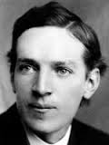
MUCKRAKERS
Reform-minded journalists who wrote mainly for popular magazines i.e. investigative journalism
Often worked to raise public awareness by exposing social ills such as, urban poverty, unsafe working conditions, child labor, and corruption in corporations and politics.
Upton Sinclair
Wrote The Jungle
Exposed conditions in the U.S. meat packing industry
Would later lead to the Pure Food and Drug Act and the Meat Inspection Act being passed

Slide 5
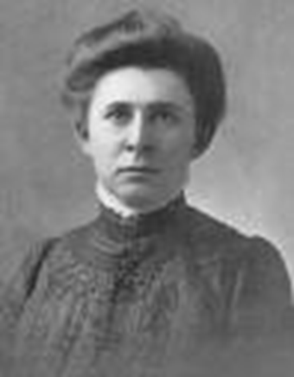
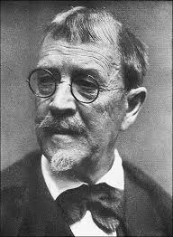
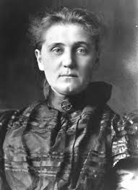
PROGRESSIVE REFORMERS
Ida Tarbell
Went after the monopoly of Standard Oil and their corrupt practices
Lincoln Steffens
Went after political machines (mob bosses) like James Pendergast from Kansas City
Jane Addams
Helped turn the public to issues of concern to mothers, such as the needs of children, public health, and world peace
Created the Hull House, a settlement home for the betterment of women

Slide 6
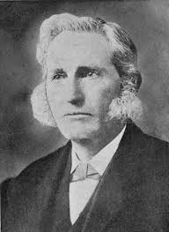
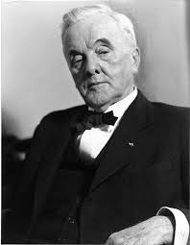
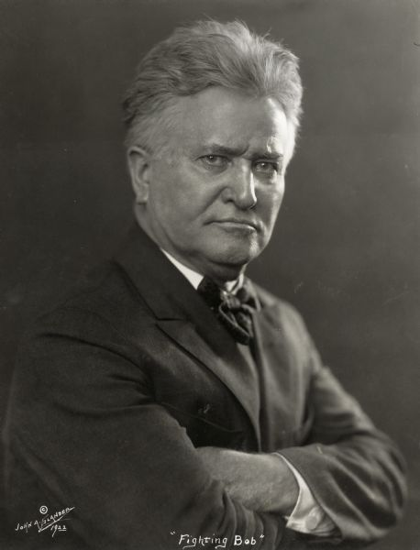
PROGRESSIVE REFORMERS
Lester Ward
Emphasized universal and comprehensive public schooling
George Norris
Advocated for no political parties in government
Robert La Follette
Created the “Wisconsin Idea” Voters should be more important to the government than special interest groups/lobbyists

Slide 7
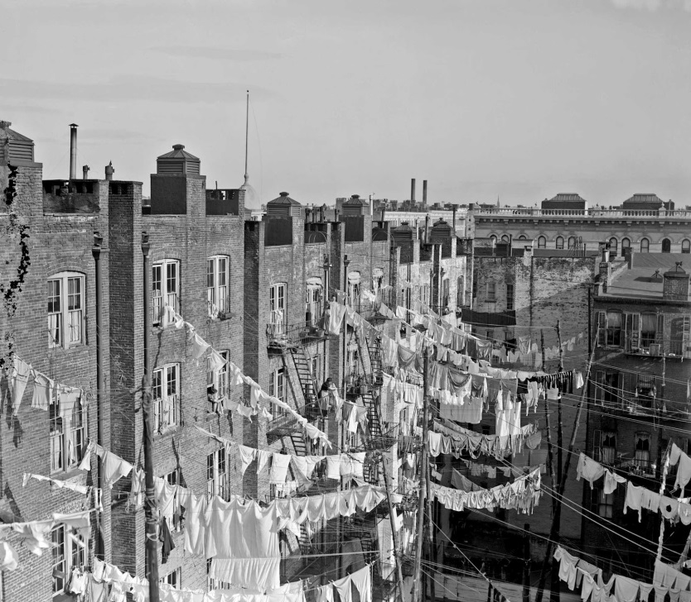
URBAN LIFE
Cities are becoming overcrowded
More people are moving from rural areas into the cities
Immigrants from Europe and Asia are flocking to American cities and settling in poor ethnic neighborhoods
Tenement Housing – small and deplorable housing units/apartments mainly used by poor ethnic groups new to the U.S.
Socio-economic classes divide society
Rich get richer
Poor get poorer
Middle class strives for reform

Slide 8
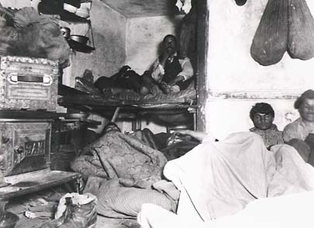

Slide 9
DANGEROUS WORK PLACES
In 1910, America had the most dangerous work places in any of the Industrialized Nations of the world.
Steel mills averaged 25% of the employee force were killed or injured each year between 1907 and 1910.
Workers averaged a 54 hour work week
The average worker worked 6 days a week, 10 hours a day and earned $1.50 a day – Women and kids earned less

Slide 10
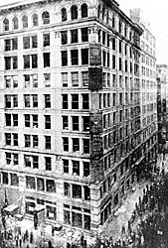
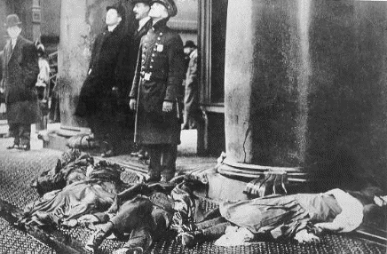
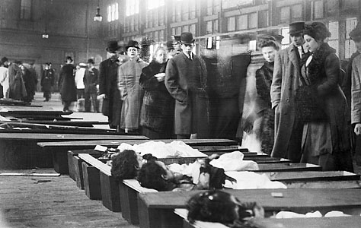
TRIANGLE SHIRTWAIST FACTORY FIRE
140 of 500 employees (all women) died in a fire when the doors were blocked.
Strict fire codes were enforced throughout the nation afterwards

Slide 11
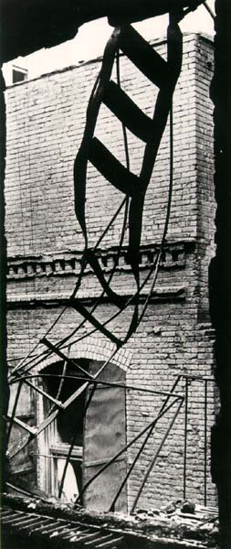
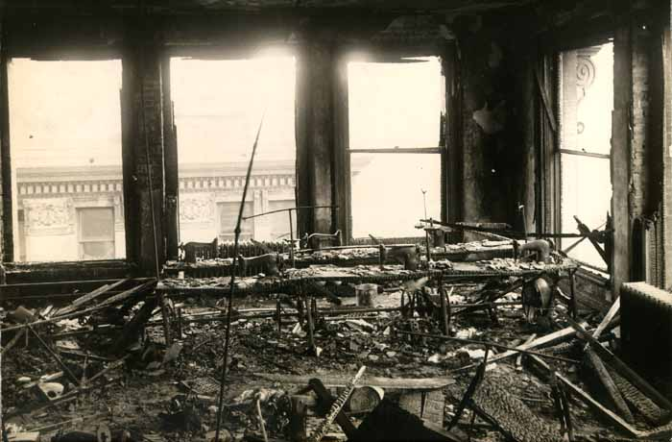

Slide 12
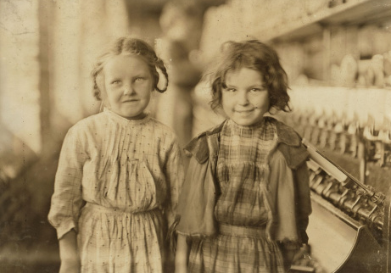
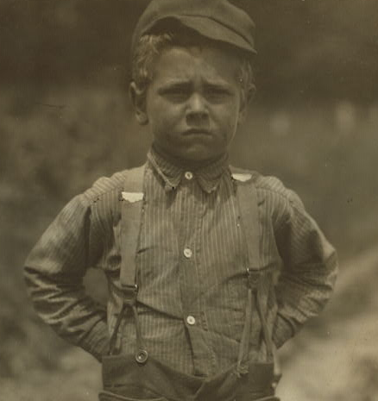
CHILD LABOR
Children were made to work in mines and other hazardous jobs that adults would refuse to do.
Children would begin to work as young as 5 years old to earn money for the family
Many were not educated and could not read or write
Child labor laws would restrict how many hours a child could work, age limitations, and education requirements

Slide 13
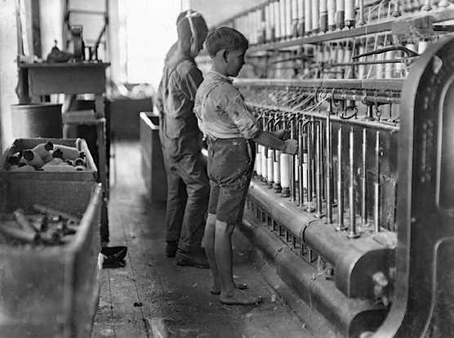
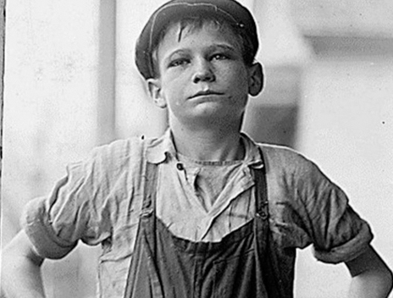
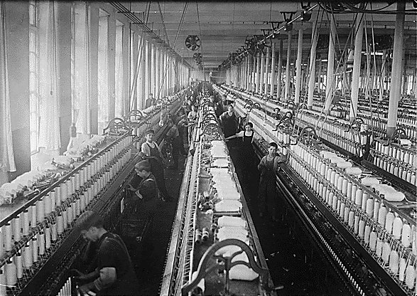

Slide 14
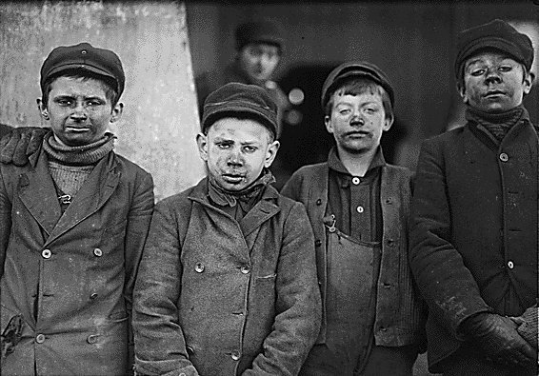
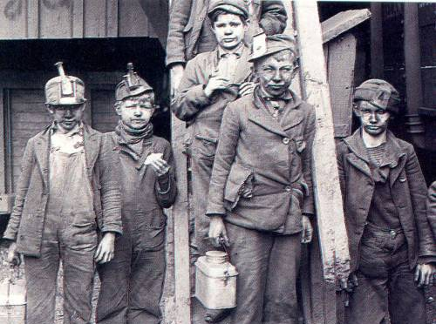
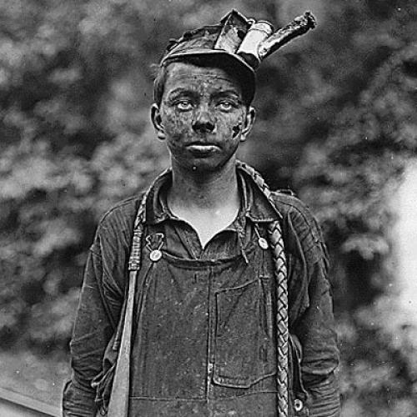
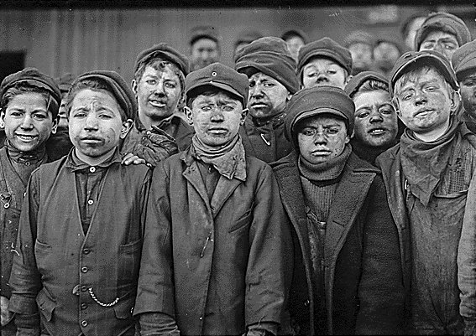

Slide 15
LABOR UNIONS
Workers joined together in common trades/business to promote change
Better/safer working conditions
Better wages
Weekends!!!
All or nothing concept… leave no one behind
Strike a deal/compromise with business owners

