Slide 1
The Judicial Branch
The Federal Court System
The U.S. Legal System

Slide 2
Role of Court
Resolve disputes
Interpret the law
Set guidelines for similar future legal cases

Slide 3
Lower Courts
Can hear the following types of cases
A person is accused of disobeying the US Constitution
A person is accused of violating a US treaty
A person is accused of breaking federal laws passed by Congress
The US government or a US citizen is charged with an offense by a foreign nation
A person is accused of committing a crime on a US ship at sea
A US ambassador or other foreign service official is accused of breaking the laws of the country in which he/she is stationed
A person accused of committing a crime on certain types of federal property
A citizen of on state brings a lawsuit against a citizen of another state.

Slide 4
Organization of the Lower Court System
District Courts
Determine the facts, reach a verdict, and apply the law
Courts of Appeals
Appealed district court cases
Circuit Courts - 1 per judicial district
Special Courts
Claims
International trade
Appeals for the armed forces
Territorial
Tax
Veteran appeals

Slide 5
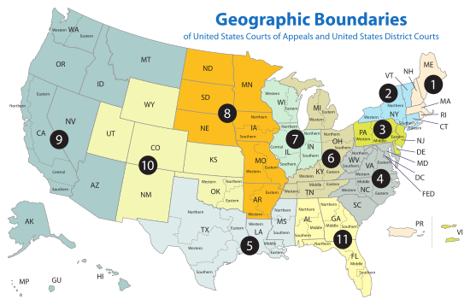

Slide 6
The Supreme Court
Justices
9 Total
The Chief Justice
Presides over the group
Appointed by the President
Serve for Life
Most retire in their late 70s
Can be impeached for serious crimes
Will hear on average 90 cases a year

Slide 7
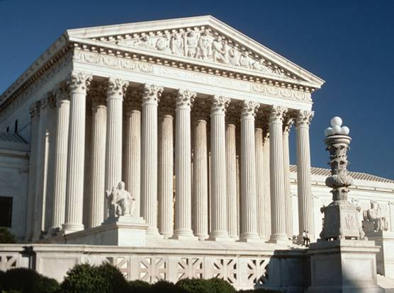

Slide 8
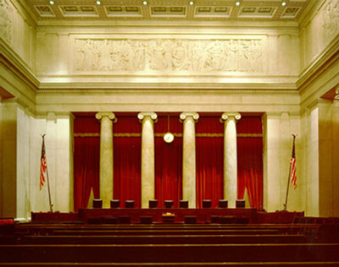

Slide 9
Websites
http://www.supremecourt.gov/
http://www.supremecourt.gov/about/members.aspx

Slide 10
U.S. Law
Common Law – rulings made in earlier cases
Cases of Negligence/Irresponsibility
Statutory Law – made by local, state, or national gov’t.
Constitutional Law – highest law in the country
Administrative Law – regulations made by agencies
Criminal Law – actions forbidden by society
Punishable by imprisonment
Civil Law – private disputes
Personal injury, breaking of contract, etc.
Pay fines or settle dispute

Slide 11
Criminal Law
Felonies
Serious crimes (murder, rape, burglary, etc.)
Misdemeanors
Less serious crimes (resisting arrest)

Slide 12
Criminal Justice System
Police enforce the law
Organized into counties
i.e. Douglas County, NE
Arresting Suspects
Rights of the Accused
Remain Silent
Right to an Attorney
Getting “booked”
Picture and Fingerprints taken
Background check conducted

Slide 13
Appearance in Court
1st Hearing
Is there enough evidence to hold the accused?
Should bail be set for the accused?
Bail money is called a Bond (security deposit)
Preliminary Hearing
Judge reviews the case
Prosecutor tries to persuade the judge that the case should go to trial
Indictment
Formal accusation made in front of a grand jury
Jury decides if the accused should be brought on formal charges
Arraignment
The accused is formally notified of the charges
Enters a plea
Guilty
Not Guilty
No-Contest

Slide 14
Jury Selection
6-12 people
Sequestered
Trial
Witnesses
Subpoena – court order requiring the person’s presence
The Verdict
Majority
Unanimous
Hung jury
Sentencing
Punishment is given
The Other Option
Plea Bargain - agree to plead guilty to a less serious charge

Slide 15
Corrections
Probation
Imprisonment
Parole
Capital Punishment

