Slide 1
Section 2: The Executive Branch
The Presidency
How the Executive Branch Works
Economic Policy
Foreign Policy and National Security

Slide 2
The Presidency

Slide 3
The President’s Roles
Chief Executive
Head of the executive branch
Carries out the nation’s laws
Commander in Chief
Head of the armed forces
Chief Agenda Setter
Gives Congress information about the state of the Union and makes recommendations
Create a budget proposal as to how the government should raise and spend its money

Slide 4
Representative of the Nation
President symbolizes the United States and its people
Chief of State
Conducts diplomacy with foreign officials
Performs ceremonial duties
Foreign-Policy Leader
Promote trade and friendship while maintaining security
Party Leader

Slide 5
Qualifications
Set by the Constitution
Be a native-born U.S. citizen
Be at least 35 years of age
Has been a U.S. resident for at least 14 years

Slide 6
Presidential Terms and Salary
Terms
4 years in office per term
2 term limit
Salary
Set by Congress
$400,000 annually
$50,000 annual allowance
official expenses
additional allowances for travel and entertainment

Slide 7
Benefits
Live in the White House
Office and private living quarters
Camp David
Special meetings
Vacations
Personal fleet of cars, helicopters, and airplanes
Air Force One
Marine One

Slide 8
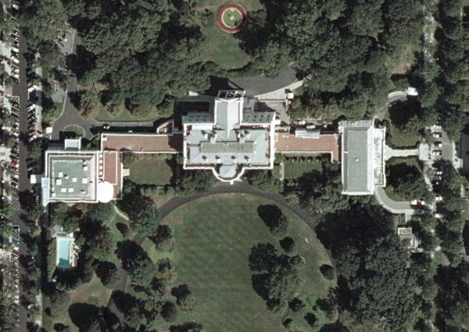
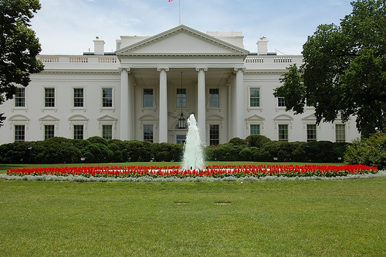
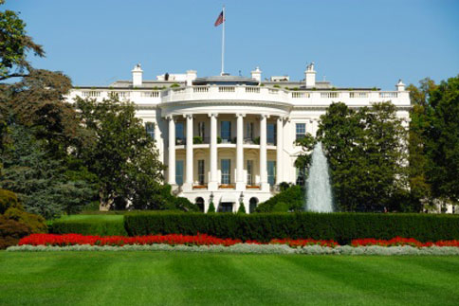

Slide 9
Succession
President of the United States
Vice President of the United States
Speaker of the House of Representatives
President Pro Tempore of the Senate
Secretary of State
Secretary of the Treasury
Secretary of Defense
Attorney General
Secretary of the Interior
Secretary of Agriculture
Secretary of Commerce
Secretary of Labor
Secretary of Health and Human Services
Secretary of Housing and Urban Development
Secretary of Transportation
Secretary of Energy
Secretary of Education
Secretary of Veterans Affairs
Secretary of Homeland Security

Slide 10
Presidential Powers
Executive
Executing Laws
Appointing Officials
Executive Privilege
Deny information requested by Congress
Diplomatic
Making Treaties
Trade or Alliances
Executive Agreements
Quicker process than making a treaty
Recognizing Governments
Military
Committing Troops
War Powers Act
Send troops into combat action for 60 days
Judicial
Pardons
Legislative
Recommend Legislation
Veto Legislation
Lobbying

Slide 11
How the Executive Branch Works

Slide 12
Executive Office of the President
White House Staff
Chief of Staff to the President
Deputy Chiefs of Staff
Assistants to the President (15)
Joint Chiefs of Staff
Top military general from each branch
Vice President
Cabinet Department (15)
Attorney General
First Lady

Slide 13
Independent Agencies
Executive branch agencies outside the cabinet departments.
Each receive separate government funding.
Social Security Administration
Equal Employment Opportunity Commission
Environmental Protection Agency
Federal Communications Commission
NASA
CIA
Peace Corps

Slide 14
Regulatory Commissions
Agencies that act with very little direction from the White House
Strongly influenced by Congress
Have the power to establish and enforce regulations
Securities Exchange Commission
Federal Trade Commission
National Labor Relations Board
Nuclear Regulatory Commission
Consumer Product Safety Commission

Slide 15
Government Corporations
Run as nonprofit businesses
US Postal Service
Federal Deposit Insurance Corporation
Tennessee Valley Authority

Slide 16
Improving the System
Inefficiency
Performance Measures
Contracting Out
Privatization

Slide 17
Economic Policies

Slide 18
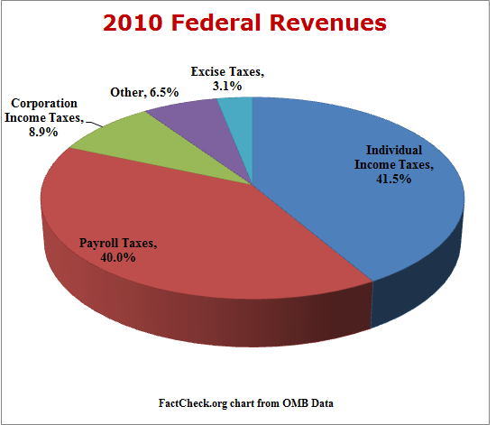
Taxes
Federal Taxes
Individual Income Tax
Corporate Income Tax
Payroll Tax
Estate and Gift Tax
Excise Tax
Gas, tobacco, alcohol
Customs Duties

Slide 19
Free-enterprise System
Own private property
Make individual choices
Engage in competition
Limited government involvement

Slide 20
Economic Goals
Slow down and lower inflation
Obtain full employment

Slide 21
Economic Stability
Fiscal Policy
A set of government spending, taxing and borrowing used to achieve a level of economic performance
Monetary Policy
Designed to regulate the economy by controlling the amount of money in circulation as well as the level of interest rates.
Federal Reserve System

Slide 22
The Federal Budget
Deficit spending
National debt
Balancing the budget
http://www.usdebtclock.org/
http://www.heritage.org/budgetchartbook/
http://www.federalbudget.com/
www.pagetutor.com/trillion/index.html

Slide 23
Foreign Policy and National Security

Slide 24
Foreign Policy Goals
Maintain National Security
Support Democracy
Promote World Peace
Provide Aid to People in Need
Establish Free and Open Trade

Slide 25
Foreign Policy at Work
Summit Conferences
Meetings between the heads of state of two or more nations.
Diplomatic Centers - Deal with U.S. Commercial Interests
Embassies
Ambassador – chief diplomatic official
Keep contact between the countries
Consulates
Consul – promote U.S. trade and commerce
– assist American citizens with travel matters and other problems

Slide 26
The Role of National Security
Department of Defense (DOD)
Central Intelligence Agency (CIA)
National Security Council (NSC)

Slide 27
Foreign Aid and Alliances
Aid
The Marshall Plan
USAID – U.S. Agency for International Development
Promote economic growth
Advance democracy
Deliver humanitarian support to victims of disasters
Promote health
Protect the environment
Alliance
NATO
NAFTA

