Slide 1
Unit 2 Origins of Law and the Constitution
Section 1
The Constitution and America’s Government

Slide 2
Basic Principles
The Constitution established the rules that the U.S. government must follow.
Five Main Principles
Popular sovereignty
Limited government
Separation of powers
Checks and balances
Federalism

Slide 3
Popular Sovereignty
Ensures that government serves the people
Federalism
Balances the power between national and state governments
Limited Government
Restricts the government’s power
Checks and Balances
Allows branches of government to restrain each other’s powers
Separation of Powers
Prevents the concentration and abuse of power

Slide 4
Popular Sovereignty
Government authority comes from the people.
Mentioned throughout the Constitution…
Preamble
Establish justice
Insure domestic tranquility
Provide for the common defense
Promote the general welfare

Slide 5
Limited Government
The Constitution limits government by establishing guidelines for how the government may act.
Keeps the government from violating citizen’s individual liberties.

Slide 6
Separation of Powers
The Constitution divides the government into 3 branches of government
Articles
Legislative Branch
Congress
Makes the nations laws
Executive Branch
President, Vice President, and Cabinet members
Carries out the laws
Judicial Branch
Supreme Court
Authority to establish courts below the Supreme Court

Slide 7
Checks and Balances
Prevents the concentration and abuse of power
Each branch of government has the authority to check, or restrain the powers of the other two branches.

Slide 8
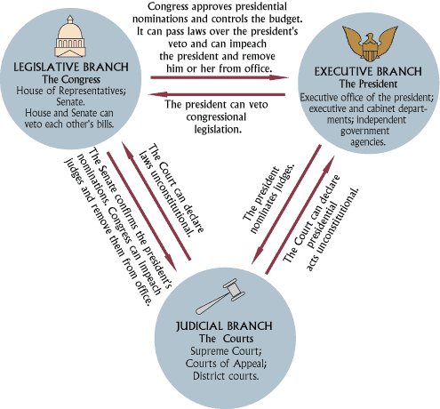

Slide 9
Legislative Powers
Passes bills into law
Congress can override a presidential veto by a 2/3 majority vote
Approves appointments to top government jobs
Holds the “power of the purse” (were the money goes)

Slide 10
Executive Powers
Approves or vetoes laws
Carries out laws
Appoints federal court judges, ambassadors, and other high-level officials
Negotiates treaties

Slide 11
Judicial Powers
Interprets the meaning of laws
Rules on the constitutionality of laws passed by Congress and actions taken by the executive branch
Judicial Review
The power of the courts to decide if laws and other government actions are valid und the U.S. Constitution.

Slide 12
Federalism
The Constitution is designed protect the rights of the states by creating a federal system.
National, State, and Local Governments
Powers NOT allowed to states
Negotiating treaties
Coining money
Engaging in war

