Slide 1
Section 2: Structure of Government

Slide 2
Distribution of Power Among Levels of Government
Unitary System Federal System Confederal System
Central government National, state, and local Independent states join
holds all legal power. governments share power. together.
Local government has All levels have the power Each state is represented
no independent power; to establish their own laws, in a central organization.
carries out decisions elect officials, and create Central organization
made by the central agencies. carries out policies made
government. by representatives.

Slide 3
Presidential vs. Parliament
Presidential System
Parliamentary System
Legislative and executive branches operate independently of each other.
Power is concentrated in a legislature.
The legislature selects one of its members, usually called a prime minister, as the nation’s principal leader.
Other legislative members serve as the leader’s cabinet.

Slide 4
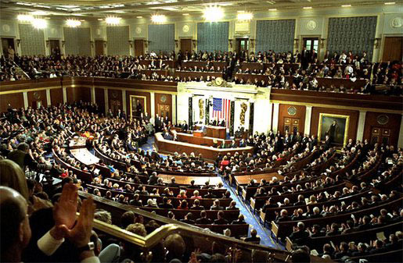
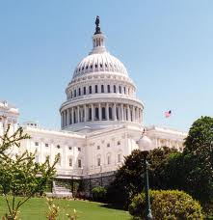
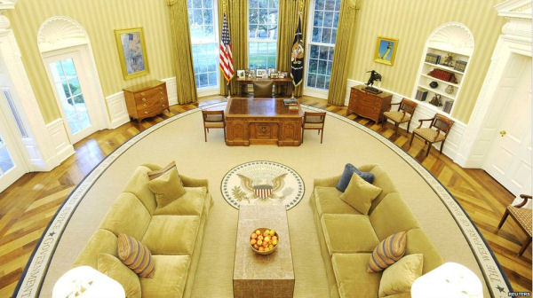
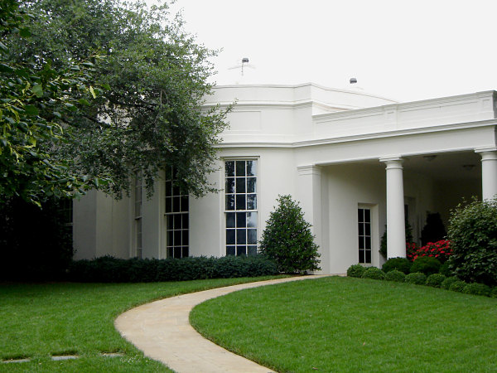
Presidential

Slide 5
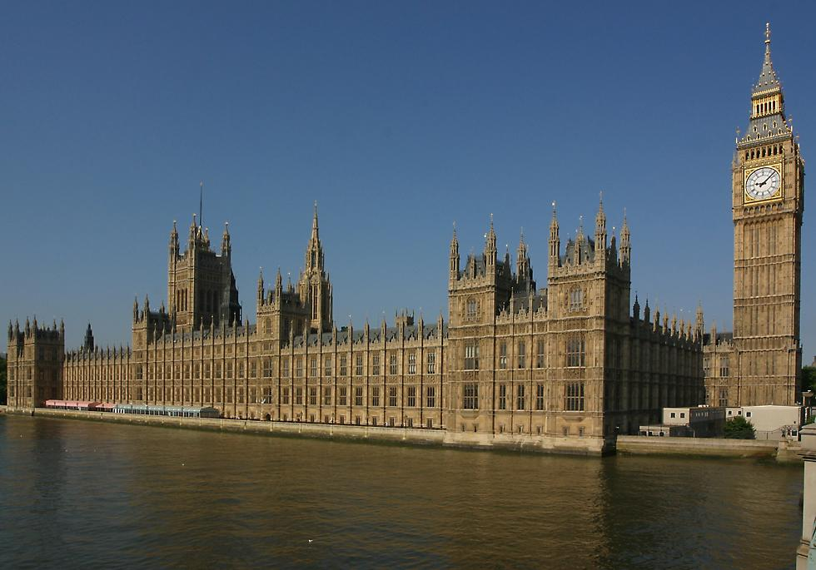
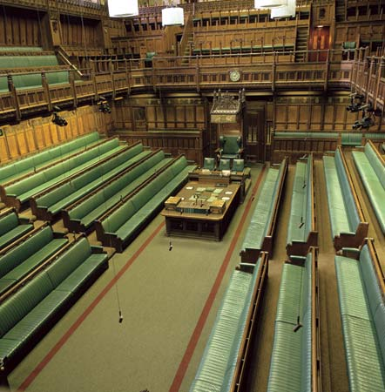
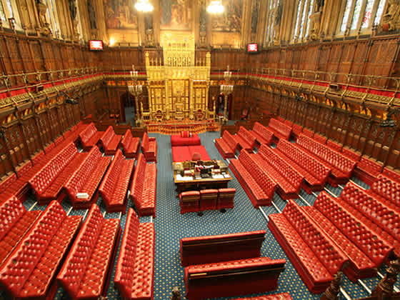
Parliamentary

Slide 6
Government
The government runs the country. It has responsibility for developing and implementing policy and for drafting laws. It is also known as the Executive.
Parliament
Parliament is the highest legislative authority in the UK. It has responsibility for checking the work of government and examining, debating and approving new laws. It is also known as the Legislature.
Forming a government
The political party that wins the most seats in a general election forms the new government, led by their party leader - who becomes Prime Minister. The Prime Minister appoints ministers, including the Cabinet, who often work in a government department, and run and develop public services and policies.
Ministers and MPs
Government ministers are chosen from MPs and Lords in Parliament. Your MP may be a member of the party forming the current Government, but it doesn't necessarily mean they are working 'in government'. Ministers must regularly respond to oral and written questions from MPs and Lords.
Scrutiny of the government
Parliament checks the work of the government on behalf of UK citizens through investigative select committees and by asking government ministers questions. The House of Commons also has to approve proposals for government taxes and spending.
Confidence motion
The government needs to retain the confidence of a majority in the House of Commons. If the House votes to indicate that it has no confidence in the government, either by defeating the government on a confidence motion or by defeating a policy that the government has indicated is a 'matter of confidence', then a General Election would be called if a confidence motion in the new government was not passed within 14 days of the original no confidence motion.
Government Bills
Each year the government informs Parliament of its plans for new legislation in the Queen's Speech. New legislation is usually introduced in the form of a Bill that must be debated and approved by Parliament before it can become an Act of Parliament - the government needs the support of the majority of the House of Commons to function.

Slide 7
Limited vs. Unlimited Gov’t.
Limited Gov’t.
Unlimited Gov’t.
Restricted governing powers through limitations in laws and constitutions.
NO ONE IS ABOVE THE LAW
Leaders have almost absolute power.
Leaders do not have to follow the same laws that they set up for their people.

Slide 8
Foundations of Democracy

Slide 9
Benefits of Democracy
Give people the opportunity to make choices.
Recognize the dignity and worth of each person.
Promote respect for the law.
Protect the rights of the minority.
Produce policies that promote the public good.

Slide 10
Forms of Democracy
Direct Democracy
Representative Democracies
A system in which laws may be made directly by all citizens.
Ex. Town Hall meetings
The people elect representatives to conduct the business of government for them.
Government officials answer to the voters.

