Slide 1
SECTION 9
THE GOVERNMENT

Slide 2
Republicans in office
Three different republicans held the office of U.S. president
Warren G. Harding
Calvin Coolidge
Herbert Hoover
All upheld what is considered to be the creation of modern-day republican ideals
Small national government
Pro business
Little to No government intervention in economic policies
Cautious Spending
Little to No involvement in the lives of citizens

Slide 3
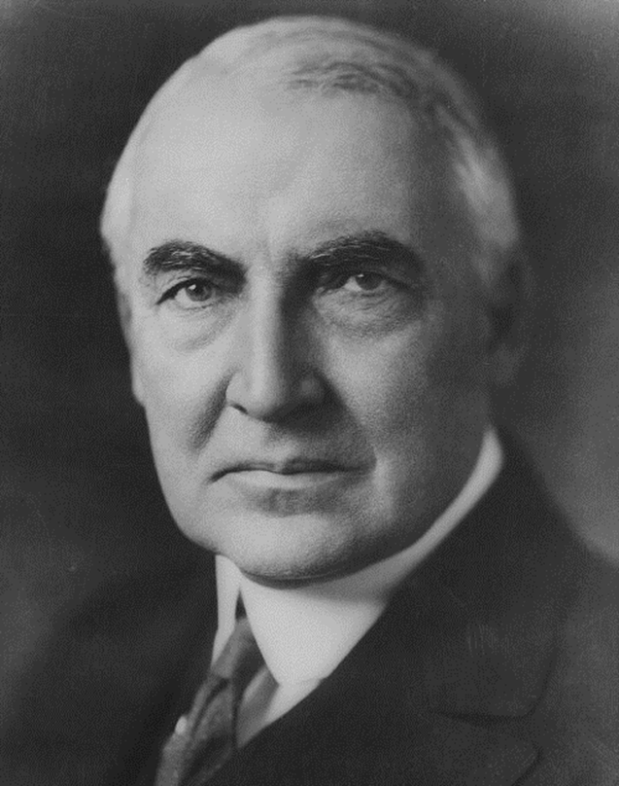
Warren g. harding
Wins 1920 Election
Republican
Outgoing personality
Pro-Business Policy
Less government in business and more business in government
Known for the multiple scandals that took place
Dies in office

Slide 4
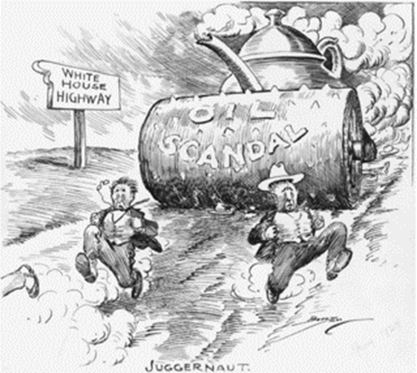
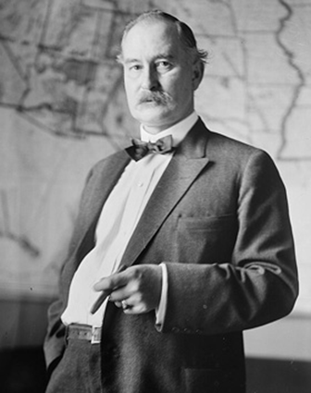
Teapot dome scandal
Harding Administration
Albert Fall – Secretary of the Interior
Gained control of the Naval oil reserves
Granted private leases
Received bribes
personal loans
cash
cattle
Went to jail

Slide 5
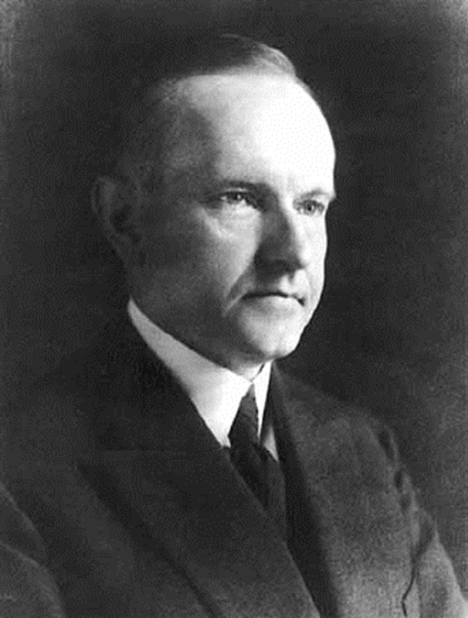
Calvin coolidge
1924 Election-Republican candidate
Took office after Harding’s death
“Silent Cal”
Harding’s Policy = Pro-Business Position
Cautious spending
Support laws that help “big business”
Anti-farmers and workers
Supporting them would only hurt the economy
Decided not to run in the 1928 Election
Believed that being president was too much work.

Slide 6
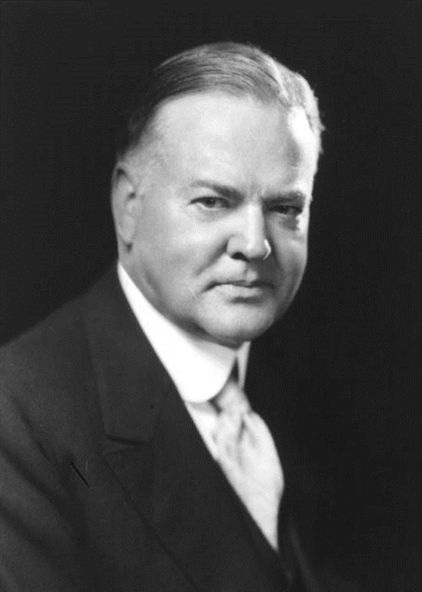
Herbert hoover
Wins 1928 Election
Republican
Well-liked
October 1929
Stock Market Crash
Great Depression Begins
1933
Dust Bowl hits the Mid-west
Was blamed for the problems that Americans were facing – a scapegoat

Slide 7
Section 10
THE STOCKMARKET CRASHES

Slide 8
Playing the stock market
Quick way to make and lose money
Just like gambling or playing a game of chance: you never really know how long your luck will last
The stock market is linked to the economy and reacts just like a rollercoaster
Up = strong economy & strong market prices
Down = weak economy (recession or depression) & low market prices

Slide 10
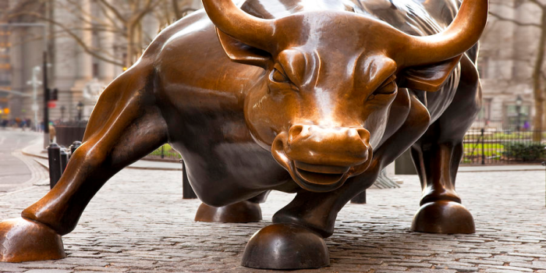
Bull Market
Prices of stock are increasing
Best time to sell stock to make profit
Bear Market
Prices of stock are decreasing
Best time to buy stock in hopes that the market will rebound soon

Slide 11
A booming market
Longest and strongest running bull market to date during the 20s
No one was afraid of the possible return of a bear market
People sold their stocks as quickly as they had bought them
Making quick cash virtually overnight

Slide 12
MARGIN BUYING
Buying stocks on credit (i.e. borrowed money)
Very risky
Would only work during a Bull Market
If the market shifted from Bull to Bear the stocks would become worthless
Stocks were never bought with actual cash so the stocks had no cash value
Economists warned of a possible market crash
Most people did not listen and kept buying
Smart people sold their stocks and got out

Slide 13
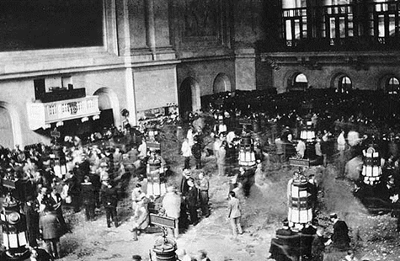
BLACK THURSDAY
October 24, 1929
Market takes a downward turn
Nervous investors begin to sell their stocks
Interest rates rose on credit
The high volume of stocks being sold made others lose confidence in the market and began to sell as well
Stock prices fell hard and fast
Everyone began to get rid of their stocks

Slide 14
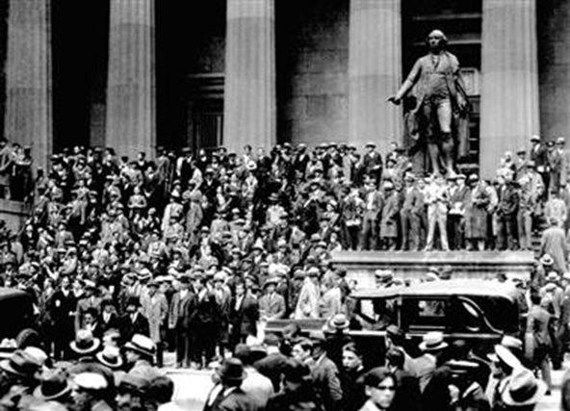
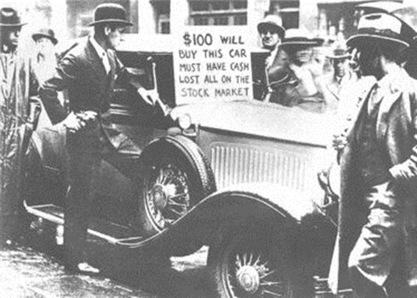
BLACK TUESDAY
Wealthy investors begin to buy stocks at low prices hoping that the market would recover
When the market didn’t recover, they sold their stocks
October 29, 1929
Stock prices fell even lower than on Black Thursday
The stock market crashes giving way to the Great Depression

Slide 16
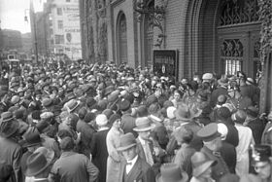
RUN ON THE BANKS
Starts in the 1930s when people realized that the stock market and economy was not rebounding
In response, the banks started to increase interest rates and not give loans.
Housing foreclosures began
People began to withdraw all of their money from the banks causing wide-spread panic
Ultimately the banking system would crash resulting in many banks closing their doors.

