Slide 1
SECTION 7
IMPORTANT COURT TRIALS

Slide 2
Religious Fundamentalism
A belief where traditional Christian doctrine should be accepted without question
Every story in the Bible is true
Attacked all “liberal” Christians who accepted modern scientific theories
Accepting modern scientific theories:
Weakened people’s faith
Led to the decline of good morals in society

Slide 3
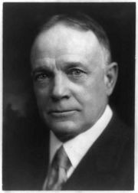
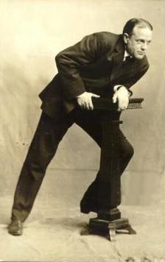
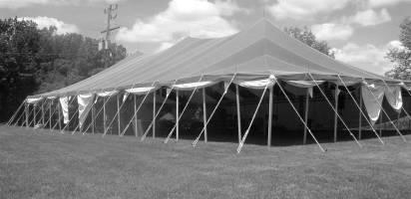
“Tent Revivals”
Billy Sunday used tent revivals and targeted small rural communities.
Midwest
South
Preached about the evils of dancing, card playing, and drinking

Slide 4
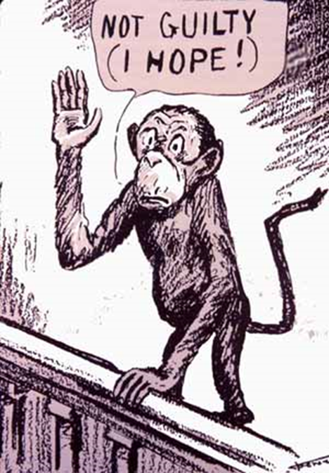
THE SCOPES TRIAL
Tennessee
Outlawed teaching of modern scientific ideas in schools
John Scopes was teaching evolution
Religious Fundamentalist v. Modern Science
Case was known as the “Monkey Trial”
The trial is questioning - “Did man come from monkeys?”
Scopes lost had to pay a $100 fine

Slide 5
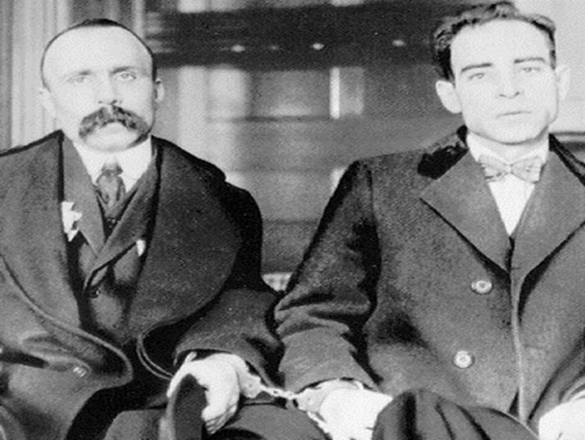
SACCO AND VANZETTI
Italian Immigrants and Members of:
Communist Party
Anarchists
Had prior criminal records
Accused of plotting to blow up places of wealthy Americans for supporting deportations of Italians
Convicted on circumstantial (coincidence) evidence
Found guilty and sentenced to death by electrocution
Came down to 2 minorities being in the wrong place at the wrong time

Slide 6
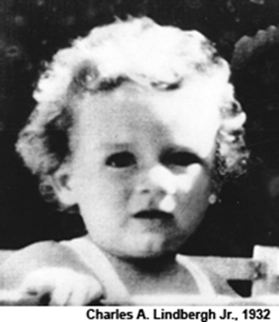
LINDBERGH KIDNAPPING
March 1, 1932
Charles Lindbergh’s only son is kidnapped from his nursery
A ransom note demanding $50,000 is found.
There would be 12 notes in all, each one increasing the amount
Up to $120,000

Slide 7
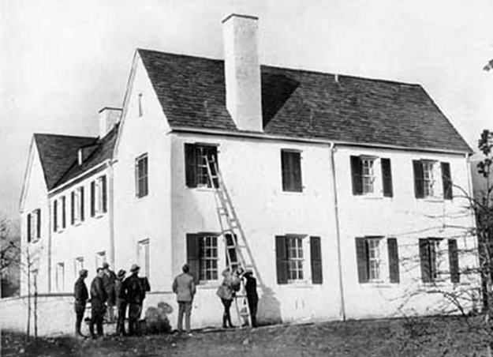
Only evidence found:
Muddy footprints in the nursery
A rickety old ladder
$40,000 of the ransom was paid out in the form of “Gold Certificates”

Slide 8
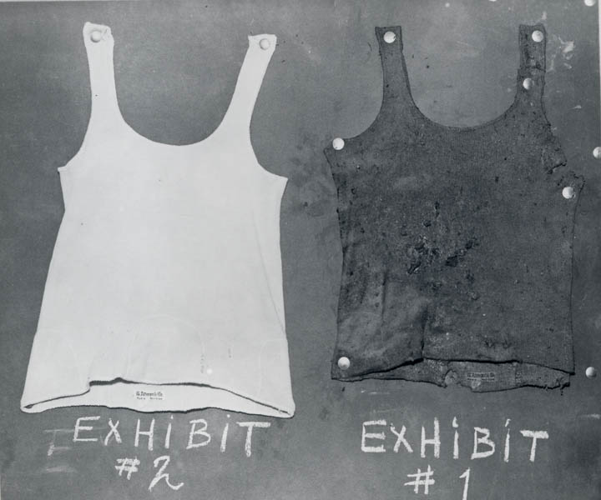
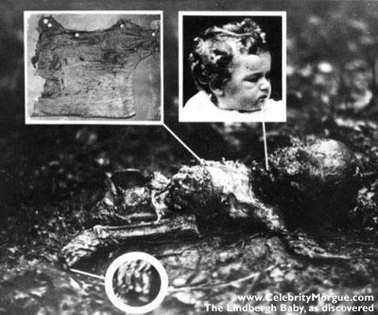
May 12, 1932
The baby’s body was found
Partly buried and badly rotted
About 4 miles from the Lindbergh home
The head was crushed
Some fingers & toes missing
Doctors said that the child had been dead about 2 months

Slide 9
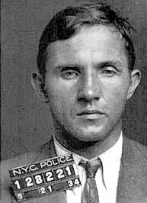
August 20, 1934
The gold certificates begin to turn up in New York city
September 15, 1934
A $10 Gold Certificate was used to buy gas
The clerk wrote down the license plate
It belonged to Bruno Richard Hauptmann
The FBI begin to watch him closely
February 13,1934,
Hauptmann is convicted and sentenced to die.
April 3,1936
Is electrocuted in New Jersey State Prison

Slide 10
SECTION 8
PROHIBITION

Slide 11
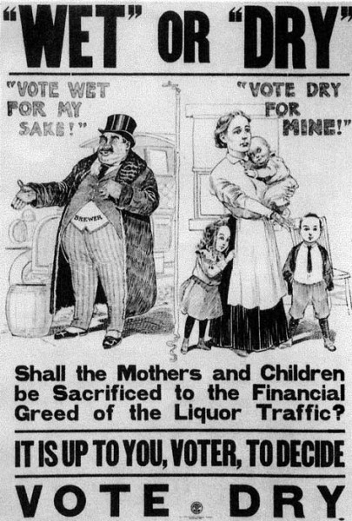
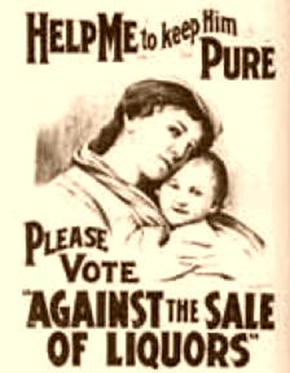
THE EVILS OF ALCOHOL
Progressive reformers blamed alcohol as the reason for:
Family violence
Poverty
Crime

Slide 12
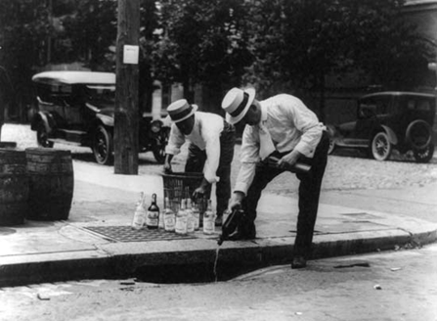
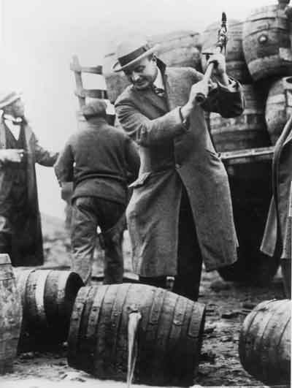
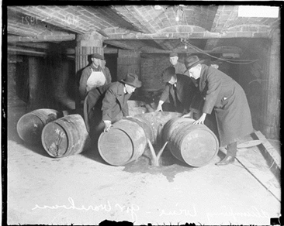
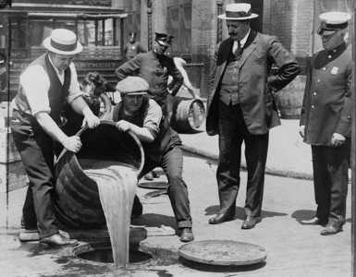
18TH AMENDMENT
Passed January 1919
Prohibition made alcohol illegal in the United States
Americans could no longer make, sell, buy, or drink alcohol
Known legally as the Volstead Act

Slide 13
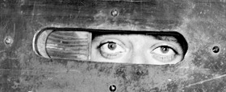
THE PEOPLE’S REACTION
The Volstead Act was not popular and was widely ignored
Many Americans broke the law by…
Made their own alcohol at home
“Bathtub Gin"
Went to underground clubs that sold alcohol
Known as “Speakeasies”
Password needed to get in

Slide 14
RISE OF ORGANIZED CRIME
Bootlegging - the illegal business of transporting (smuggling) alcohol
Would primarily smuggle alcohol from Canada and Mexico into the U.S.
Became a profitable business during prohibition
Criminal Gangs controlled the smuggling and distribution of alcohol
All major cities had organized crime that was controlled by a “mob boss”

Slide 15
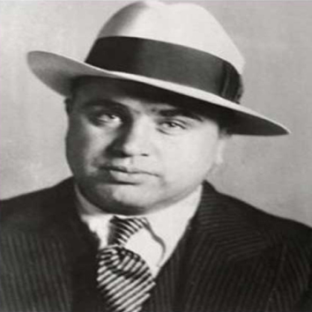
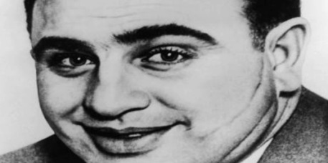
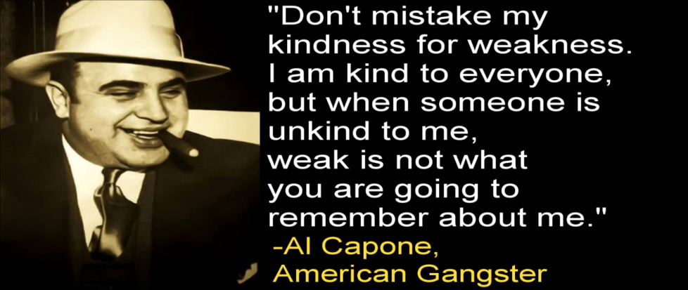
ALPHONSE ‘AL’ CAPONE
a.k.a. Scarface
Political boss of Chicago
Controlled the most successful alcohol trade in the country
Said to have ordered numerous hits
Identified as the “face” of Organized Crime
Busted for Tax Evasion
Died of Syphilis

Slide 16
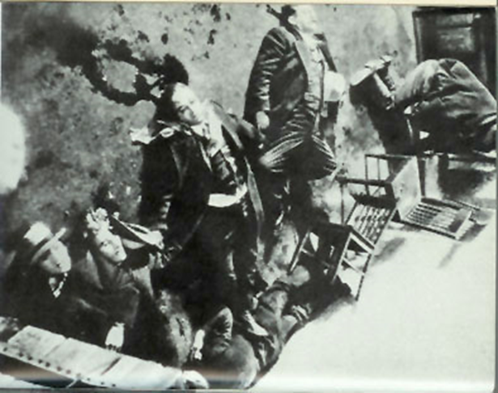
ST. VALENTINES DAY MASSACRE
Feb. 14, 1929 – Chicago, IL
George “Bugs” Moran’s north side gang was working their main liquor headquarters
2 men walked in dressed as policemen
The 7 men working thought it was a raid and dropped their guns
Using 2 shot guns and 2 machine guns, Capone’s men shot more than 150 bullets
6 of Moran’s men and 1 unlucky friend were killed

