Slide 1
SECTION 5
THE HARLEM RENNAISSANCE

Slide 2
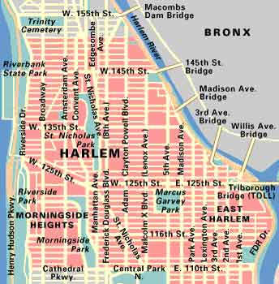
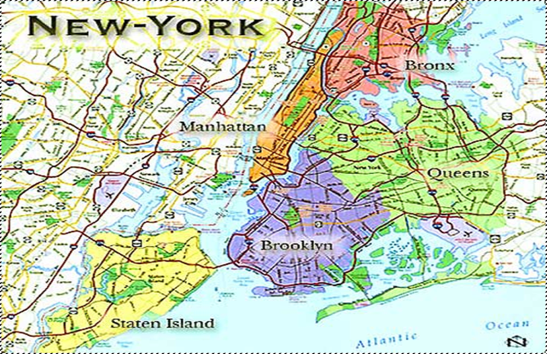
HARLEM – NEW YORK CITY
Neighborhood located on Manhattan Island
Predominately a black community since 1905

Slide 3
A CELEBRATION OF CULTURE
1920 – mid 1930s
The Harlem Renaissance was a literary, artistic, and intellectual movement
Created a new black cultural identity that included:
Group expression
Self determination
Racial pride

Slide 4
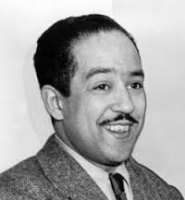
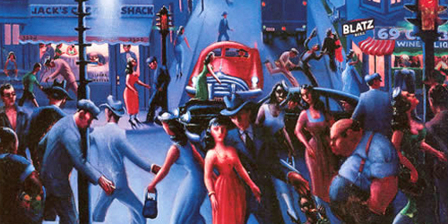
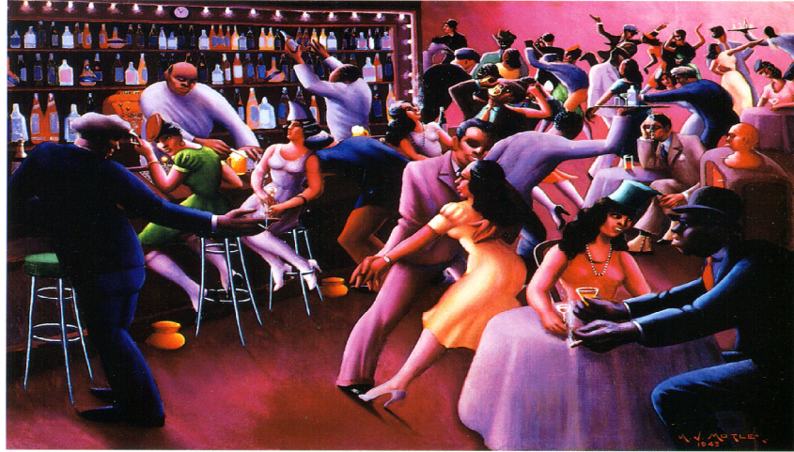
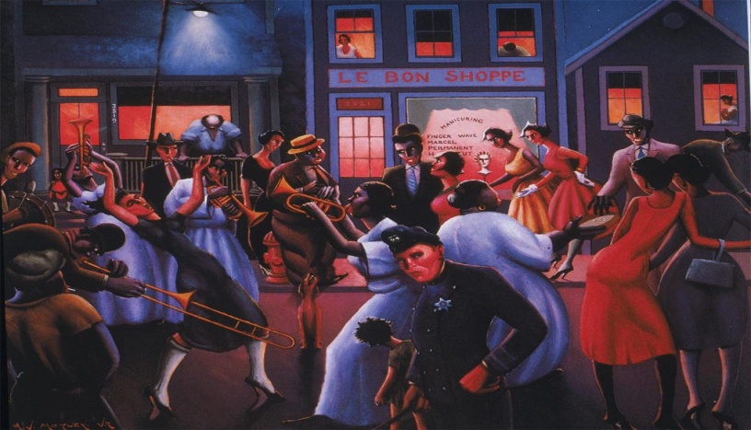
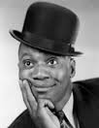
NOTABLES
Langston Hughes
Author, poet, & intellectual
Bill ‘Bojangles’ Robinson
Movie & Broadway dancer
W.E.B. DuBois
Intellectual
Archibald Motley
Painter

Slide 5
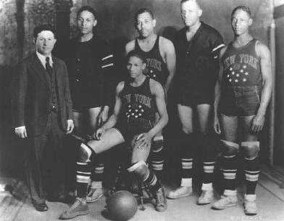
HARLEM GLOBETROTTERS
1929 – Present
Competitive exhibition team
Started in Chicago 1927
Moved to Harlem for the 1928-1929 season

Slide 6
SECTION 6
JAZZ AND BLUES MUSIC

Slide 7
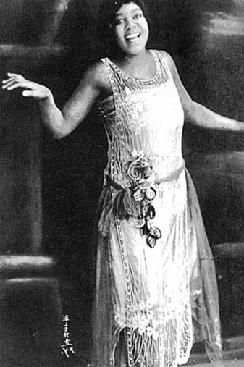
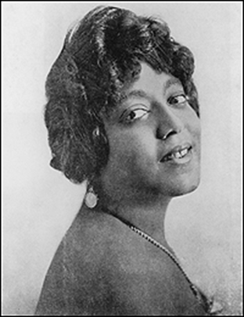
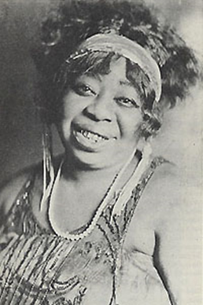
THE BLUES
Style
Mixture of slave music and religious spirituals
Featured heartfelt lyrics and slurred notes that matched the mood of the lyrics
Started in the South
Described the feelings and lives of blacks living in a racial South
Moved North with the Great Migration
Was incorporated into the Jazz style by Louis Armstrong

Slide 8
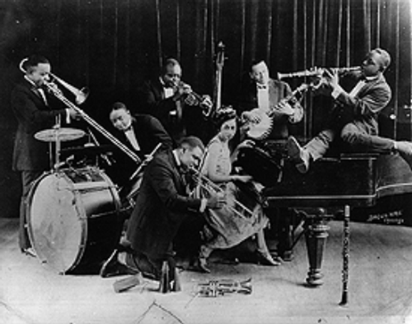
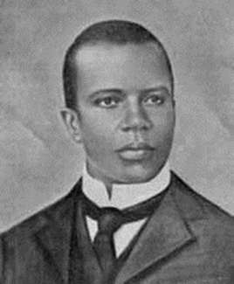
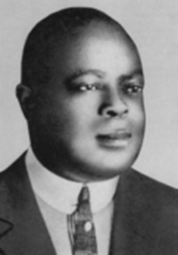
JAZZ MUSIC
Style
Mixture of West African rhythms, Afro-American spirituals, Ragtime, European harmonies
Ragged or improvised tunes
Sometimes mixed with the blues style
Started in the South
Early 1900s
New Orleans, LA
Big Brass Band
Scott Joplin – Ragtime Music Style
Joseph “King” Oliver
Moved North with the Great Migration
Northern Artists take a lot of the Jazz sound into their music, creating “Swing”.

Slide 9
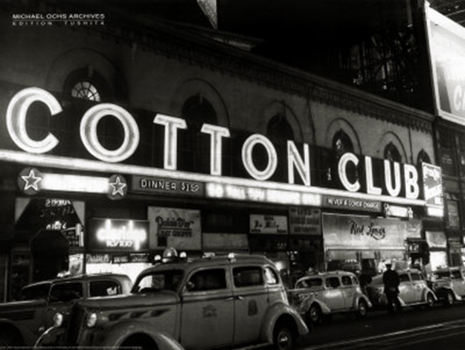
COTTON CLUB
Located in the neighborhood of Harlem
Focal point for Afro-American music artists
Because of racism, most clubs were “whites only”
Even if they were located in Black neighborhoods w/ Black performers
Many artists went to Europe to perform and were widely accepted
Creating a “Jazz age” especially in Paris

Slide 10
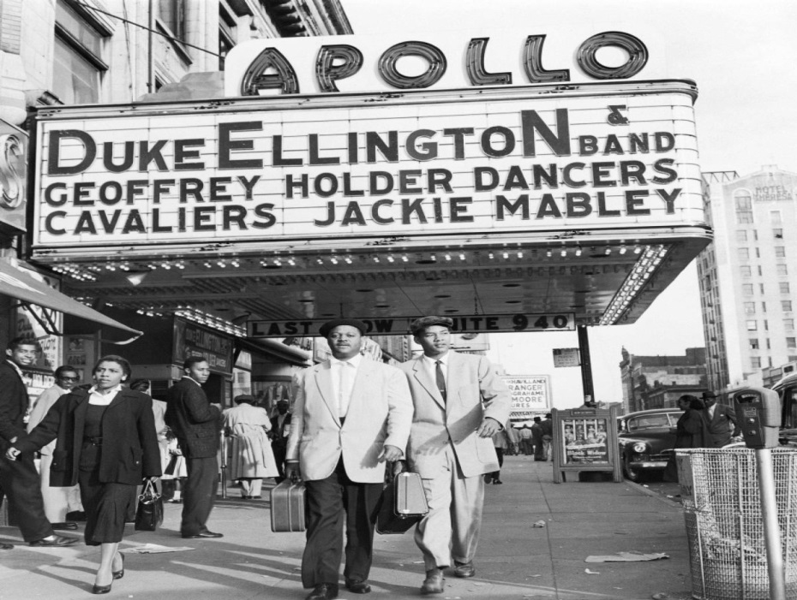
APOLLO THEATER
Located in the Harlem neighborhood
A noted venue for African-American performers
Starting point for many famous black musicians
Originally a whites-only venue

Slide 11
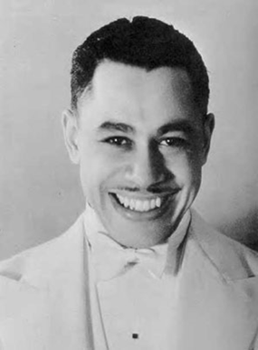
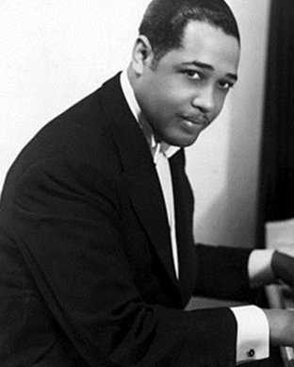
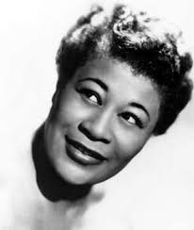
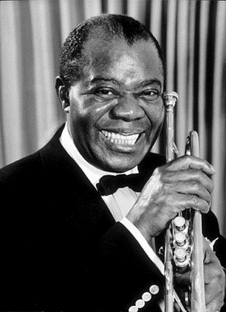
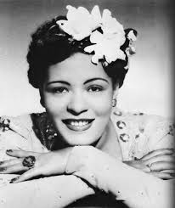
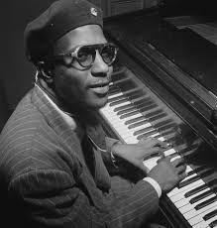
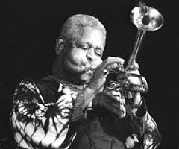
NOTABLES
Musicians
Duke Ellington
Thelonious Monk
Louis Armstrong
Dizzie Gillespie
Singers
Cab Calloway
Ella Fitzgerald
Bessie Smith
Billy Holiday

