Slide 1
UNIT 2 – CRIMINAL LAW
Section 4: Serving Time & Prison Life

Slide 2
Minimum Security
Prisoners are considered to pose little physical risk to the public and are mainly non-violent "white collar criminals".
Prisoners live in less-secure dormitories, which are regularly patrolled by correctional officers.
Prisoners have communal showers, toilets, and sinks.
A minimum-security facility generally has a single fence that is watched, but not patrolled, by armed guards.
At facilities in very remote and rural areas, there may be no fence at all.
Prisoners may often work on community projects, such as roadside litter cleanup with the state department of transportation or wilderness conservation.
Many minimum security facilities are small camps located in or near military bases, larger prisons (outside the security perimeter) or other government institutions to provide a convenient supply of convict labor to the institution.
Many states allow persons in minimum-security facilities access to the Internet.

Slide 3
Medium Security
Prisoners may sleep in dormitories on bunk beds with lockers to store their possessions.
They may have communal showers, toilets and sinks.
Dormitories are locked at night with one or more correctional officers supervising.
There is less supervision over the internal movements of prisoners.
The perimeter is generally double fenced and regularly patrolled.

Slide 4
Close Security
Prisoners usually have one- or two-person cells operated from a remote control station.
Each cell has its own toilet and sink.
Inmates may leave their cells for work assignments or correctional programs and otherwise may be allowed in a common area in the cellblock or an exercise yard.
The fences are generally double fences with watchtowers housing armed guards, plus often a third, lethal-current electric fence in the middle.

Slide 5
Maximum Security Prison
All prisoners have individual cells with sliding doors controlled from a secure remote control station.
Prisoners are allowed out of their cells one out of twenty four hours. When out of their cells, prisoners remain in the cell block or an exterior cage.
Movement out of the cell block or "pod" is tightly restricted using restraints and escorts by correctional officers.

Slide 6
Supermax Facilities
Provide the highest level of prison security.
These units hold those considered the most dangerous inmates, as well as inmates that have been deemed too high-profile or too great a national security risk for a normal prison.
Include inmates who have committed assaults, murders, or other serious violations in less secure facilities, and inmates known to be or accused of being prison gang members.
Most states have either a supermax section of a prison facility or an entire prison facility designated as a supermax.
23-hour confinement and abridged amenities for inmates

Slide 7
Solitary Confinement
A special form of imprisonment in which a prisoner is isolated from any human contact, though often with the exception of members of prison staff.
Sometimes employed as a form of punishment beyond incarceration for a prisoner and has been cited as an additional measure of protection from the inmate.
This form of punishment is also given for violations of prison regulations.
It is also used as a form of protective custody and to implement a suicide watch.

Slide 8
Protective Custody
A type of imprisonment (or care) to protect a person from harm, either from outside sources or other prisoners.
Many administrators believe the level of violence, or the underlying threat of violence within prisons, is a chief factor causing the need for PC units.
Prisoners have the opportunity to request protective custody if they get the impression that the environment they are living in is harmful to their well being.
Their request may be granted if the officials rule that the prisoner is truly at risk.
Protective custody might simply involve putting the person in a secure prison (if the threat is from the outside), but usually protective custody involves some degree of solitary confinement.
For people who are threatened because of their association with a certain group, moving them to another section of the prison may be sufficient.

Slide 9
Rehabilitation & Re-entry to Society
Second Chance Act
Authorizes $165 million in spending per year on:
Schooling and drug treatment inside prison
Aid with housing, employment and the building of family and community ties after release.
elderly offender early release program
Why?
states cannot afford to keep building more prisons
concern for the victims of repeat offenders and for the wasted lives of the offenders themselves
about 40% of all federal prisoners released will reoffend

Slide 10
Elderly Offender Early Release Program
To qualify for early release, federal prisoners must meet ALL of these criteria:
Be at least 60 years old
Be serving a sentence that is not a life sentence and that is not for a crime of violence, sex offense, terrorism offense, or espionage offense
Has served 10 years or 2/3 of the sentence in prison, whichever is longer
Has no prior state or federal convictions for a crime of violence, sex offense, terrorism offense, or espionage offense
Has, in the Bureau of Prison’s sole discretion and determination, no history of violence or history of conduct that would constitute one of the offenses listed above
Has never escaped or attempted to escape from federal prison
Is not, in the Bureau of Prison’s sole discretion and determination, a danger to the public AND
Would be less expensive to supervise on home confinement than to incarcerate in a federal prison.

Slide 11
“Good Time”
Good conduct time, good time credit, or time off for good behavior is a sentence reduction given to prisoners who maintain good behavior while imprisoned.
Good time can be forfeited if a prisoner is determined to commit disciplinary infractions and/or crimes while incarcerated.
Under U.S. federal law, prisoners serving more than one year in prison get 54 days a year of good time for every year they serve.
Prisoners who demonstrate good behavior serve only about 87.1% of their total sentences.

Slide 12
Parole
Release of a convicted person from prison before the entire sentence has been served.

Slide 13
Probation
The status of a convicted person who is given some freedom on the condition that for a specified period he or she act in a manner approved by a special officer to whom the person must report.
Offenders who are put on probation are typically required to adhere to a number of "conditions of probation," including:
Obey all laws (even petty laws like jaywalking have been known to land a probationer back in jail).
Abide by any court orders, such as an order to pay a fine or restitution.
Report regularly to the probation officer.
Report any change of employment or address to the probation officer.
Abstain from the excessive use of alcohol or the use of any drugs.
Submit to regular alcohol or drug testing.
Refrain from travel outside of the jurisdiction without prior permission of the probation officer.
Avoid certain people and places.
If a probation violation is discovered and reported, it is likely that the court will conduct a probation revocation hearing.

Slide 14
Corrections
Community corrections
Boys Town
Halfway houses
Jails
Prisons
Overcrowding?
Too many conveniences?
Price = $$$?

Slide 15
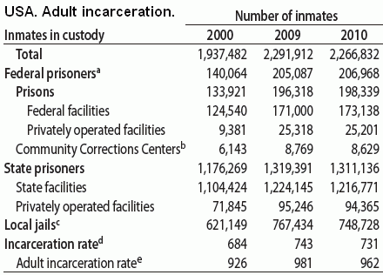
Statistics http://www.bop.gov/about/statistics/ http://www.sentencingproject.org/map/map.cfm

Slide 16
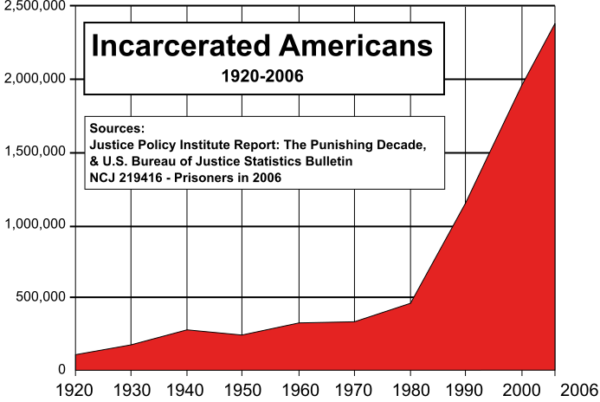

Slide 17
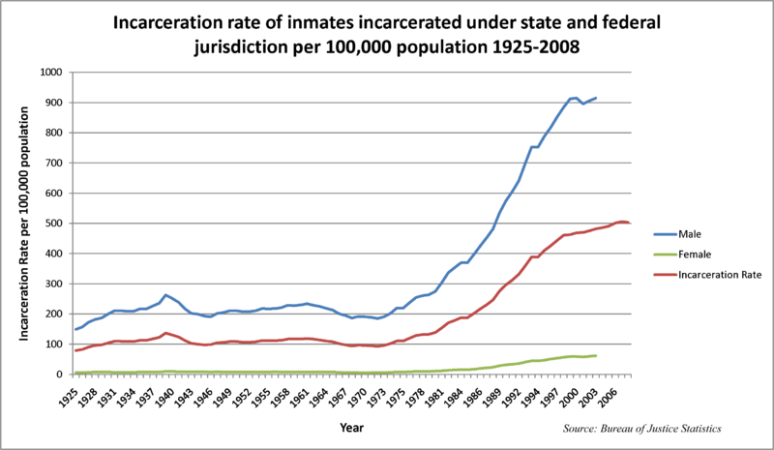

Slide 18
2002 study showed that nearly 275,000 prisoners released in 1994, 67.5% were rearrested within 3 years, and 51.8% were back in prison
Those serving the longest time, 61 months (5 years) or more, had a slightly lower re-arrest rate (54.2%) than every other category of prisoners.
From 2000 - 2008, the state prison population increased by 159,200 prisoners, and violent offenders accounted for 60% of this increase
From 2000 – 2008 the number of drug offenders in state prisons declined by 12,400
In 2007, around $74 billion was spent on corrections.
Jailing an individual costs an average of $60 a day nationally
Housing the approximately 500,000 people in jail in the USA awaiting trial who cannot afford bail costs $9 billion a year.
62% of local jail inmates are awaiting trial.
The total number of inmates in 2007 in federal, state, and local lockups was 2,419,241. That comes to around $30,600 per inmate

Slide 19
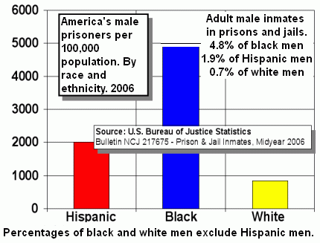
Ethnicity | Male | Female | Total
White non-Hispanic | 678 | 91 | -
Black non-Hispanic | 4,347 | 260 | -
Hispanic of any race | 1,775 | 133 | -
All inmates | 1,352 | 126 | 732

Slide 20
Federal Prisoners Since 1950

Slide 22
