Slide 1
SECTION 3
YOUTH CULTURE

Slide 2
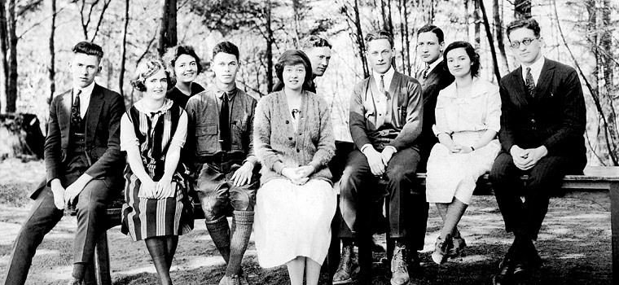
College students
Young people living in rural communities moved to the cities for better opportunities and more adventure.
Number of college students increase

Slide 3
Fashion
Men
Women
Less formal attire
Shorter pant leg cuffed so sock would sometimes show
Sports Clothing
Letter Jackets
Baggy Trousers/Knickers
Caps/Hats
Replicas “Knock-offs” of expensive fashion
Made cheaper through use of different fabric
More comfortable clothing
Shorter skirts
Trouser pants
The “boyish” figure

Slide 4
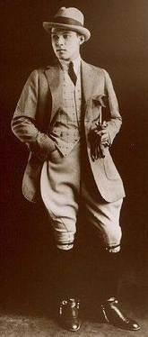
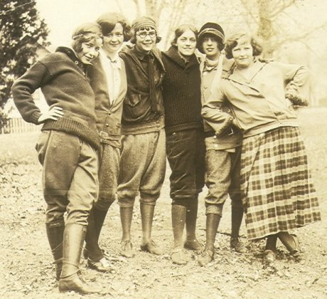

Slide 5
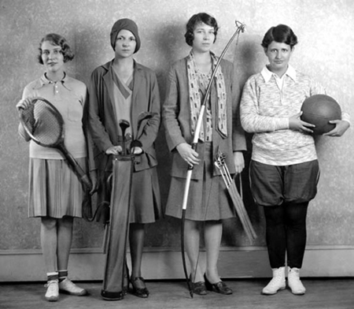
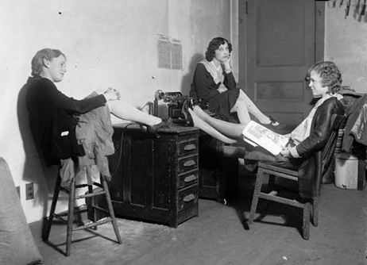
The “new” woman
The “new woman” was career minded, independent, and adventurous
Hair styles became shorter
The “bob”

Slide 6
Flappers
The “new” liberated woman
Would smoke and drink
The Style
Short “bobbed” hair
Long necklaces
Heavy make-up
Revealing dresses
Sheer silk stockings

Slide 7
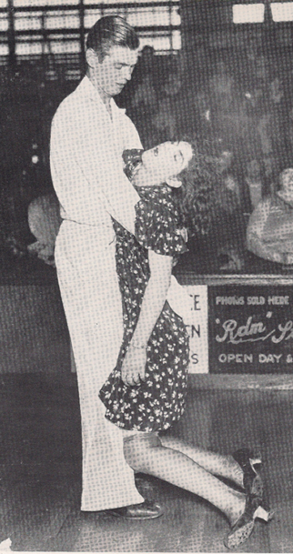
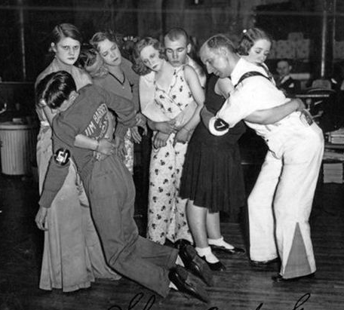
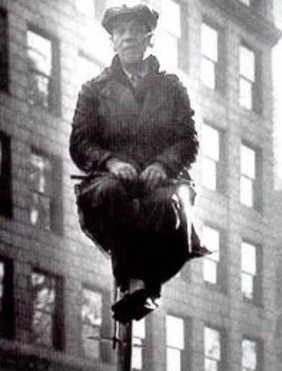
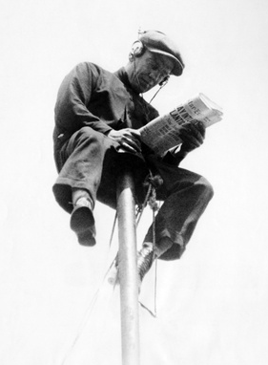
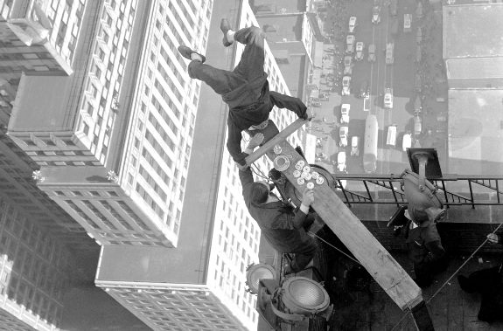
Fads/trends
Flagpole sitting
Dance marathons

Slide 8
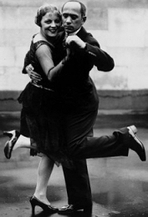
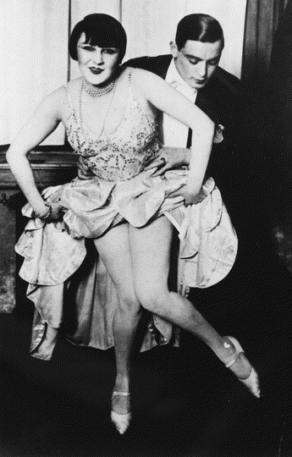
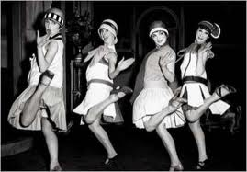
Dance Clubs
Popular place for older youth to hang out at and have fun
Save money up for months to go to dance clubs
Dance Styles
Charleston
Foxtrot
Shimmy

Slide 9
SECTION 4
SPORTS
AND
LIVE ENTERTAINMENT

Slide 10
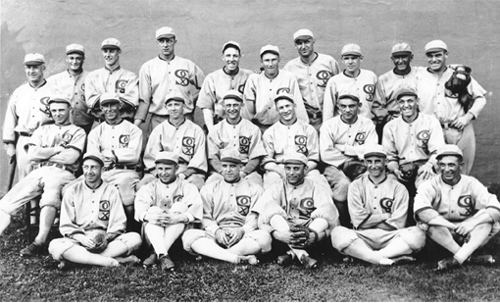
Professional Baseball
Chicago White Sox -1919
“Black Sox” Scandal
Players threw the World Series for money
Judge Landis kicks out the players involved for life

Slide 11
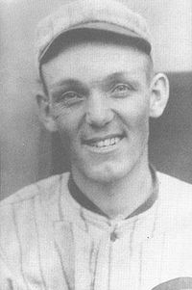
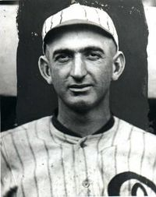
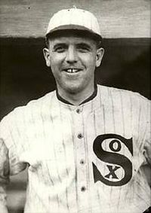
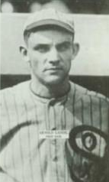
The Players
Joe Jackson
Buck Weaver
Eddie Cicotte
Chick Gandil
“Swede” Riesberg

Slide 12
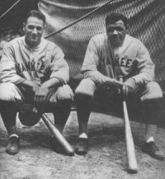
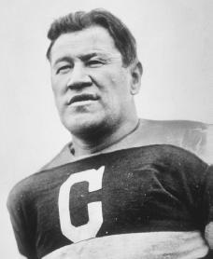
Sports and Sports Legends
Team of the 20s
New York Yankees
Babe Ruth
Ty Cobb
Lou Gerhig
Babe Ruth
Led the NY Yankees to 4 World Series
60 homeruns in 1 season
Jim Thorpe
All-around athlete
Football, basketball, track and field

Slide 13
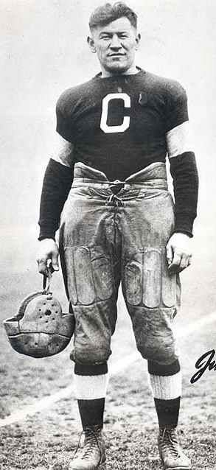
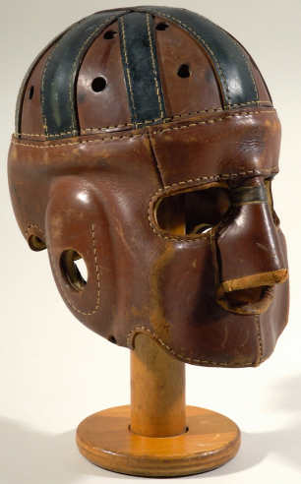
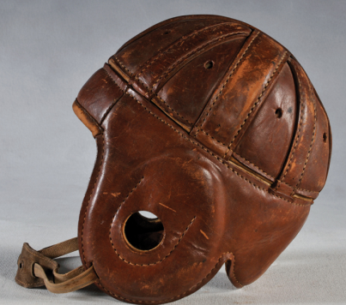
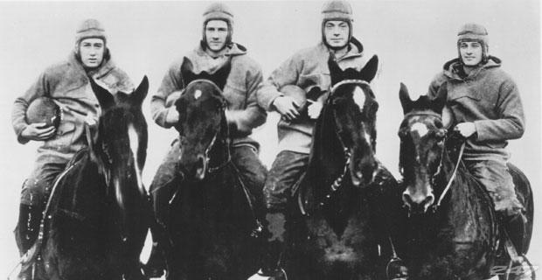
Professional and College Football
College Football
Army v. Navy
Harvard v. Yale
Professional Football
Thanksgiving Day Game -1925

Slide 14
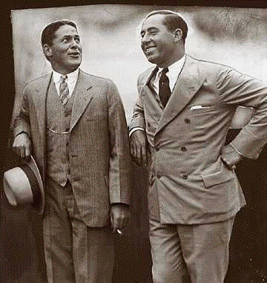
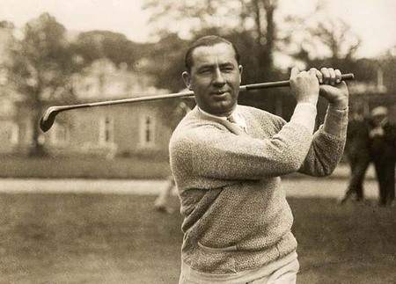
Professional Golf
Bobby Jones and Walter Hagen (Movie: Legend of Bagger Vance)
Brought Professional Golf to the forefront of sports, the sport takes off in popularity
Bobby Jones

Slide 15
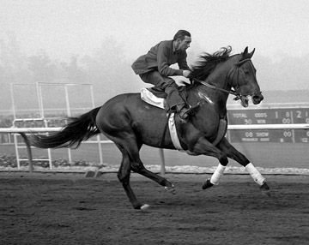
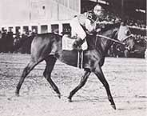
Horse Racing
Horse Jockey: George “Mars” Cassidy
Ak-Sar-Ben in Omaha est. Horse racing (south of UNO)
Sea Biscuit (1930s)

Slide 16
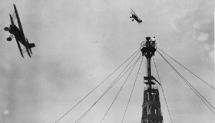
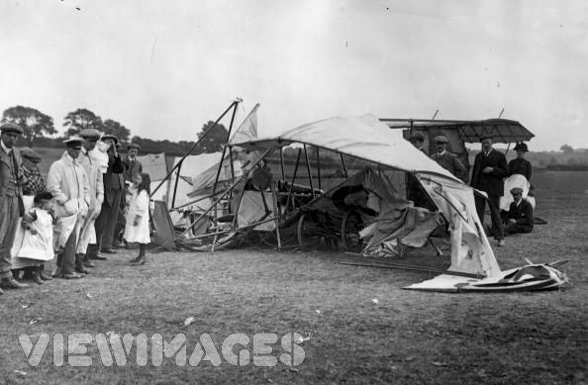
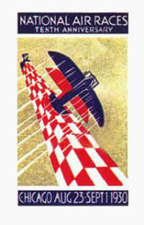
Air Races
World War I pilots
Would compete for prizes
Eddie Rickenbacker
Jimmy Doolittle
Great Crashes!

Slide 17
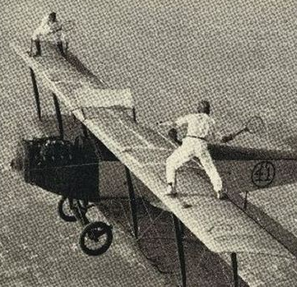
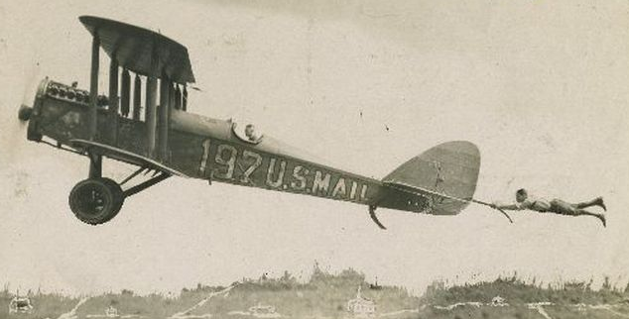
Barnstormers & Dare Devils
World War I pilots would fly around the country giving air shows
Would perform for crowds in farm fields
Insane stunts with no safety harnesses

Slide 18
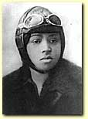
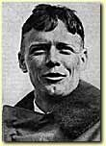
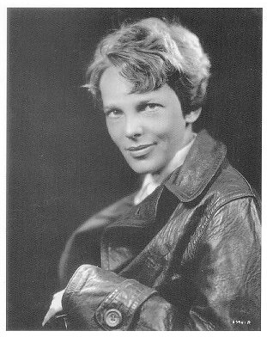
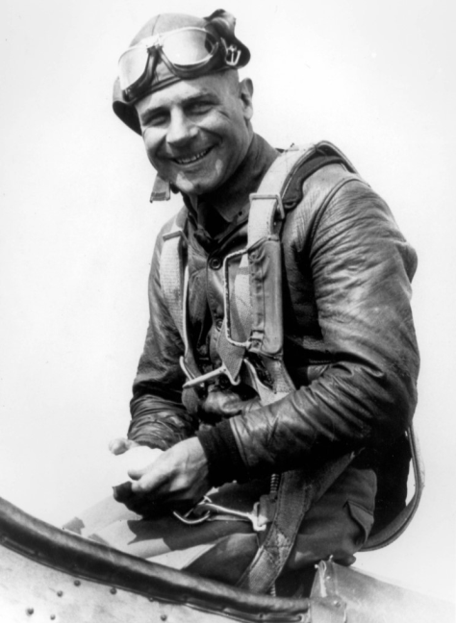
Aviators
Bess Coleman – 1st African Amer. Woman pilot
Charles Lindbergh – 1st man to fly across the Atlantic Ocean: NY to Paris: 33.5 hrs
Amelia Earhart – 1st Woman to fly across the Atlantic Ocean
Jimmy Doolittle – 1st non stop flight across the country: 9 hrs

