Slide 1
UNIT 2 – CRIMINAL LAW
Section 3: Trial Process For Crimes

Slide 2
State Prosecution
The states prosecute most crimes against the person, such as
murders and assaults
and many crimes against property, such as
robberies and thefts

Slide 3
Federal Prosecution
Crimes most frequently prosecuted by the federal government include
drug trafficking offenses
organized crime
financial crimes
large scale frauds and crimes in which there is a special federal interest such as crimes against federal officials, and frauds against the United States
Crimes that only the federal government may prosecute include
customs offenses
offenses involving federal tax matters
crimes of espionage and treason

Slide 4
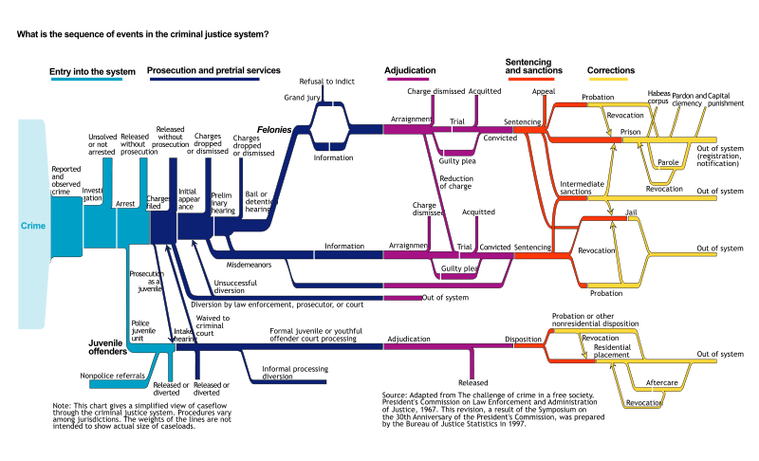

Slide 5
Proceedings

Slide 6
Before the Trial
Booking – formal process of making a police record of
the arrest
Name
Address
Date of birth
Place of employment
Details about any previous arrests
Finger printed and photographed
Other
Fingernail clippings
Handwriting specimens
Blood samples
Urine tests

Slide 7
Initial appearance before a judge/magistrate
Judge explains defendant’s rights
Explains the exact nature/reason of the charges
Attorney is appointed/obtained
Judge may set bail
Misdemeanor Case
Defendant enters a plea of guilty or not guilty
Felony Case
Plea is entered at the arraignment
The most important part of the initial appearance is deciding whether the defendant will be released from custody and under what conditions.

Slide 8
Pretrial Release
8th Amendment – excessive bail shall not be required
Bail – released from custody after putting up an amount of money
Paid directly to the court
Entire amount
Percentage (i.e. 10%)
Personal Recognizance – defendant must promise to return and must be considered a low risk
Nature/circumstance of offense
Family and community ties
Financial resources
Employment background
Prior criminal record

Slide 9
Information Gathering
Misdemeanor Cases
Most states will proceed to trial based on the prosecutor's information (details the nature and circumstances of the charge)
Not entitled to a preliminary hearing or grand jury review
Felony Cases
Most states use a preliminary hearing instead of the information system

Slide 10
Preliminary Hearing
Judge
Determines if there is enough evidence to require the defendant to stand trial
Proceed to trial
Dismiss the case
Prosecutor
Required to establish that a crime has been committed and that the defendant probably did it.
Defendant’s attorney
Allowed to cross-examine the prosecutor’s witnesses
Call favorable witnesses on behalf of the defendant

Slide 11
Grand Jury
Group of 16-23 people
Determines if there is sufficient cause to believe that a person has a committed a crime and should be made to stand trial.
Indictment – formal charge of criminal action
Prosecutor
Presents evidence to convince grand jury members that a crime has been committed and that there is probable cause that the defendant did it.
Defendant and Attorney
Can not appear before the grand jury
Judge
Is not present and rules of evidence do not apply

Slide 12
Arraignment and Pleas
Arraignment takes place after an indictment has been made or information issued
Defendant must enter a plea
Guilty = date is set for sentencing
Not Guilty = date is set for trial
Jury trial
Trail before the judge only (“bench trial)
No Contest (equivalent to pleading guilty)
Does not admit guilt, but does not contest the charges
Evidence cannot be used in later civil trial for damages based on the same set of facts
No trial = proceeds directly to sentencing

Slide 13
Pretrial Motions: The Exclusionary Rule
Formal request that a court make a ruling or take some other action
Motion for discovery of evidence
Examine certain evidence in the possession of the prosecutor before the trial starts
Motion for continuance
Request more time to prepare the case
Motion for change of venue
Request to change location of trial
Motion to suppress evidence
Request that certain evidence not be allowed to be presented

Slide 14
Plea Bargaining
Negotiation between the accused, the defense attorney, and the prosecutor
Granting certain concessions to the defendant in exchange for a plea of guilty
Less serious charge
Recommend a lighter sentence
Judge must decide
Was decision made freely, voluntarily, and with knowledge of all the fact

Slide 15
The Trial

Slide 16
Right to Trial by Jury – 6th Amendment
Jury is not used
Guilty pleas
Certain minor offenses
Less than 6 months in prison
Waive
Defendants can give up their right to a jury trial and instead have their case heard by a judge

Slide 17
Jury Members
Selected from…
Voter registration
Tax lists
Drivers’ license roll
Represent the community
Size
Federal courts = 12 members
Supreme court require at least 6 members
U.S. Supreme Court = 9 members

Slide 18
Speedy Trial
Case can be dismissed
Defendants often waive their right to a speedy trial
More time to prepare for the case
Key witness might be unavailable

Slide 19
Establishing Witnesses
Defendants in a criminal case have a right to compulsory process for obtaining witnesses
Subpoena – court order requiring a witness to appear in court to testify
Right to confront
Be face-to-face with the witnesses against them
Contempt of Court – against court rules
Removed from the court room/restrained
Warrant for arrest

Slide 20
Appeal Process
Defendants who believe that they have been wrongly convicted can ask for a mistrial
Ask for a new trial
Very seldom accepted
Appeal to a higher court to review the case
Can challenge the conviction or sentencing

Slide 21
Sentencing and Corrections

Slide 22
Options
Suspended Sentence
Not served at time it is imposed
May serve time later if rearrested on other charges or violate probation
Probation
Released to the supervision of a probation officer after agreeing to certain conditions
Home Confinement
Fine
Restitution
Pay back or make up for whatever loss or injury was caused
Work Release
Allowed to work in the community but return to prison at night or weekends
Imprisonment
Death

Slide 23
Purpose of Punishment
Retribution
Punishment for breaking the law
Deterrence
Discourages the offender from committing another crime in the future
Rehabilitation
Help change behavior
Incapacitation
No longer poses a threat to society

Slide 24
Capital Punishment
a.k.a. – death penalty
Electrocution
Lethal Injection
Gas Chamber
Firing Squad
Hanging
1630 – first execution for murder in America
1972 – first time in which the death penalty was found unconstitutional by the U.S. Supreme Court

Slide 25
Circumstances for Capital Punishment
Aggravating circumstances
Factors that suggest a more severe punishment is appropriate
Gruesome murder
Crimes involving children
Previous convictions
Mitigating circumstances
Factors that suggest a less severe punishment is appropriate
History showing that the victim had previously abused the defendant
Defendant’s age
No prior criminal record

Slide 26
2001 U.S. Department of Justice
3,581 prisoners sentenced to death.
1,969 were Caucasian
358 were Hispanic
1,538 were African American
28 were Native American
33 were Asian
13 were classified as “other race”
51 were women
2 in 3 had prior felony convictions
1 in 13 had prior homicide convictions
The average education attained was 11th grade
The average age at the time of arrest was 28 (about 13% were 19 years old or younger at the time of their arrest)
The youngest person on death row was 19, and the oldest was 86

