Slide 1
SECTION II
Sources of Authority and Structure
(Types of Government)

Slide 2
Monarchy
Absolute
King/Queen have almost complete power.
Hereditary Position
Right to rule passes from one generation to the next
Divine Right
Power to rule was given by god
Constitutional
King/Queen is a ceremonial head of state.
Real power lies in another part of the government.

Slide 3
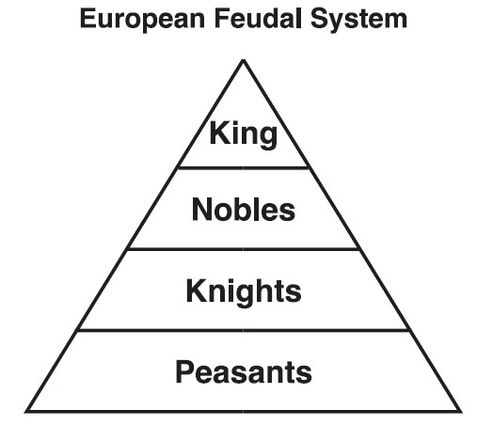
Feudalism
Rule of local lords bound to a monarch by loyalty.
Hierarchy system based on level of command/power a person has

Slide 4
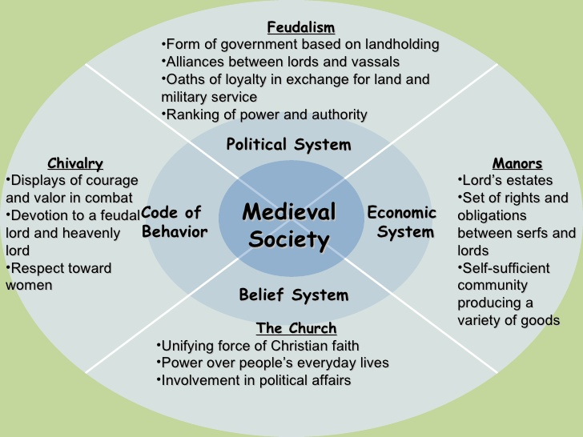

Slide 5
Republic
A nation in which supreme power rests with the citizens and is exercised by their elected representatives
i.e. President, Senators, House of Representatives, Governor, Mayor, City Council, and Board of Education

Slide 6
Democracy
A system of government in which citizens exercise supreme power, acting either directly on their own or through elected representatives.

Slide 7
Dictatorship
Power is concentrated in the hands of a single person or a small group of people. Power is maintained through force by controlling the police and military.
Autocracy – rule by one
Most common form of dictatorship
Oligarchy – rule by a few
i.e. top military generals or the wealthy elite
Totalitarian – control all aspects of citizen’s lives
political, religious, social, cultural, & personal

Slide 8
Theocracy
A form of government in which a state is governed by the divine guidance (God) provided to religious leaders
God is recognized as the head of the state.
i.e. Vatican City, Tibet, Iran, and the Taliban

Slide 9
Bureaucracy
A large, complex organization that functions under uniform rules and procedures through bureaus or departments staffed with nonelected officials.
Chain of command
i.e. universities, military, private businesses, government offices, etc.

Slide 10
Economic Structure within Governments

Slide 11
Fascism
A totalitarian system in which businesses remain in private hands but under government control

Slide 12
Nazism
A form of totalitarianism and type of fascism, based in part on the myth of racial superiority.

Slide 13
Communism
A system of government in which a single political party controls both the government and the economy
Develop a classless society

Slide 14
Socialism
An economic system that calls for public ownership of the means of production

Slide 15
Capitalism
An economic system in which individual investors, or capitalists, privately own the means of production; also known as a free enterprise system.

