Slide 1
UNIT I
Historical Influences on American Government

Slide 2
Section i
Role of Government

Slide 3
What is Government?
Definition
an establishment with the power to make and enforce rules for a group of people living in a political unit or state.
Purpose
Governments make and enforce laws for the public good
Protect the interests of the people

Slide 4
Functions of Government
Maintaining order
Providing Services
Resolving Conflict
Promoting values

Slide 5
Origins of Government
Prehistory
Cavemen
Nomadic tribes
Ancient History
Egyptians
Human Gods
Greeks
Aristocracies
City-states
Direct Democracy
Romans
Representative Government
Republic
Senate
Medieval History
Christianity
Divine Right of Kings
Magna Carta (1215)
Modern Age
1776 to present
Parliamentary System*
Democracy
Communism
As society becomes more complex, how does the role of government change?

Slide 6
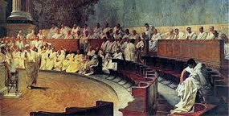
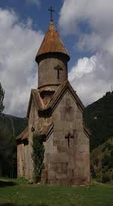
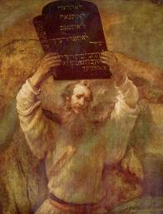
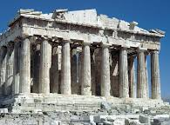
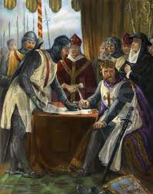
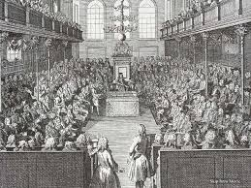
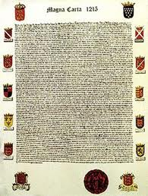
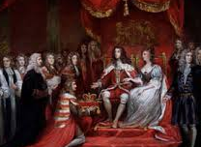
1000 BCE
Judaism
Justice
500 BCE
Ancient Athens
Direct Democracy
500 BCE
Roman Republic
Representative Government
50 CE
Christianity
Equality in the Eyes of God
1215
Rule of Law
Magna Carta
1628
Limited Government
Parliament
1689
Individual Rights
English Bill of Rights

Slide 7
Timeline of Democracy
Middle Ages/
Medieval Times
Ancient Greece
Modern Times
750
500
150
0
500
1000
1500
2000
Roman Empire
Dark Ages
Rise of Democracy Again
Rise of Democracy
Loss of Democracy

Slide 8
What is Political Science?
Definition
a social science discipline concerned with the study of the state, nation, government, and politics and policies of government

Slide 9
Political Theories
Definition
a branch of political science that focus on ideas of past and present political thinkers and the doctrines and proposals of political movements and groups

Slide 10
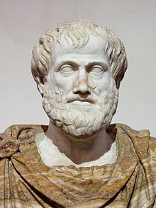
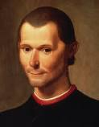
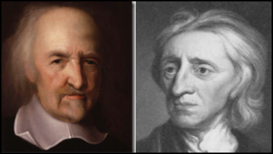
Important Political Theories
Aristotle
Niccolo Machiavelli
Thomas Hobbes
John Locke
What do these individuals say about the purpose of government and what functions the government should provide to its people?

Slide 11
Aristotle 384 BC - 322 BC
Ancient Greek philosopher
Revered as the father of political science
Thought deeply about who should have the power to rule.
Categorized governments along two lines.
How many people are involved in governing
One powerful ruler,
A few upper-class aristocrats
Mass of common people.
Motivation in making decisions.
Ideal rulers care about the common good.
Corrupt rulers care only about advancing their own selfish interests.
The ideal form of government was a monarchy led by a single, virtuous ruler, but rule by a single person could easily lead to the abuse of power.
“We should consider not only what form government is best, but also what is possible and what is easily attainable by all.”
Rule by the well-intentioned many would suit most societies
a.k.a. Polity
Argued that in a polity, the best-qualified citizens, whether rich or poor, would dominate government.

Slide 12
Niccolo Machiavelli 1469 - 1527
An Italian political philosopher
Machiavelli examined the behavior of leaders, good and bad.
He developed ideas about how best to win the power struggle game.
The Prince - describes strategies that a prince, or ruler, could use to acquire power, create a strong state, and keep it safe from attack.
Urged rulers to take a hard look at the world as it is, not as it ought to be.
A prince can not afford to look to morality as their guide to action
“how we live is so far removed from how we ought to live, that he who abandons what is done for what ought to be done, will rather bring about his own ruin than his preservation.”
The Power Struggle Game
A ruler needs to be as smart as a fox and as strong as a lion.
A prince must be prepared to do whatever is necessary for the survival of their state.
“the end justifies the means.”
A prince must not hesitate to “destroy those who can and will injure him”
Instill fear in others, even if this costs him the love of the people.
“it is safer to be feared than loved.”

Slide 13
Thomas Hobbes 1588 - 1679
English philosopher
First to introduce the idea that government was the result of a social contract between people and their rulers
Thought that people were too selfish to govern themselves and needed the protection of a strong ruler.
Theory
People once lived in a state of nature before any governments had been formed and were free to do as they pleased, without laws or other restraints.
Some people used their freedom to prey on others - the result “every man against every man.”
The Social Contract
People to give up some of their freedom by agreeing to obey an absolute ruler
The ruler agreed to bring peace and order to society.
Hobbes did not promote democracy
The social-contract theory did lay the groundwork for the idea that government was formed by the consent of the people.

Slide 14
John Locke 1632 - 1704
An English political theorist and philosopher
Helped lay the foundations for democratic government.
Believed that people formed governments to protect their rights, not to save them from themselves.
Social Contract
Argued that all people were equal and enjoyed certain natural rights, or rights that all people have by virtue of being human.
Right to life
Liberty
Ownership of property produced or gained through one’s own labors.
Agreed with Hobbes that it was in people’s self-interest to enter into a social contract that exchanged some of their freedom for the protection of government.
Argued that the social contract was provisional
If a ruler failed to protect the people’s life, liberty, and property, then the people had a right to overthrow that ruler and establish a new government.
The purpose of government is to protect the rights of the people

