Slide 1
UNIT 2 THE “ROARING” 20s
LIFE AFTER THE GREAT WAR – A NOT SO “ROARING” START

Slide 2
THE GREAT MIGRATION
African Americans begin to leave the south and head north
More job opportunities
Better pay
Not as racist

Slide 3
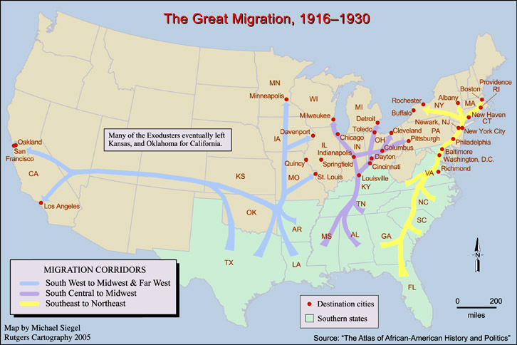

Slide 4
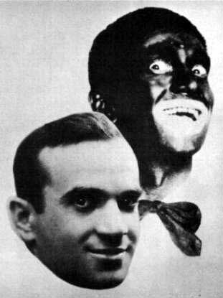
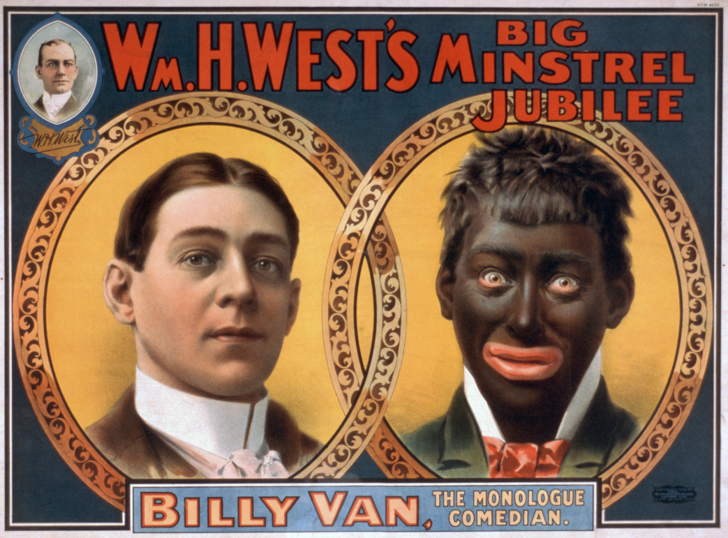
RACISM
Racial segregation
Jim Crow Laws – 1876
Separate but Equal – 1896
Portrayal of racial stereotypes
“Black Face”

Slide 5
1919 – RED SUMMER
Racial tensions increase around the country because of unemployment after the war.
While white men were fighting the war in Europe, their jobs were filled by black workers.
When the soldiers came back home, their jobs were gone.
Some black workers were laid off/fired to give their jobs to white men back from the war.
Many African Americans were able to keep their jobs because they were cheaper than white labor.
Race riots broke out all over the nation

Slide 6
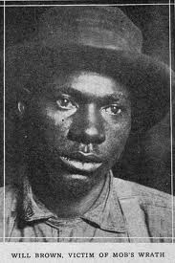
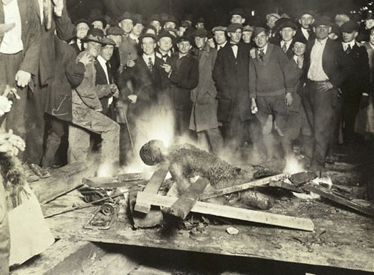
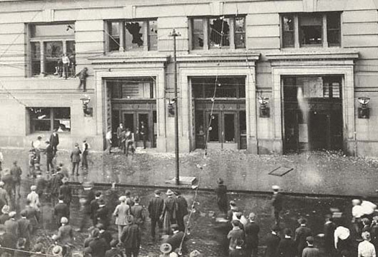
LYNCHING OF WILL BROWN
Summer – 1919, Omaha, NE
Black man (Will Brown) is accused of sexually assaulting a white woman and is killed by a mob in downtown Omaha.

Slide 7
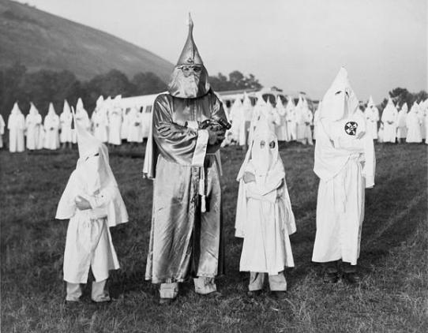
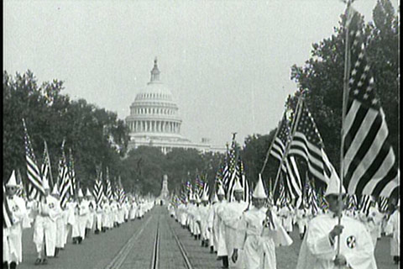
KU KLUX KLAN (KKK)
Membership soars to over 4 million
Nationwide membership, not just in the south
1922 – March in Washington D.C.

Slide 8
SECTION 2
CHANGE OF PACE

Slide 9
URBAN v. RURAL
More people are moving out of the country and into the city

Slide 10
NEW MONEY
America’s strong economy after WWI, consumerism, and the stock market make it easier for people to make money quickly.
The number of millionaires increase 400%

Slide 11
BUYING ON CREDIT
No cash needed
Buy now, pay later
Increases individual consumerism
People can buy more luxury goods

Slide 12
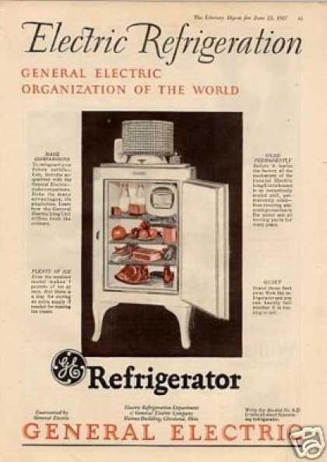
ELECTRICITY
1924
2/3 of all homes had electricity
Home Appliances
Vacuum cleaners
Refrigerators
Washing Machines

Slide 13
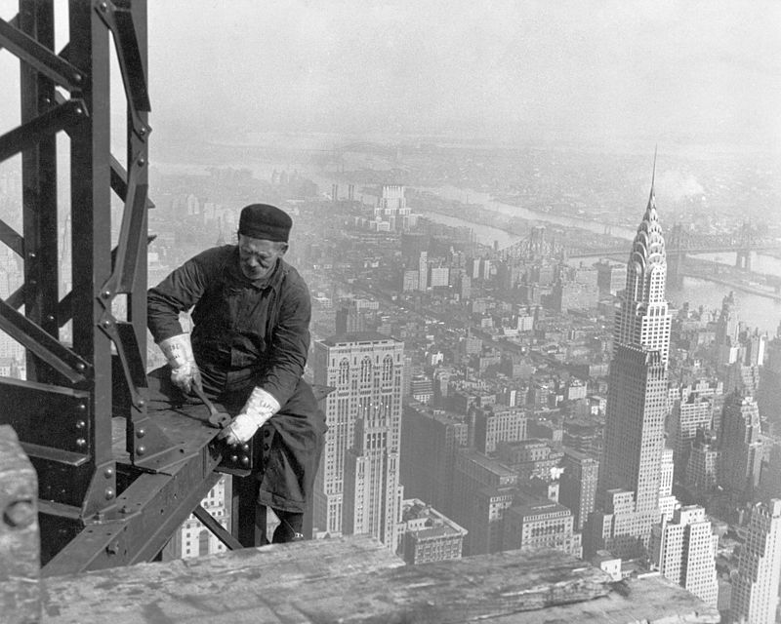
SKYSCRAPERS
Steel, electricity, and the elevator make the creation of skyscrapers possible
Art Deco Style
1920 – 40s
Design
Geometric shapes
Symmetry

Slide 14
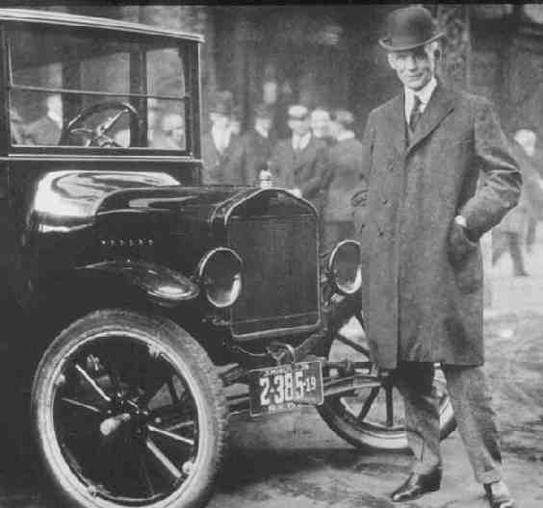
FORD’S MODEL T
“Tin Lizzie”
Made the first mass produced and affordable car through the use of his assembly line
Only color available was black

Slide 15
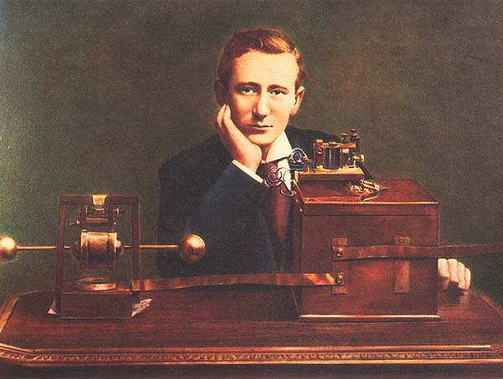
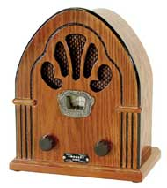
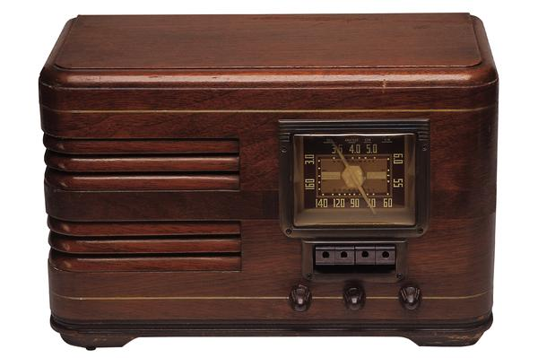
THE RADIO
Invented by Guglielmo Marconi in 1910
Mass produced and sold in the 1920s
Most desired household product
Radio stations broadcasted the news, sports, church services, and music.

Slide 16
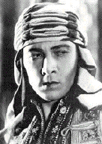
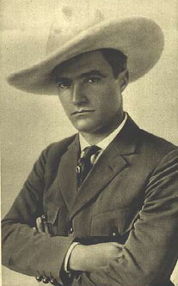
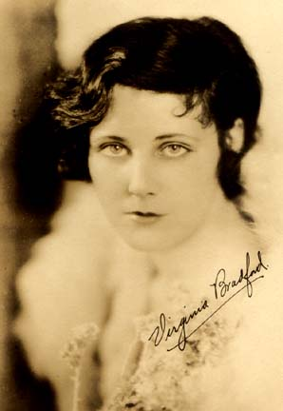
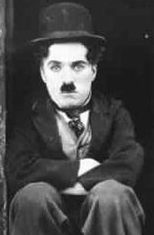
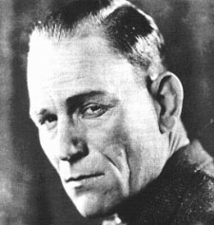
MOVIES
Epic stories come to the screen
“The Ten Commandments”
Movie stars become icons
Lon Cheney = Horror
Tom Mix = Western
Charley Chaplin = Comedy
1927
The first “talkies” come out
“The Jazz Singer”
Hollywood becomes the entertainment center of the country

