Slide 1
UNIT 2 – CRIMINAL LAW
Section 1: What is Crime?

Slide 2
Definition of Crime
Crime = something that one does or fails to do that is in violation of a law.

Slide 3
Types of Crime
Crime of Omission
If a person fails to act on what is a legal duty
Preliminary Crimes
Solicitation
Ask, command, urge, or advice another person to commit a crime
Attempt
Performs all of the elements of a crime but fails to achieve the criminal result
Conspiracy
An agreement between two or more persons to commit a crime

Slide 4
Crimes Against People
Homicide
Killing of one human being by another
Attempted Suicide
Deliberate taking of one’s one life
Assault and Battery
Attempt or threat to carry out a physical attack on another person
Any unlawful physical contact inflicted by one person on another person without consent
Stalking
Sexual assault
Rape
Sexual intercourse without consent
Acquaintance (date) rape

Slide 5
Criminal Homicide
Malice
Having the intent to kill or seriously harm another, showing lack of regard for human life
Negligent homicide
Failure to exercise a reasonable or ordinary amount of care in a situation, thereby causing harm to someone.
Motor-vehicle homicide
Noncriminal Homicide
Killing that is justifiable or excusable and for which the killer is deemed faultless.
i.e. Motor-vehicle homicide

Slide 6
Categories of Murder
First-degree murder
Premeditated and deliberate killing or attempt
Second-degree murder
With malice but not premeditated or deliberation
Intent to kill did not exist until the moment of the murder
Felony murder
Killing that takes place during arson, rape, robbery, or burglary

Slide 7
Manslaughter
Voluntary manslaughter
Killing that occurs after the victim has done something to the killer that would cause a reasonable person to lose self-control
Involuntary manslaughter
Unintentional killing resulting in reckless conduct

Slide 8
Crimes Against Property
Arson – burning of a person’s property
Vandalism –destruction of/damage to property
a.k.a. malicious mischief
Larceny – theft of property
Shoplifting and concealment
Burglary – unauthorized entry with the intent to commit a crime
a.k.a. breaking and entering
Robbery – taking of property through force/intimidation
Unauthorized Use of a Vehicle – taking a vehicle without owner’s consent
Carjacking

Slide 9
Embezzlement – taking of property by a person that it has been entrusted to
Extortion – use of threats to obtain property of another
blackmail
Forgery – making of false documents/falsely signing documents
Receiving Stolen Property – buy/receive stolen property
Computer Crime – any violation of criminal law that involves the use of computer technology

Slide 10
Parties to Crime
Principal
Person who commits a crime
Accomplice
Someone who helps the principal commit a crime
Accessory before the fact
Person who orders or helps the principal commit a crime, but is not present
Accessory after the fact
A person who, knowing a crime has been committed, helps the principal or accomplice avoid capture or helps them escape

Slide 11
How Does Crime Affect everyone?
Lost or damaged lives
Fear and suffering
MONEY
Government expenditures on crime = $150+ billion per year
A family of 4 pays on average $1,500+ per year in taxes relating to crime even if they are not victims of crime.
What causes crime, and what can be done about it?

Slide 12
Crime in America
In 2001 24.2 million crimes were committed
24% violent in nature
According to surveys of victims
50% reported crimes against themselves
Less than 40% reported property crimes
Law enforcement records
Of cases reported, about 20% led to an arrest
Arrest rate is considerably higher for violent crimes

Slide 13
Crime Rate
Higher in urban than suburban communities
Higher in suburban than rural communities
Crime is not confined to any particular group
15-24 year-olds commit more violent crimes than any other group
Males commit almost 4x as many crimes as females
Female offenses has increased in recent years
68% of female victims knew their offenders
45% of male victims knew their offenders
About 35% of victims report that the offender had been using alcohol
Violent crimes are more likely to occur during the day
2/3 of rapes occur at night

Slide 14
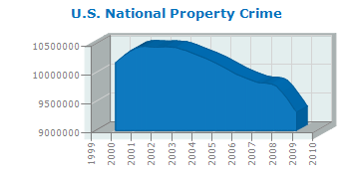
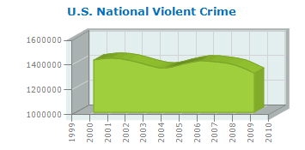

Slide 15
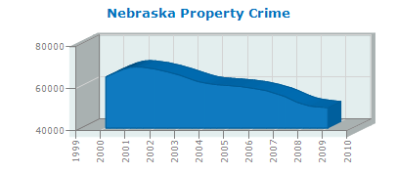
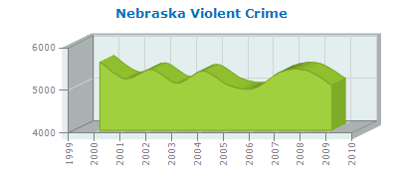

Slide 16
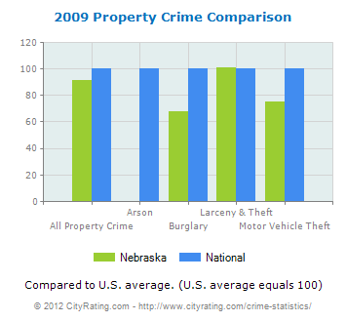

Slide 17
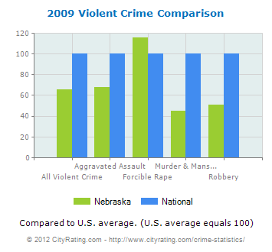

Slide 18
Nebraska Crime Statistics and Rates Report
2009 Crime (Actual Data) | Incidents
Aggravated Assault | 3,205
Arson | N/A
Burglary | 8,701
Forcible Rape | 595
Larceny and Theft | 37,432
Motor Vehicle Theft | 3,481
Murder and Manslaughter | 40
Robbery | 1,219
Crime Rate (Total Incidents) | 54,673
Property Crime | 49,614
Violent Crime | 5,059

Slide 19
Which States are the Most Violent?
In small groups of 3-5 people
Choose 5 states that you believe have the most crime and violence.
Choose 5 states that you believe have least amount of crime and violence

Slide 20
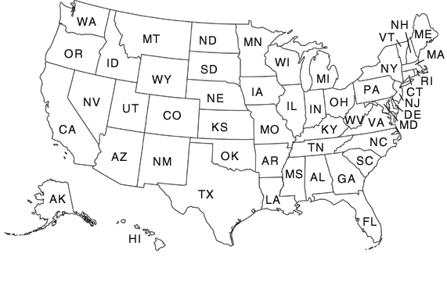

Slide 21
10 most peaceful states:
Maine
Vermont
New Hampshire
Minnesota
Utah
North Dakota
Washington
Hawaii
Rhode Island
Iowa
10 least peaceful states:
Louisiana
Tennessee
Nevada
Florida
Arizona
Missouri
Texas
Arkansas
South Carolina
Mississippi

Slide 22
11 Most Dangerous Cities in the U.S.
1. St. Louis | 530
2. Atlanta | 484
3. Birmingham Alabama (tie) | 380
3. Orlando (tie) | 380
5. Detroit | 369
6. Memphis | 361
7. Miami | 346
8. Baltimore | 339
9. Kansas City, Missouri | 337
10. Minneapolis (tie) | 331
10. Cleveland (tie) | 331

