Slide 1
PROGRESSIVE MINORITIES
Dubois, Washington, and Women’s Suffrage

Slide 2
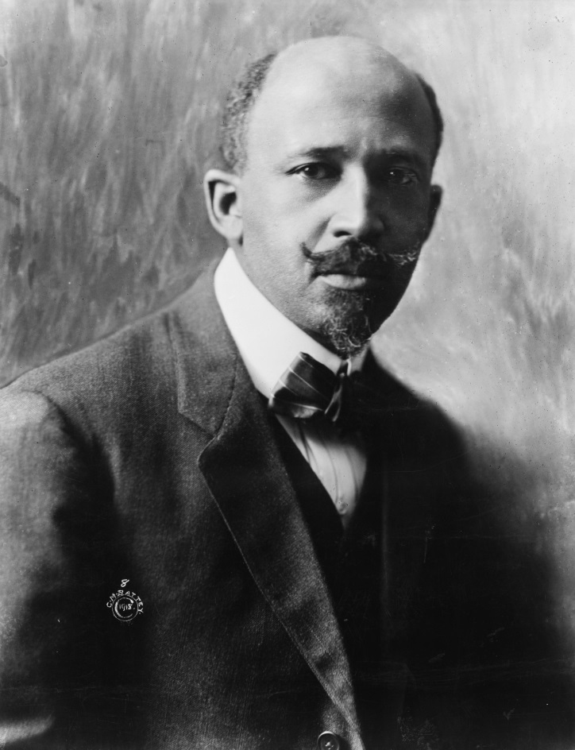
W.E.B. DuBois
1868 – 1963
Sociologist, historian, civil rights activist, author, and editor
Attended Harvard
Co-founder of the NAACP
Leader of the Niagara Movement
African-American activists who wanted equal rights for blacks
Insisted on full civil rights and increased political representation
Strongly protested against lynching, Jim Crow laws, and discrimination in education and employment

Slide 3
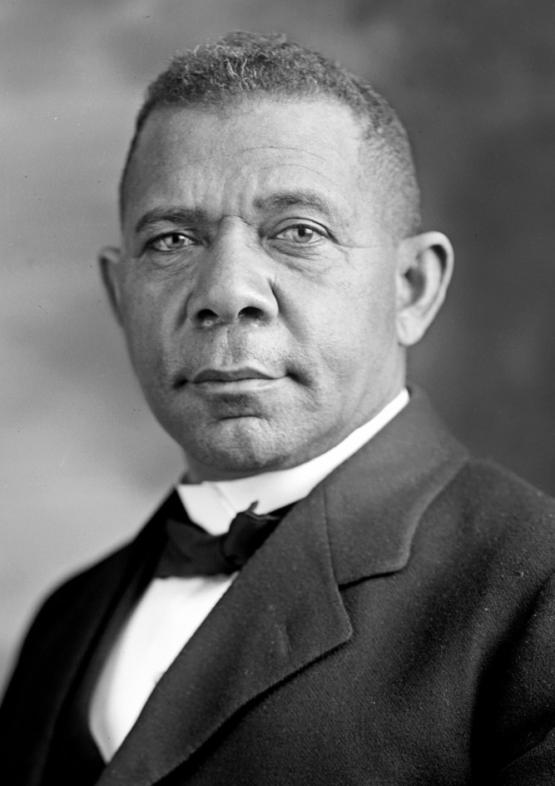
Booker T. Washington
1856 – 1915
Educator, author, orator, and advisor to U.S. presidents
Born into slavery
Became spokesperson for newly freed slaves who were now being oppressed by disfranchisement and Jim Crow discriminatory laws
Atlanta Compromise
Avoid confrontation over segregation
Focus on self-help, schooling, and economic advancement in the black community.

Slide 4
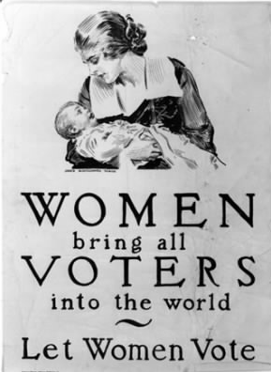
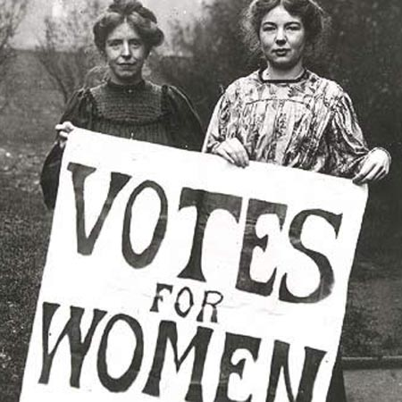
Women’s Suffrage (1848 – 1920)

Slide 5
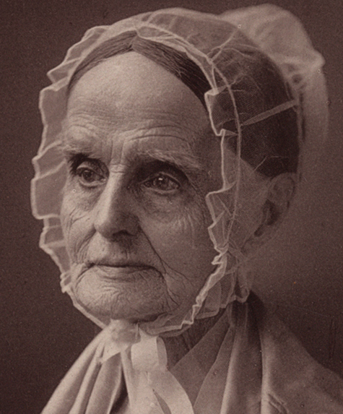
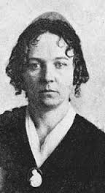
Seneca falls convention
1848
1st women's rights convention
Discussed the social, civil, and religious rights of women
Organized by Elizabeth Cady Stanton and Lucretia Mott
“Declaration of Sentiments” was created
Included women’s suffrage

Slide 6
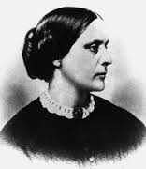
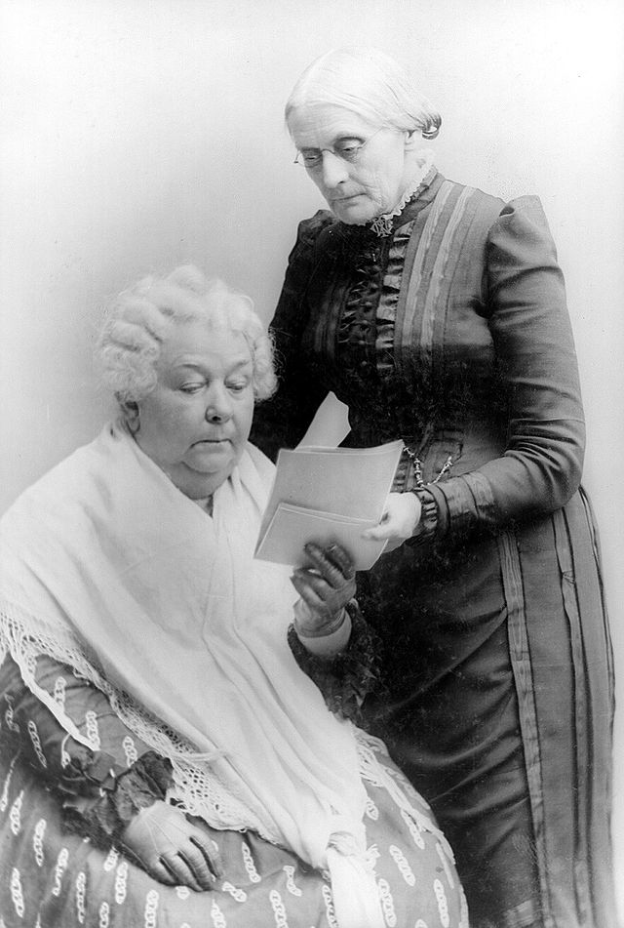
National American Woman Suffrage Association (NAWSA)
Created in 1869
Elizabeth Cady Stanton
Susan B. Anthony
Largest organization working for women's suffrage
Strategies
Win suffrage state by state
Takes a lot of time and is slow
Create a Constitutional Amendment
Extremely difficult to achieve
¾ of all states must agree with the amendment to pass and become a law

Slide 7
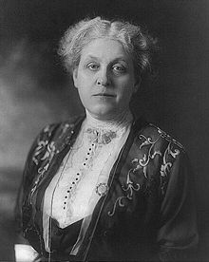
Carrie Chapman Catt
1859 – 1947
Suffrage leader
Campaigned for the 19th Amendment
President of NAWSA after Susan B. Anthony
1900 – 1904
1915 – 1920
Believed that the best way to win suffrage was the state by state approach
Supported President Wilson during WWI
The movement slowed down and caused tension within NAWSA
Pressured Congress to pass the 19th Amendment

Slide 8
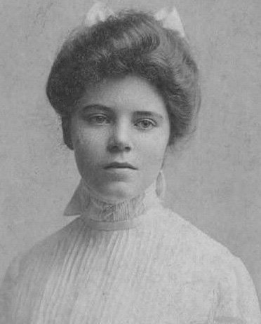
Alice Paul
1885 – 1977
Suffragist and women's rights advocate
Main leader and strategist of the 1910s campaign for the 19th Amendment
Organized the Washington D.C. Parade in 1913
Took a more radical approach to win suffrage
Methods started to create tension Carrie Chapman Catt
Broke with NAWSA
Formed the National Woman’s Party in 1916
Arrested for “obstructing traffic” while picketing non-violently
Sent to prison

Slide 9
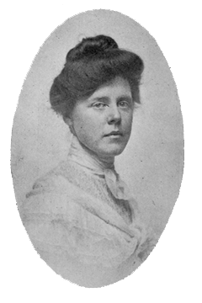
Lucy Burns
1879 – 1966
Suffragist and women's rights advocate
Close friend of Alice Paul
Helped form the National Woman’s Party (NWP)
Took a more radical approach to win suffrage
Taught women how to conduct automobile campaigns, lobby, and work with the press
Arrested while picketing the White House and was sent to prison
Organized protests with other prisoners
Created a document stating the rights of political prisoners
Was put in solitary confinement
Spent the most time in jail

Slide 10
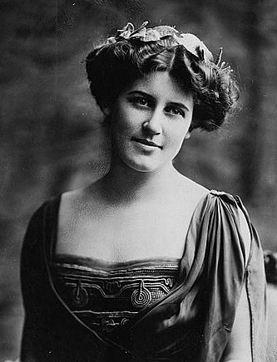
Inez Milholland
1886 – 1916
Suffragist, labor lawyer, World War I correspondent, and public speaker
Member of the National Woman's Party
Key participant in the Woman Suffrage Parade of 1913
Known as “the beautiful face of the suffrage movement”
Was better known for her looks than her brains
Believed that women should have the right to vote because of the traits that were unique to women
"house-cleaners of the nation“
women's votes could remove social ills such as sweatshops, tenements, prostitution, hunger, poverty, and child mortality
Thought that suffrage was a secondary concern to the war in Europe
Died while touring the nation on behalf of suffrage

Slide 11
Washington D.C. Suffrage Parade
March 1913
1 Day before President Woodrow Wilson’s Inauguration
5,000 – 8,000 women participated in the parade
An elegant progression of symbolically dressed, accomplished, and professional women
Quickly devolved into riot
D.C. police did little to help
Women were finally assisted by the Massachusetts and Pennsylvania National Guard, and boys from the Maryland Agricultural College
Created a human barrier protecting the women from the angry crowd

Slide 12
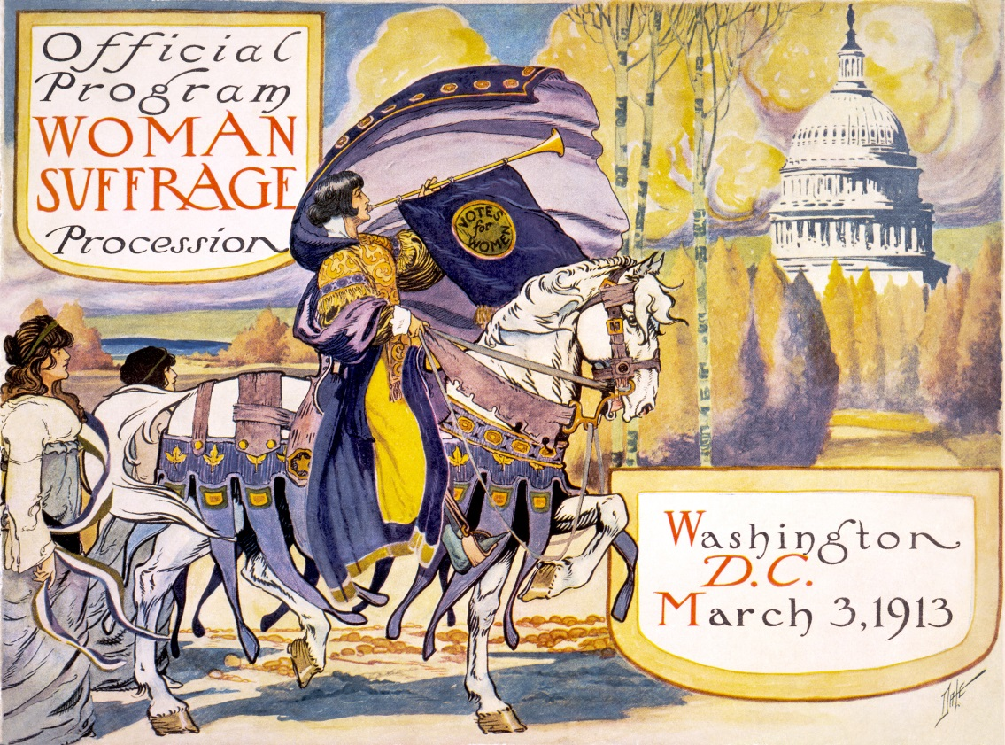
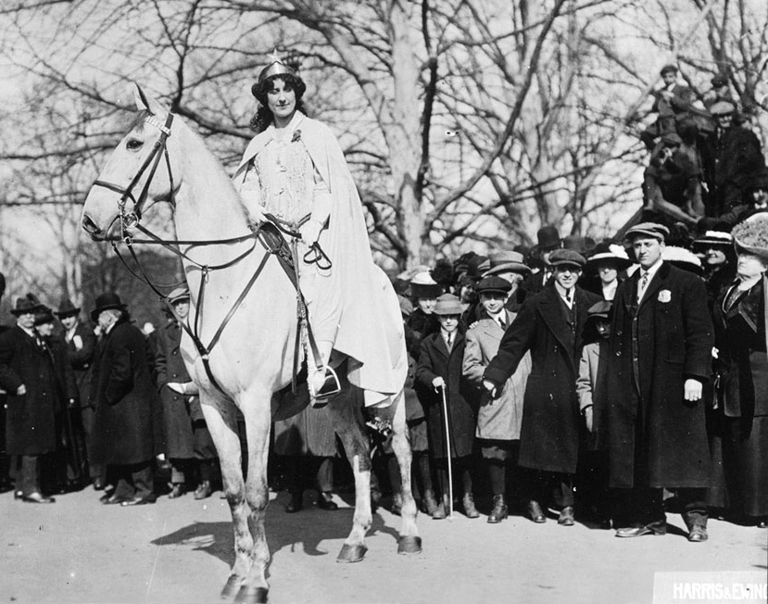
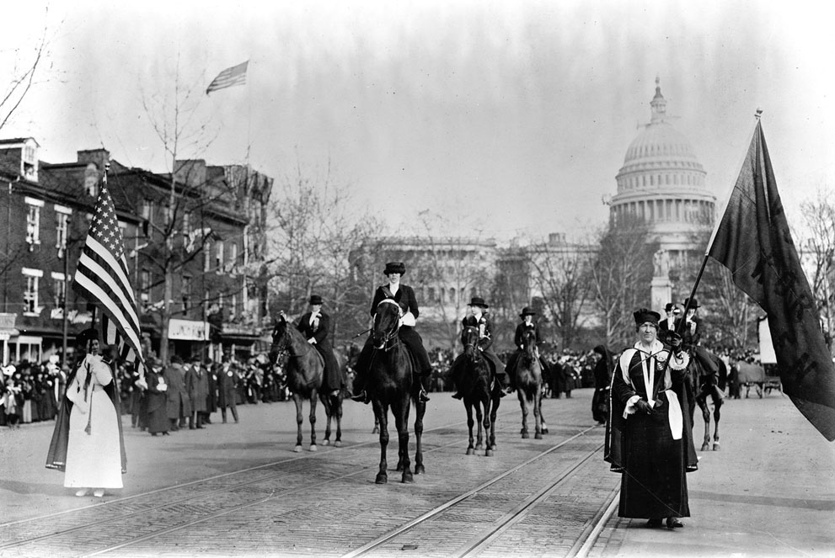
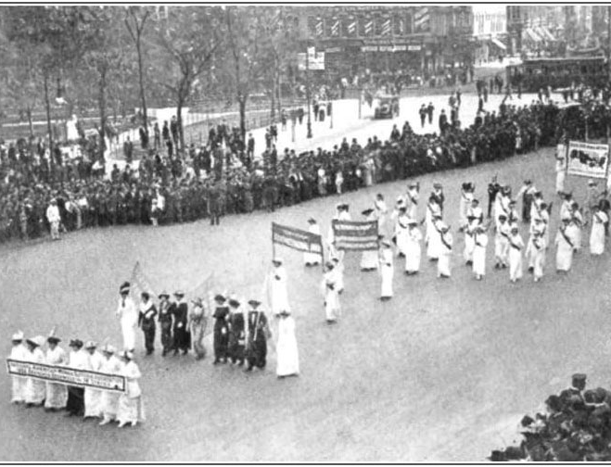

Slide 13
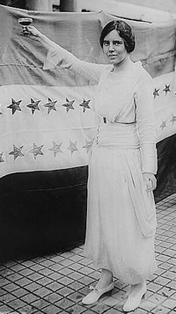
National WomAN’S pARTY (NWP)
April 1913
Founded by Alice Paul and Lucy Burns
Primary Goal = Congressional Union
Pass a constitutional amendment that ensured woman’s suffrage
Went after President Woodrow Wilson for not doing enough for woman’s suffrage
Opposed World War I
Focused on an Equal Rights Amendment following the creation of the 19th amendment

Slide 14
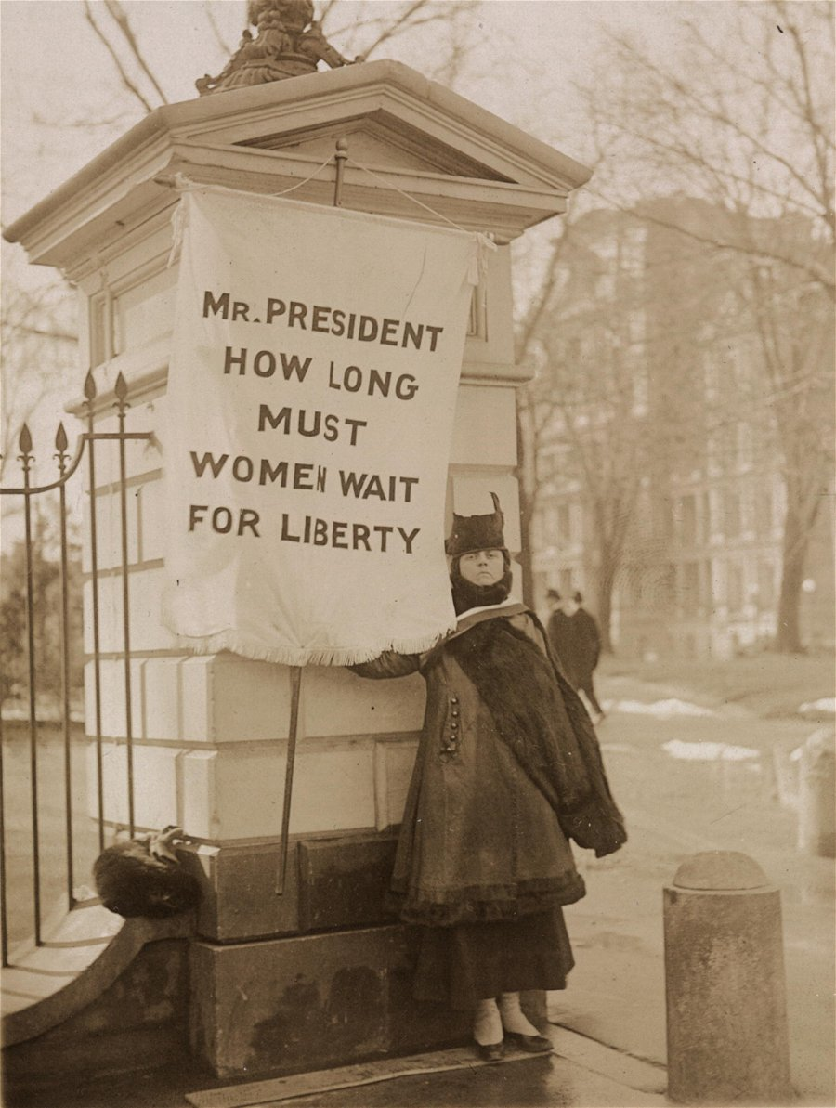
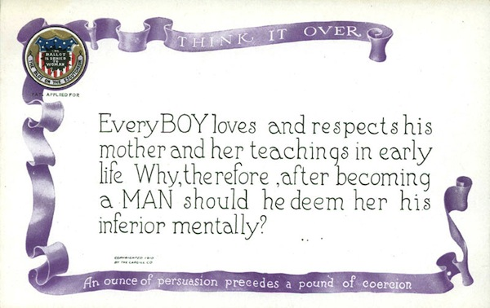
“Silent Sentinels”
Women who picketed for women's rights in front of the White House
Lasted about 2 ½ years
More than a thousand different women picketed every day and night except Sunday
Many were arrested while picketing for obstructing traffic
Were sent to Occoquan Workhouse (Prison)
Many went on hunger strikes
Some were force-fed as a consequence

Slide 15
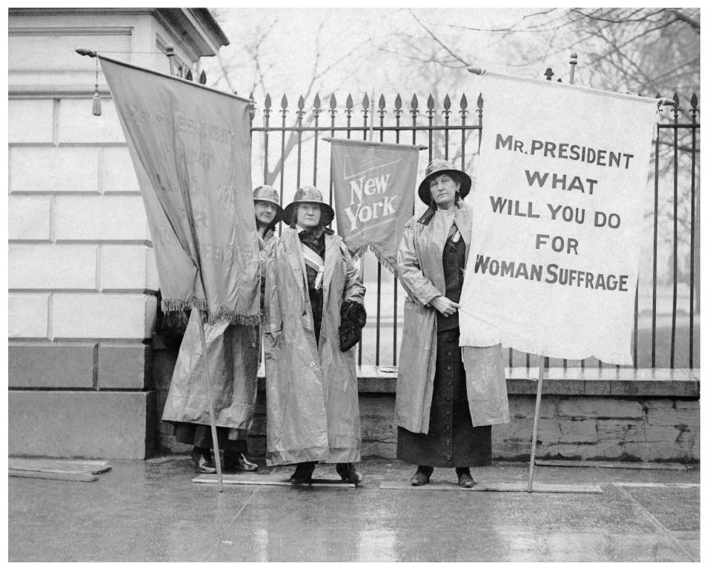
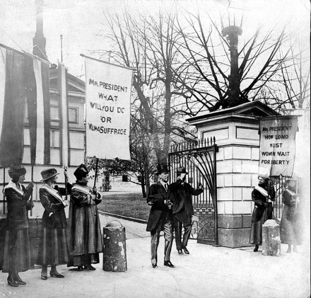

Slide 16
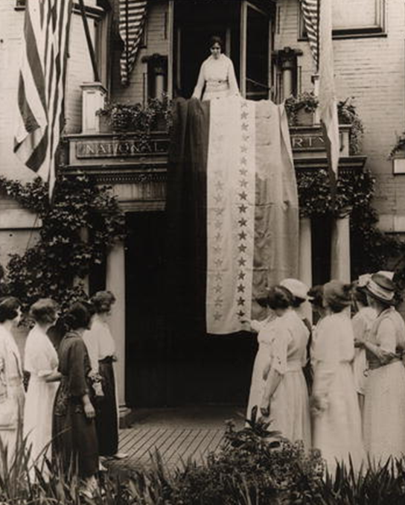
19th Amendment
President Wilson spoke out in favor of women’s suffrage in his 1918 State of the Union address before Congress
August 1920 - Tennessee narrowly approved the 19th Amendment. This provided the final state ratification necessary to add the amendment to the Constitution
Was ratified on August 18, 1920
Prohibits any United States citizen from being denied the right to vote on the basis of sex

