Slide 1
PRESIDENTS OF THE PROGRESSIVE ERA
Taft, Wilson, and a Bull Moose?

Slide 2
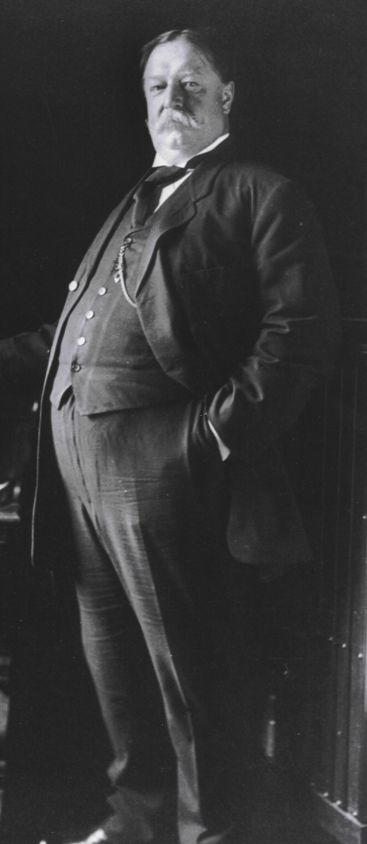
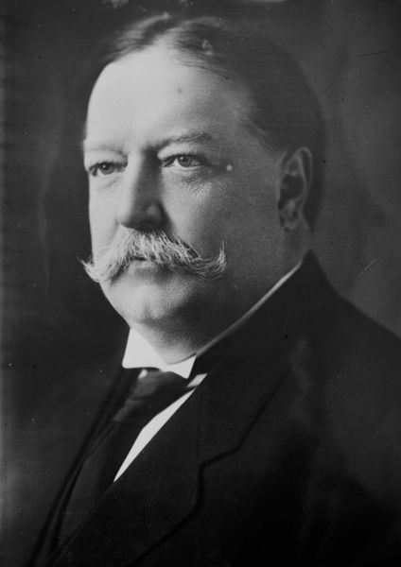
William Howard Taft
1909-1913
Republican
Fattest President
332 lbs.
Got stuck in the White House bathtub
Never wanted to be President
Wanted to be Chief Justice of the Supreme Court

Slide 3
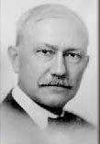
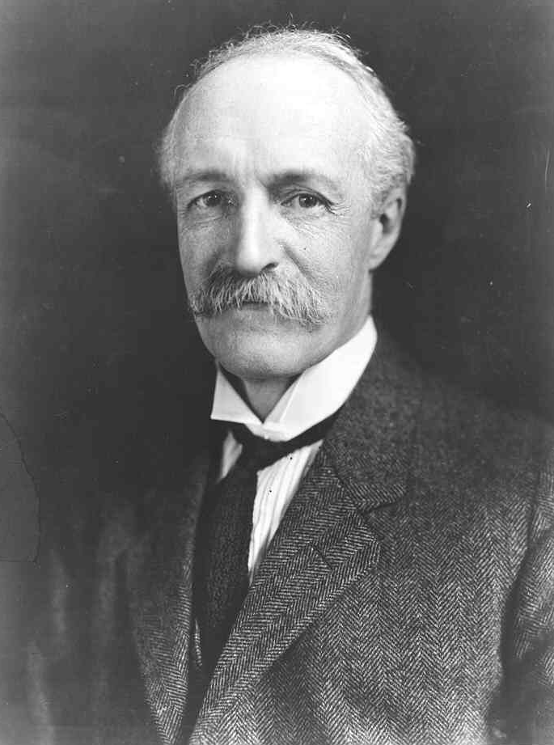
Taft’s presidency
Mann-Elkins Act (1910)
Extended Government powers over Interstate telephone and telegraph companies
16th Amendment (1913)
Congress can levy a tax based on a person’s income
The Ballinger-Pinchot Affair
Pinchot criticized Ballinger for not doing enough for the environment
Taft told Pinchot to stay out of I
Pinchot didn’t stop and Taft fired him
Pinchot told Roosevelt what was going on and
Taft loses the support of Roosevelt over the whole affair
Ballinger
Secretary of
the Interior
Pinchot
Head of the U.S.
Forest Service

Slide 4
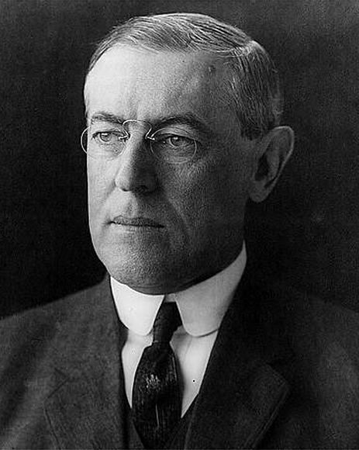
Woodrow Wilson
1913-1921
Democrat
Former Gov. of New Jersey
Former Pres. of Princeton University
Considered to be the most influential president of the Progressive Era
President during World War I
Received the Noble Peace Prize in 1919
Supported racial segregation
Did not originally support the women’s suffrage movement

Slide 5
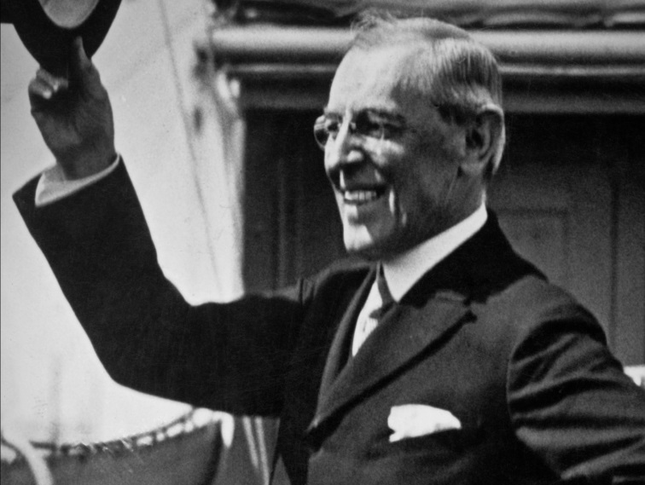
Wilson’s Presidency
Federal Reserve Act (1913)
Created a National Banking System
Clayton Antitrust Act (1914)
Outlawed monopolies
Adamson Act (1916)
Established an 8 hour workday
Additional pay for overtime work
Keating-Owen Child Labor Act (1916)
Prohibiting the sale of goods produced by factories that employed children under fourteen
Espionage Act (1917)
Prevent the support of U.S. enemies during wartime
Sedition Act (1918)
Made speech and the expression of opinion that cast the government or the war effort in a negative light illegal
19th Amendment
Women’s Suffrage
Helped create the League of Nations

Slide 6
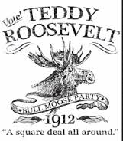
The Bull Moose Party a.k.a. Progressive Party
Taft and Roosevelt are both Republicans
The Republican Party chooses Taft to run for president in the 1912 election
Roosevelt cannot run as a republican
The Democrat Party chose Woodrow Wilson to run in the 1912 election
Roosevelt cannot run as a democrat
In order to participate in the 1912 election, Roosevelt had to run as part of a 3rd party
Roosevelt runs under the Progressive Party
The Progressive Party becomes more popularly known as the Bull Moose Party because of quote taken from Roosevelt while running in 1912
“I’m as fit as a bull moose”

Slide 7
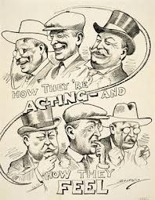
Election of 1912
Taft and Roosevelt spent the entire campaign attacking each other
Taft complained about Roosevelt’s agenda
Roosevelt complained about Taft’s agenda
Both never focused on what they were going to do if elected president accept for derail the other person.
Roosevelt was more popular than Taft
Won more state primaries than Taft
Wilson was left unchecked by both Roosevelt and Taft during the campaign
Wilson ran a honest campaign
Focused on what he would do if president
Won the 1912 election

Slide 8
