Slide 1
Section 3 Origins of U.S. Government

Slide 2
Early Influences
The English
Colonists to N. Amer. brought
Limited gov’t.
The Magna Carta (1215)
Monarchs must act according to set laws
Representative gov’t.
Bicameral legislature
House of Lords & House of Commons
Both shaped the gov’t. of the colonies
Lots of Important documents
Charters

Slide 3
Independence
Obstacles
Colonial unity
Diff. reasons for coming to N. Amer.
Colonists came from diff. countries
Varying economies b/c of geography
Native Americans
Federalists and Anti-federalists
European interventions and war

Slide 4
Colonists vs. Great Britain
Colonists
Great Britain
Political Distance
Was allowed to take care of its own affairs for over 150 years
Protests & boycotts
Creation of the First Continental Congress
Declaration of Independence
British Policies
Colonists should help pay off the debt from the French and Indian War
Proclamation Line
Stamp Act taxes
Taxation w/o representation
British soldiers deployed
War

Slide 5
Road to Revolution
1765 – Stamp Act
A tax levied by Parliament on all paper goods in the colonies raises cries of “no taxation without representation.”
1767 – Townshend Acts
Theses acts place duties on goods imported into the colonies. The colonists resist by boycotting all British goods.
1770 – Boston Massacre
Protesters in Boston provoke British soldiers, causing them to fire into the crowd, killing five people. Paul Revere’s famous engraving of the event helps spark further protests.
1773 – 1774 Boston Tea Party and the Intolerable Acts
Colonists protesting the Tea Act dump taxed tea into Boston Harbor. Britain responds by imposing the Intolerable Acts on the colonies. George Washington calls the acts “repugnant to every principle of natural justice”
Militia troops skirmish with British soldiers at Lexington and Concord, beginning the American Revolution
1775 – Fighting Begins
1776 – Declaration of Independence
The Continental Congress adopts a resolution declaring the colonies to be “Free and Independent States.”

Slide 6
Declaration of Independence
Background Info
Purpose of Document
Signed July 4, 1776
Supported and urged by Benjamin Franklin and John Adams
Written by Thomas Jefferson
Sent to Britain’s King George and Parliament
First signature from John Hancock
Official break between the colonies and Great Britain.
All 13 colonies are now unified states.
States the grievances of the colonies and reason for breaking away from Britain.
Will go to war if necessary to keep their independence

Slide 7
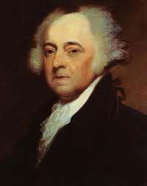
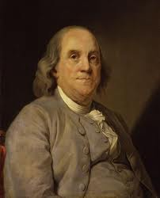
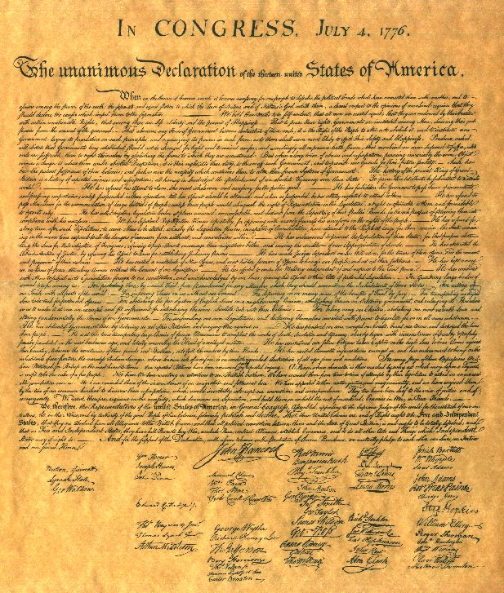
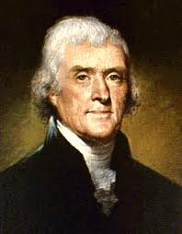

Slide 8
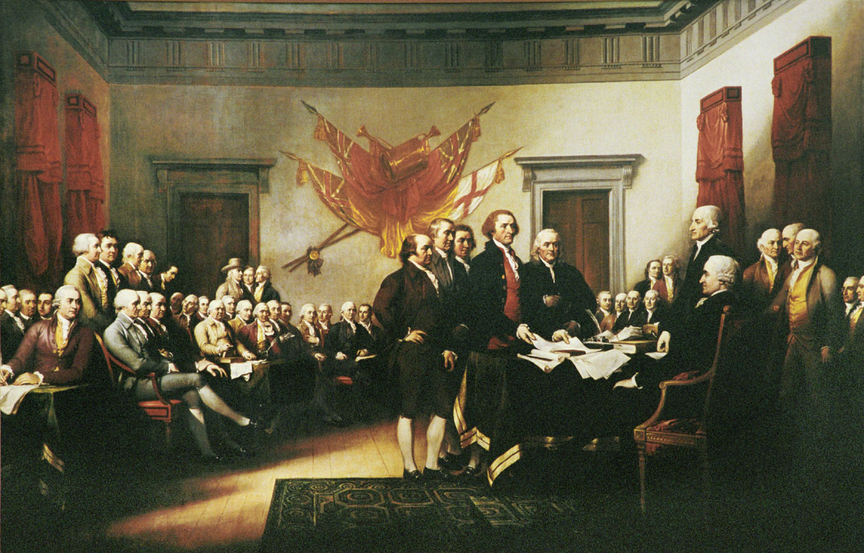
The Signing of the Declaration of Independence

Slide 9
The First National Government

Slide 10
Articles of Confederation (1777) and the Second Continental Congress
Reason for Creation
What it Accomplished
No legal document that gave Congress the authority or power to borrow money, make treaties, create currency, etc.
Nothing legally tied the colonies together into a unified country.
Formed a single national government by loosely tying the colonies together
Unicameral legislature only
Limited gov’t.

Slide 11
Did the Articles of Confederation work?
Not Really
Cultural & economic diff.
Geographic isolation
State’s had too much power
Negotiating with foreign countries
Creating their own militaries
Rebellions

Slide 12
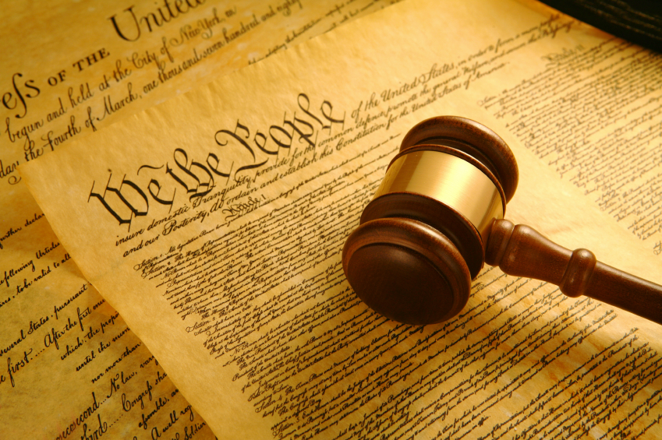
The Constitutional Convention
The Articles of Confederation
Gave too much power to the individual states
The Constitutional Convention (1787)
Adopted America’s current Constitution
The nations most important governing document
“supreme law of the land”

Slide 13
Convention Background
James Madison – Father of the Constitution
“The Virginia Plan”
A 3-branch federal system
William Patterson
“The New Jersey Plan”
A 1 house legislature with equal representation
3/5 Compromise
Slaves equal 3/5 of a person
State population = how many representatives the state has in the legislature

Slide 14
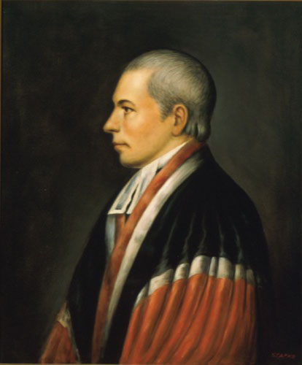
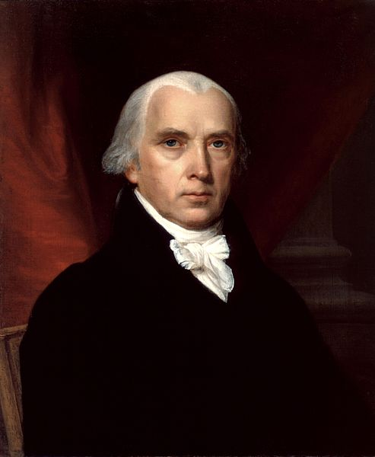
James Madison
William Paterson

Slide 15
A Closer Look at the Purposed “Plans”
The Virginia Plan (Large States)
Branches | Three - legislative, executive, and judicial. The legislature was more powerful, as it chose people to serve in the executive and judicial branches.
Legislature | Two houses (bicameral). The House of Representatives was elected by the people and the Senate was elected by the state legislatures. Both were represented proportionally.
Other Powers | The legislature could regulate interstate trade, strike down laws deemed unconstitutional and use armed forces to enforce laws.
The New Jersey Plan (Small States)
Branches | Three - legislative, executive, and judicial. The legislature appoints people to serve in the executive branch, and the executive branch selects the justices of the Supreme Court.
Legislature | One house (unicameral). States would be represented equally, so all states had the same power.
Other Powers | The national government could levy taxes and import duties, regulate trade, and state laws would be subordinate to laws passed by the national legislature.

Slide 16
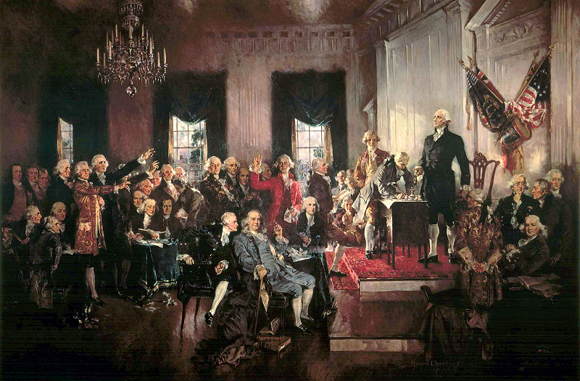

Slide 17
The Great Compromise
The Problem
Small states felt that all states were equal in stature and that if Congressional representation were based upon population, they would be outvoted on everything. Large states felt that populations should determine how many representatives a state should have, because they were afraid that they would be outvoted by the small states.
The Compromise (Connecticut Plan)
Combined the Virginia Plan and New Jersey Plan to create our current legislature with two houses, one based on population and elected by the people and the other house allowing two senators per state being appointed by state legislatures.

Slide 18
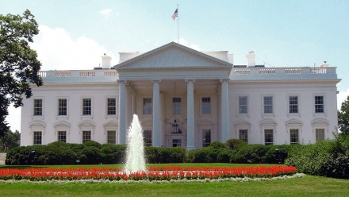
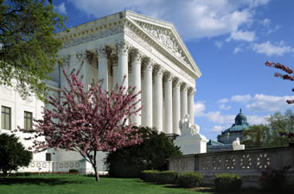
The Capitol = Congress
Legislative Branch
The White House
Federal Branch
U.S. Supreme Court
Judiciary Branch

Slide 19
Ratification of the Constitution
 | Date | State | Votes
 |  |  | Yes | No
1 | December 7, 1787 | Delaware | 30 | 0
2 | December 11, 1787 | Pennsylvania | 46 | 23
3 | December 18, 1787 | New Jersey | 38 | 0
4 | January 2, 1788 | Georgia | 26 | 0
5 | January 9, 1788 | Connecticut | 128 | 40
6 | February 6, 1788 | Massachusetts | 187 | 168
7 | April 26, 1788 | Maryland | 63 | 11
8 | May 23, 1788 | South Carolina | 149 | 73
9 | June 21, 1788 | New Hampshire | 57 | 47
10 | June 25, 1788 | Virginia | 89 | 79
11 | July 26, 1788 | New York | 30 | 27
12 | November 21, 1789 | North Carolina | 194 | 77
13 | May 29, 1790 | Rhode Island | 34 | 32

Slide 20
Articles of Confederation vs. The Constitution

Slide 21
 | Articles of Confederation | Constitution
Levying taxes | Congress could request states to pay taxes | Congress has right to levy taxes on individuals
Federal courts | No system of federal courts | Court system created to deal with issues between citizens, states
Regulation of trade | No provision to regulate interstate trade | Congress has right to regulate trade between states
Executive | No executive with power. President of U.S. merely presided over Congress | Executive branch headed by President who chooses Cabinet and has checks on power of judiciary and legislature
Amending document | 13/13 needed to amend Articles | 2/3 of both houses of Congress plus 3/4 of state legislatures or national convention
Representation of states | Each state received 1 vote regardless of size | Upper house (Senate) with 2 votes; lower house (House of Representatives) based on population
Raising an army | Congress could not draft troops and was dependent on states to contribute forces | Congress can raise an army to deal with military situations
Interstate commerce | No control of trade between states | Interstate commerce controlled by Congress
Disputes between states | Complicated system of arbitration | Federal court system to handle disputes between states and residents of different states.
Sovereignty | Sovereignty resides in states | Constitution was established as the supreme law of the land
Passing laws | 9/13 states needed to approve legislation | 50%+1 of both houses plus signature of President
Feldmeth, Greg D. "Articles of Confederation vs. The Constitution," U.S. History Resources ..//gfeldmeth/chart.art.html (24 June 2004

