Slide 1
Unit 3 – Powers of Government
Section 1 = The Legislative Branch
Section 2 = The Executive Branch
Section 3 = The Judicial Branch

Slide 2
Unit 3 Section 1
The Legislative Branch

Slide 3
Organization of Congress
Terms and Sessions
Term Limits
Congressional Leaders
Rules of Conduct

Slide 4
House of Representatives
Size
Set by Congress
Based off of state population
Terms
2 years
Congressional Districts
Apportion = house seats are given to each state
State legislature determines state district boundaries
Gerrymandering
Districts are sometimes drawn for political reasons
Favor one party over the other

Slide 5
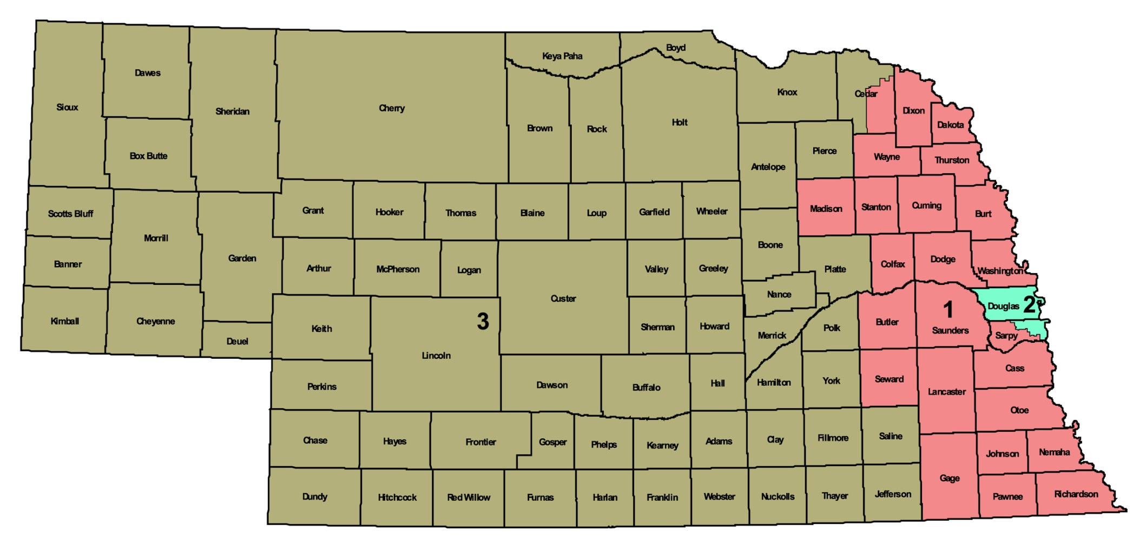
2000-2010 District Map

Slide 6
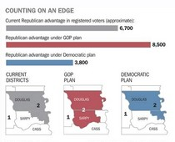
What is up with Sarpy County?

Slide 7
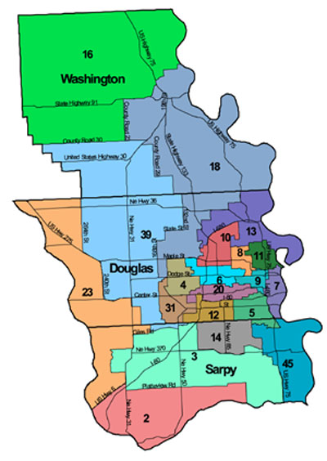

Slide 8
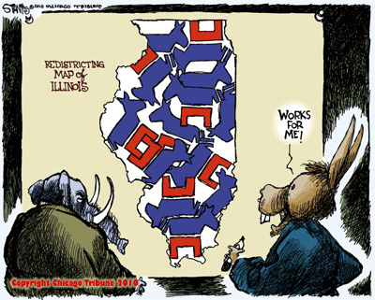
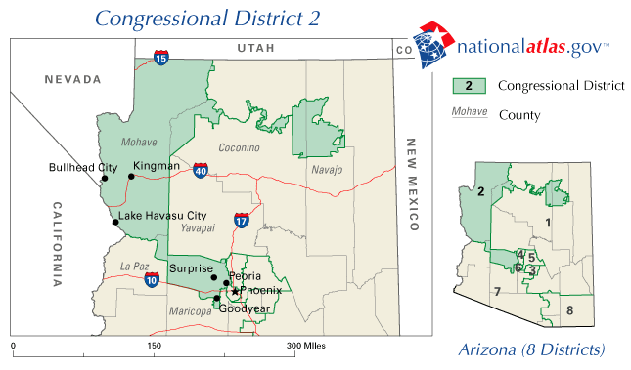
Gerrymandering

Slide 9
Qualifications
At least 25 years old
U.S. citizen for at least seven years
Legal resident of the state they represent
Salary and Benefits
$145,100 annually
Pay increase if re-elected
Lots of Benefits

Slide 10
Senate
Size
Set by the Constitution
Two members per state
Terms
6 years
Qualifications
At least 30 years old
U.S. citizen for at least 9 years
Legal resident of the state they represent
Salary
$145,100 annually
Same benefits and legal protection as House members

Slide 11
Members of Congress
Usually business people or lawyers
Almost everyone has a college degree
Most have advance degrees
Most members are white
Male
40 years of age or older

Slide 12
Congressional Leaders
House of Representatives
Speaker
(R or D)
Floor Leader
(R and D)
Majority leader
Assistant to the Speaker
Minority leader
Party’s chief spokesperson
Party Whips
(R and D)
monitor/influence how the party’s members vote on legislation

Slide 13
Senate Leadership
Vice President
Breaks tie votes
President pro tempore
Formal head of the senate
Person in the majority party who has been in the senate the longest
Majority Floor Leader
Party’s chief spokesperson
Minority Floor Leader
Party Whips

Slide 14
Conduct
Judge members’ qualifications
Can refuse to seat the elected member
Judge members’ behavior
Discipline members
Censure
Expulsion

Slide 15
The Committee System

Slide 16
Types
Standing Committee
Permanent
Deal with trade, foreign policy, or finances
19 in the House
16 in the Senate
Subcommittees
Division of standing committees
More specialized
About 215 in Congress

Slide 17
Select Committees
Deal with special issues
Focus on investigations
Usually temporary
Joint Committees
Made from members of both House and Senate
More effective than having 2 separate groups
Conference Committees
Made from members of both House and Senate
Temporary – work out a compromise on versions of bills passed by both houses

Slide 18
Powers of Congress

Slide 19
Expressed Powers
Powers given to the federal government by the Constitution to make laws in the following areas:
Government finance
Regulation of commerce
National defense
Law enforcement
National sovereignty

Slide 20
Raise & collect taxes
Regulate foreign & interstate commerce
Coin & print money
Provide & maintain military forces
Admit new states into the union
Determine punishment for treason
To borrow money
Establish rules for becoming a citizen
Set standard of weights & measures
Establish post offices
Declare war
Establish military laws
Call up a national militia
Govern the District of Columbia

Slide 21
Special Powers
Stated by the Constitution
Given to the Senate, House, or sometimes both
Impeaching officials
Bring federal officials trial
House and Senate
Approving treaties
Senate
Approving appointments
Senate
Deciding elections
House

Slide 22
Implied Powers
To make all laws which are necessary and proper.
“Necessary and Proper Clause”
Creation of a National Bank
Creation of Military Academies
Most laws created since 1900

Slide 23
How A Bill becomes A Law

Slide 24
Referral to Committee
Bill must be introduced to Congress and referred to a committee.
Sent to a subcommittee for consideration
Must obtain committee approval to advance to the floor

Slide 25
Hearings
Committee or subcommittee hearings which are open to the public
Supporters and opponents of the bill can testify
Interest groups and ordinary people affected by it can also testify

Slide 26
Markup
After a bill is approved in a subcommittee, the exact phrasing is decided
Very time-consuming process
Involves lots of details
Bill needs to be passed in a full committee to move forward

Slide 27
Floor Consideration
House Floor is 1st to vote on the approval of a bill
Senate Floor is 2nd
Filibuster = delay tactics to hold off a final vote
Voting
Roll-call “individual” vote

Slide 28
Conference Committee
Compromise between the House and Senate on a bill

Slide 29
Presidential Action
Sign the bill, which makes it law
Veto the bill
Keep the bill for 10 days without signing it.
If Congress is in session, the bill becomes a law without the President’s signature
Pocket Veto
President keeps it for 10 days when Congress is not in session and it does not become a law

