Slide 1
Growing Tensions in Europe
Imperialism, Monarchies, and Alliances

Slide 2
Imperialism
The quest for colonial empires.
Why?
Land
Natural Resources
Trade
Every country did this!
Examples
13 original colonies was part of the British Empire
Louisiana Territory was part of the French Empire
Pros.
More $$$
Political & Economic Influence
“World Power” Status
Cons.
More $$$
Larger Military Required
Native Population

Slide 3
Effects of Imperialism
Growing nations are in need of more resources for their country so they expand into other areas and take control.
Bordering countries begin to get paranoid and react by building up their militaries for protection.
Some countries are not able to build as big of militaries as others and form alliances with other nations for additional help.

Slide 4
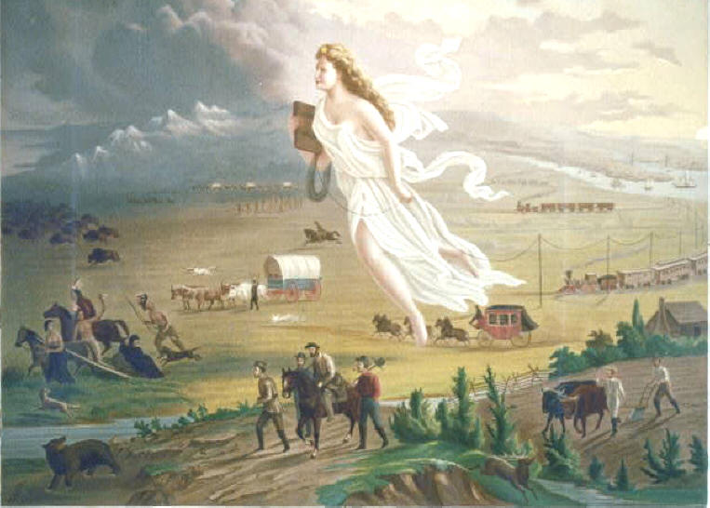
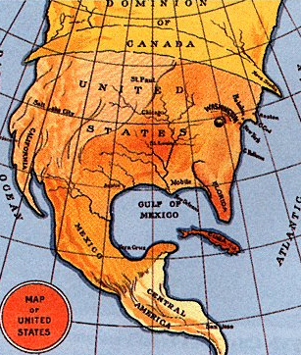
American Imperialism
Manifest Destiny
Territories in the Caribbean and South Pacific

Slide 5
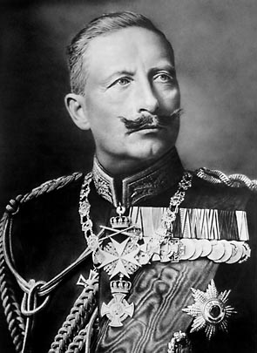
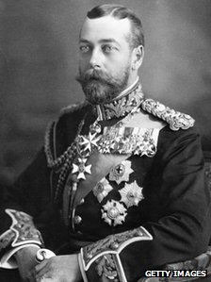
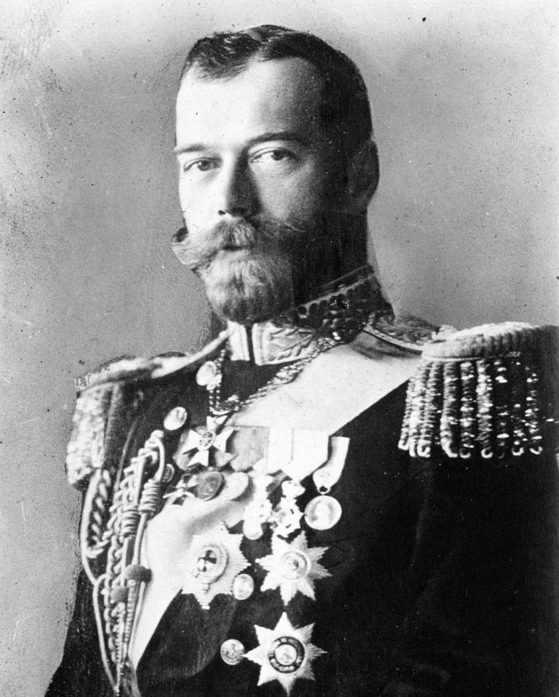
European Monarchies
Royal families from Europe are all connected in some way. (Blood or Marriage)
Cousins
Cousins
Kaiser Wilhelm II
King George V
Tsar Nicholas II

Slide 6
Subjects vs. Rulers
SUBJECTS
RULERS
The Industrial Revolution
Hundreds of thousands move from the country to the cities for jobs in factories – jobs are too few
Cities become quickly overcrowded
Large split between the rich and poor
People are fed up with Royal Families
Power has been limited through the years
Still live entitled
Palaces & Crown Jewels
Don’t understand the issues facing their subjects
Some don’t even care

Slide 7
Tension Escalates
Monarchy in Russia is teetering
Revolution is in the near future to overthrow the centuries old monarchy
European countries begin to mobilize and strengthen their militaries for hostilities
Militarism = The principle or policy of maintaining a large military establishment.
Army and Naval Superiority is key to any nation wanting to be a super power

Slide 8
Creation of Alliances
Some countries are unable to build militaries large enough to protect from outside threats.
Small economies
Fewer citizens
Not as advanced in technology
These countries will form alliances with other nations for protection if an attack were to happen.
Alliance = A formal agreement or treaty between two or more nations to cooperate for specific purposes.

Slide 9
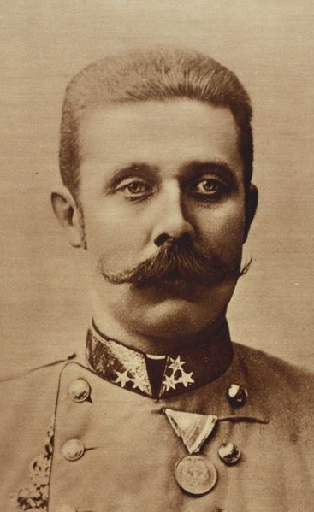
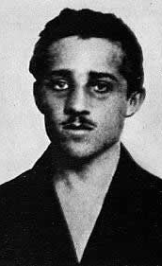
The Breaking Point
Countries are practicing nationalism = national pride or loyalty towards one’s culture.
Serbia
A country that is part of the Austria-Hungarian Empire
Identifies culturally with the Russian Empire and not with their Germanic Austria-Hungarian rulers.
Tension between Russia and Austria-Hungary arise over the control of Serbia
Sarajevo, Bosnia (June 28, 1914)
Future heir of Austria-Hungary, Archduke Franz Ferdinand, and his wife are assassinated by a Serbian nationalist group (the Black Hand) while traveling in the capital of Bosnia

