Slide 1
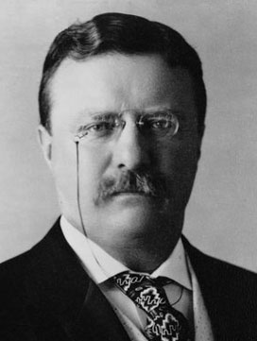
A PROGRESSIVE PRESIDENT
THEODORE ROOSEVELT

Slide 2
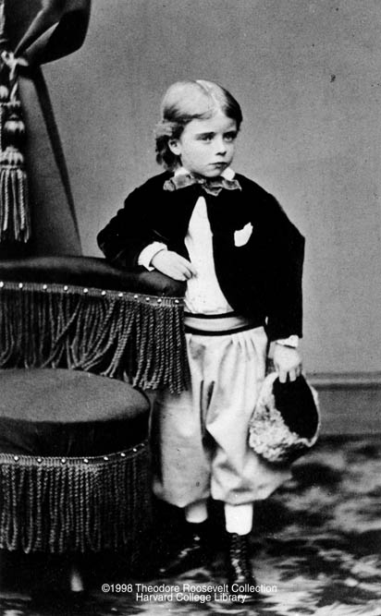
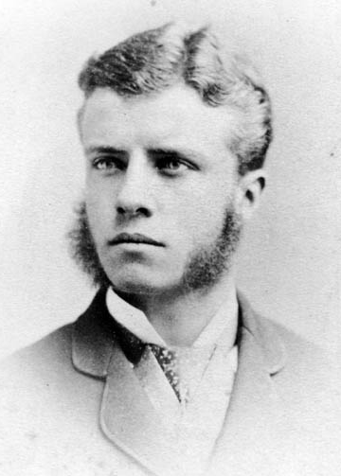
YOUNG ROOSEVELT
1858
Born in New York to a wealthy family
Had asthma and was sickly
College
Graduated from Harvard University in 1880
Graduated from Columbia Law School

Slide 3
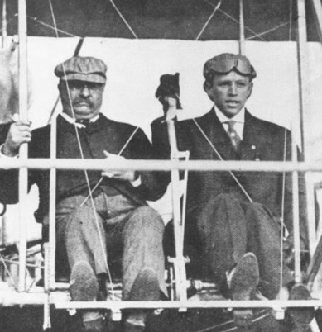
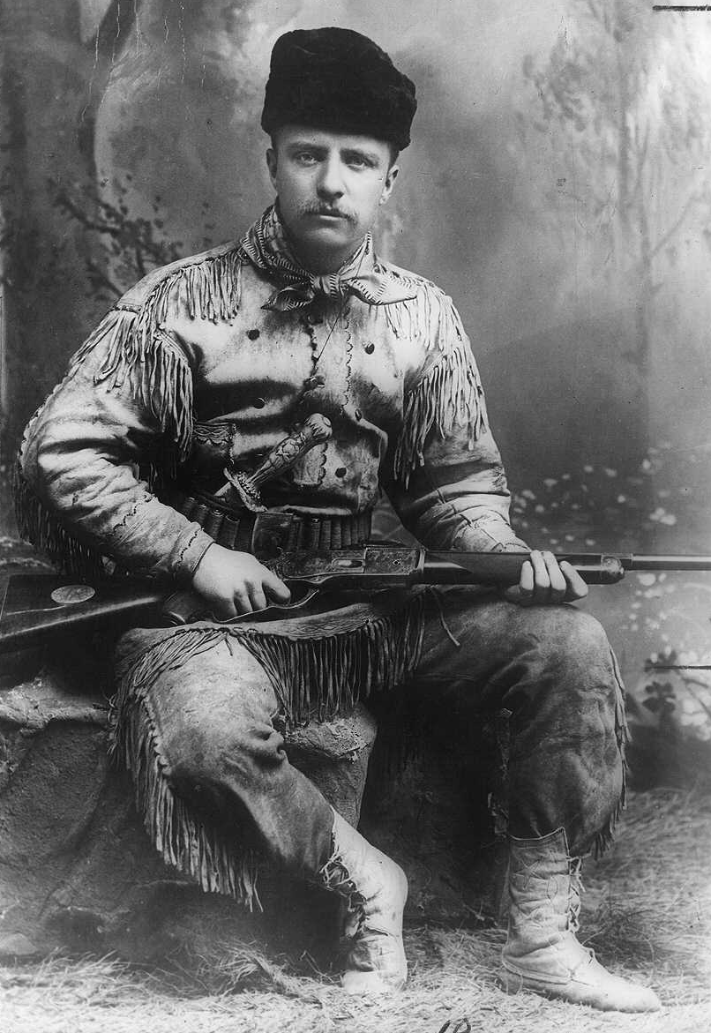
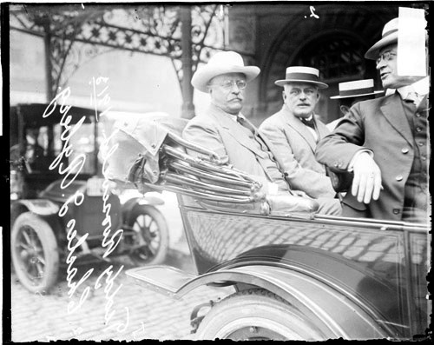
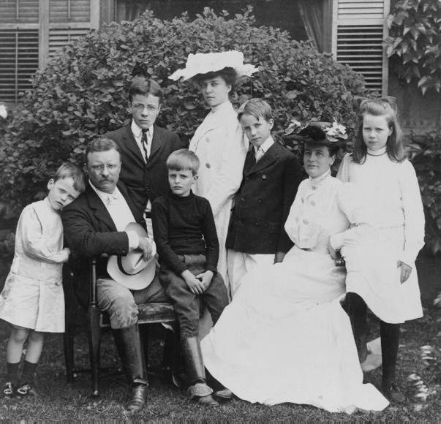
Avid outdoorsman
Hunting
Horse Riding
Most athletic President
Boxing
Rowing
First President to… ride in a car and fly on a plane
Father of 6

Slide 4
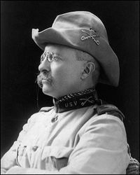
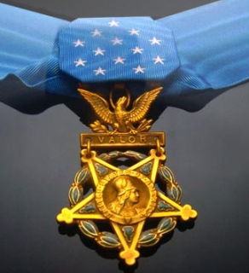
ROOSEVELT THE SOLDIER
Colonel in the U.S. Army
Rough Riders
Hero of the Spanish American War
Awarded the Medal of Honor
Battle of San Juan Hill

Slide 5
ROOSEVELT THE POLITICIAN
Governor of New York
Secretary of Navy for President Cleveland
Vice President to William McKinley
Became President in 1902 after McKinley was assassinated.
Youngest president to take office (42 yrs. old)

Slide 6
PRESIDENT ROOSEVELT
Republican
Youngest president to take office
42 yrs. old
Powerful Progressive
Main goal was to fight class distinctions
Took a “hands on” approach to Govt.
Awarded the Nobel Peace Prize for negotiating the Russo-Japanese War
Renames the Executive Mansion to the White House

Slide 7
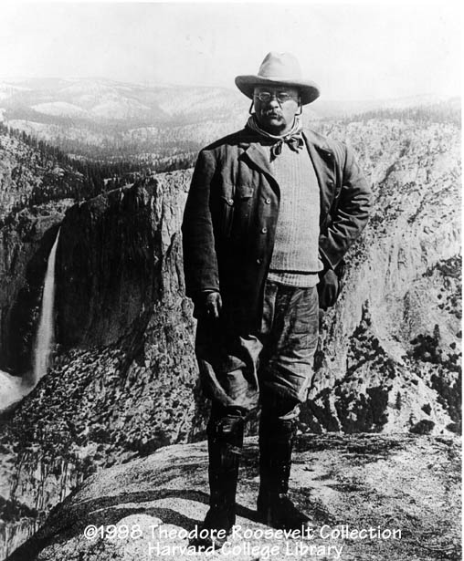
ROOSEVELT AND CONSERVATION
Recognized that the natural resources of the U.S. was limited.
Set aside nearly 150 million acres as forest reserves
He created 16 national monuments
51 wildlife refuges

Slide 8
THE “SQUARE DEAL”
Campaign slogan
He promised to “see to it that every man has a square deal, no less and no more.”
Balance the interests of business, consumers, and labor.
Treat the working man fairly
Called for limiting the power of trusts, promoting public health and safety, and improving work conditions.

Slide 9
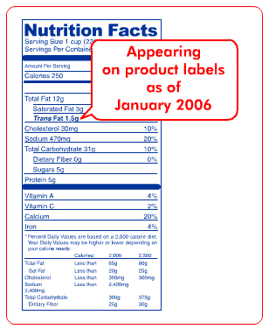
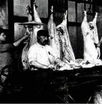
HEALTH & SAFETY
Federal Gov’t. orders tests on food and medicine
Meat Inspection Act – 1906
Meat must be inspected when crossing state lines
Pure Food and Drug Act
ingredients must be displayed

Slide 10
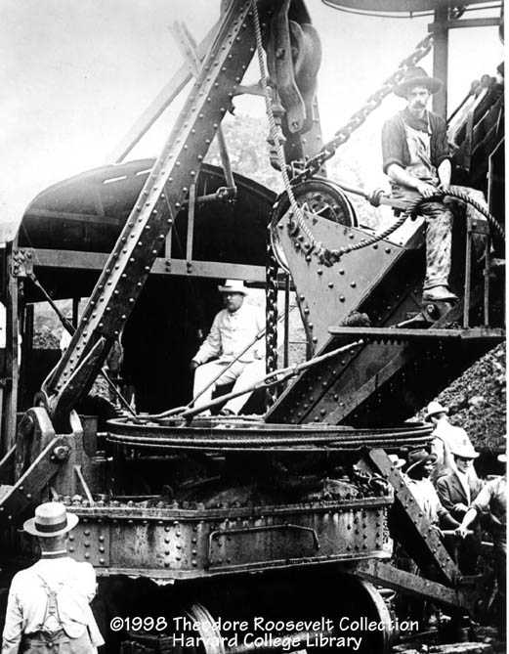
THE PANAMA CANAL
Construction (1904-1914)
The canal would be critical to the strategic strength of the U.S.
The Navy needed to be able to quickly mobilize and protect both coastlines of the U.S.

Slide 11
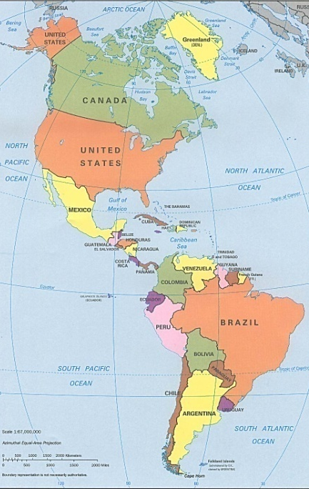
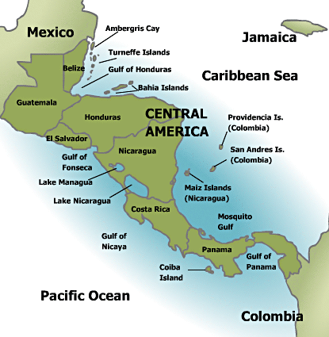

Slide 12
HAY-BUNAU-VARILLA TREATY
Revolution in Columbia
Locals want to break away from Columbia to be their own country - “Panama”
US supports independence for “Panama”
1903 U.S. Marines prevent the Columbians from putting down the Panama rebels.
Treaty is signed giving control of the dig site and canal zone to the Americans
Pay the French company $40 million
French leave the Canal and the U.S. takes over construction

Slide 13
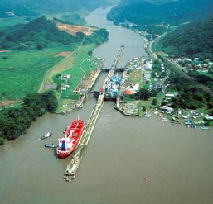
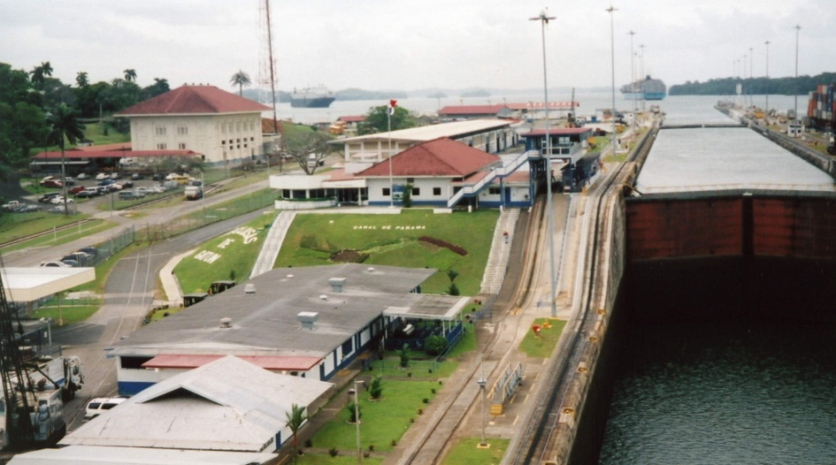
PANAMA CANAL – TODAY
N

Slide 14
MONROE DOCTRINE
1823
European Countries are to stay out of the western hemisphere
Leave North, Central, and South America alone
Current European colonies may remain, but no expansion
The U.S. will police all disputes in the area, not Europeans

Slide 15
ROOSEVELT COROLLARY
1904
America will be the “policemen” of the Caribbean and Central America
Prevent European expansion in Central America and the Caribbean
U.S. military will maintain order in the area
Has the right to get involved in any matter to stop conflicts in the region

